Slide 1
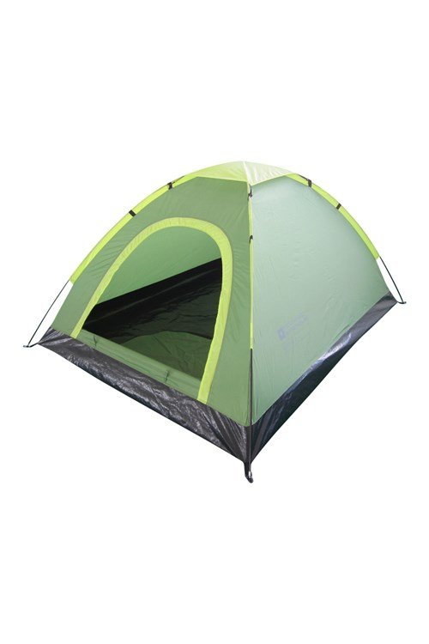
Camping
Parent Information
Monday 19th June 2023

Slide 2
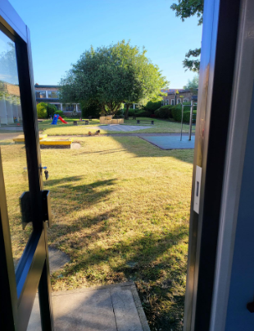
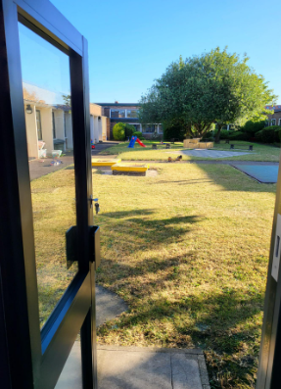
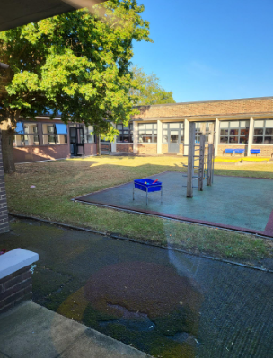
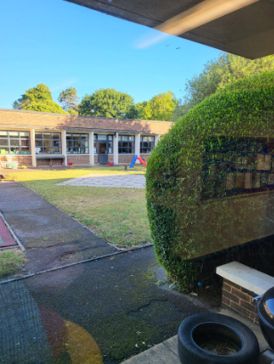
At 2:00, on Friday, the children will be taken out of class to set up their sleeping spaces (including putting up tents)
The children, in tents, will be sleeping in the Quad – above are pictures of the area.
As you can see, it is an enclosed area surrounded by the Year 2 classes, the staffroom and the halls.

Slide 3
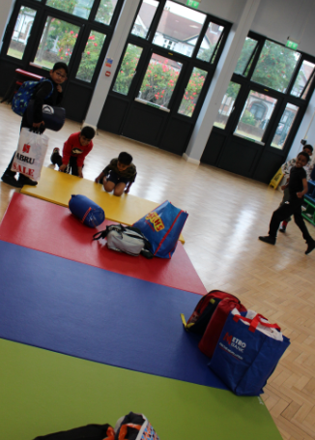
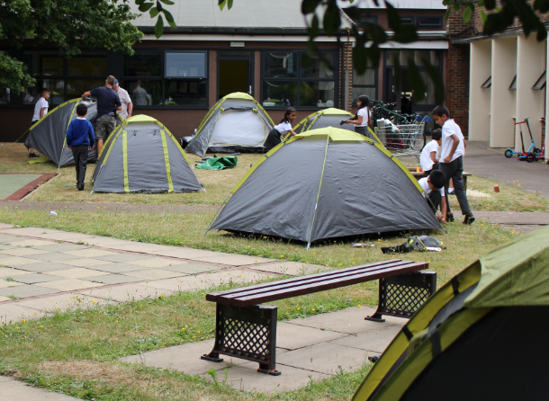

Slide 4
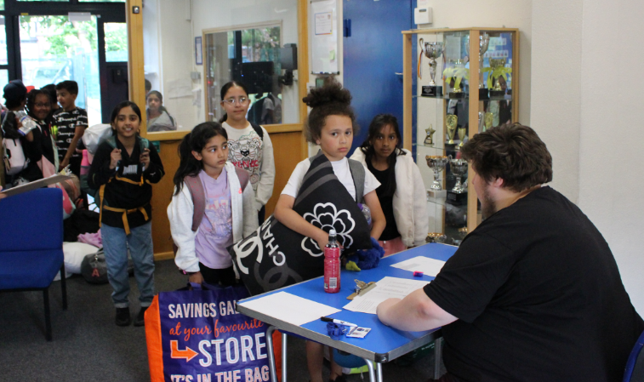
The children will go home, as normal, at 3:30pm on Friday.
At home, they will have dinner, have a wash and change into their clothes for the evening. It is vital that they have dinner as we will only be having snacks during the rest of the evening.
It is best to be in clothes they do not mind getting messy and the footwear should be trainers as they will be doing some sporty activities.

Slide 5
At 6:30, they will return to school to be registered. Please be prompt as we want to start activities at 6:45 – this is what they should have with them:
Essential items to pack for the camping experience:
Sleeping bag
Pillow
A change of clothes for Saturday
Warm clothes to sleep in (please remember, even in the summer, camping can be cold at night, so layers are essential)
Trainers (they can be wearing these when they come).
Named water bottle
Toiletries including toothpaste, toothbrush and roll on deodorant.
Snack for themselves on the Friday night (non-fizzy drink, crisps, etc.)
These can be carried in a good-sized rucksack or other similar types of bag.
Q from the children:
Can we bring something to help us sleep e.g. a bear?
Yes
Q from the children:
Can we bring nuts?
No, we are a nut-free
School.

Slide 6
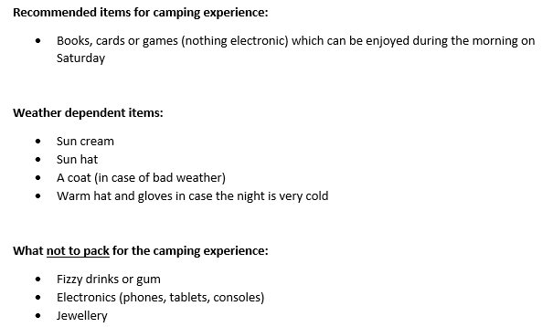
Q from the children:
Why can’t we bring electronics?
To aid independence.
Appreciate the outdoors and see there are other ways to have fun.

Slide 7
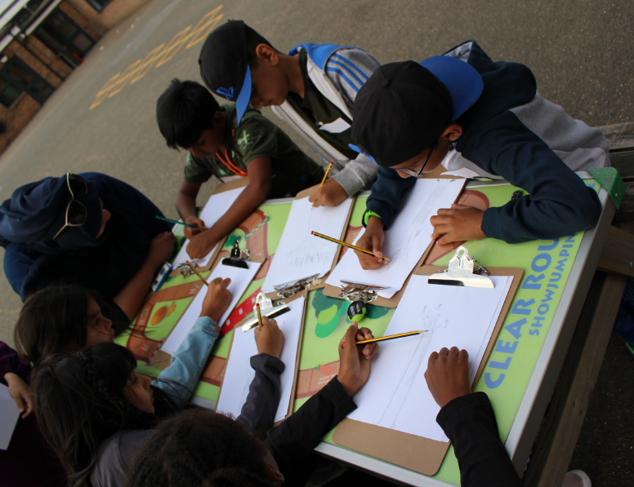
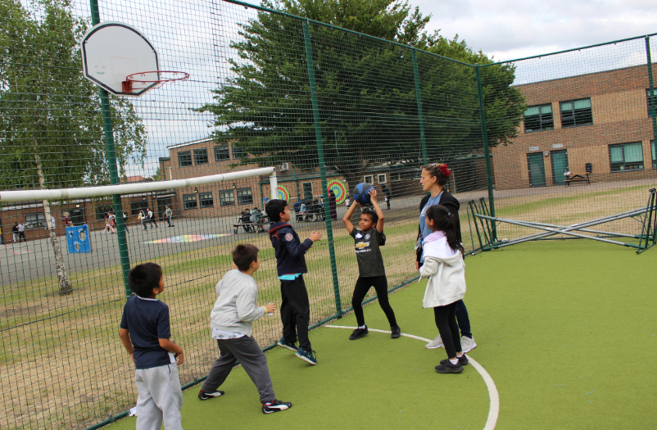
Activities will begin at 6:45.
Initially, they will be split into 3 groups – they will be mixed up to encourage collaboration between the different classes and to foster new friendships.

Slide 8
At 8:30, children will be taken to the Quad so, from that time, all children will be in an enclosed space.
Here, we will be undertaking some team games.
A reminder that, as it said on the letter, we will encourage all children to take part but – if they do get really homesick – they will not be forced and you will be contacted to collect them.

Slide 9
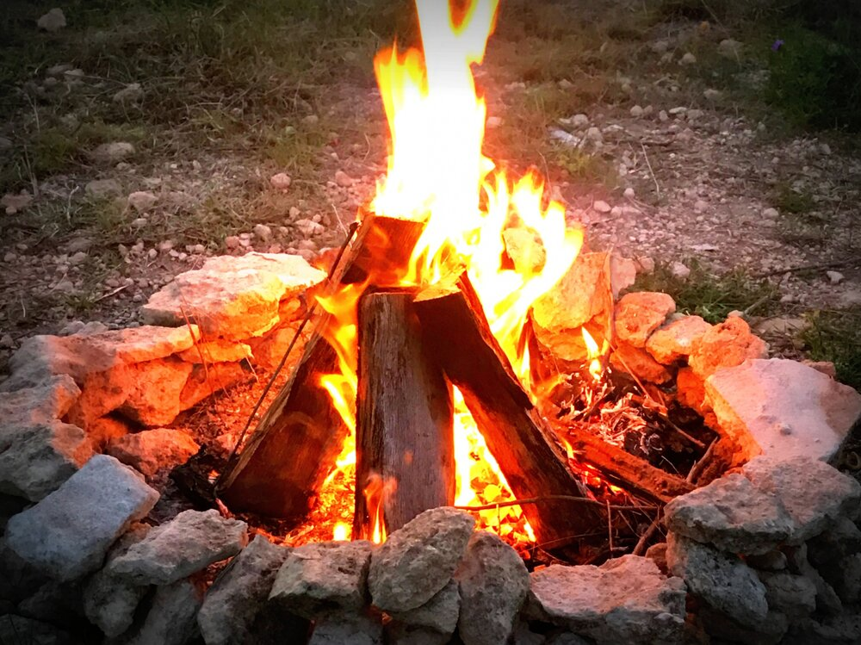
At 9:00, we will have the campfire.
The fire will be looked after by Mr. Boddy who will follow health and safety procedures to ensure that all children are safe.
We will have a fun time around the campfire having hot chocolate, roasting marshmallows and singing campfire songs.
Q from the children:
Will the marshmallows be Halal?
Yes

Slide 10
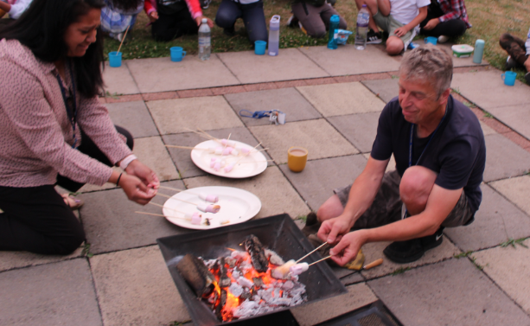
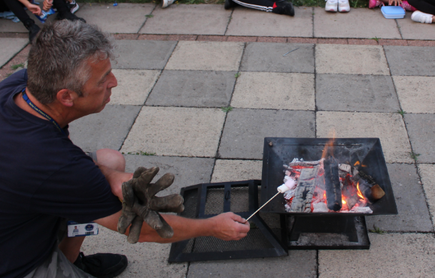
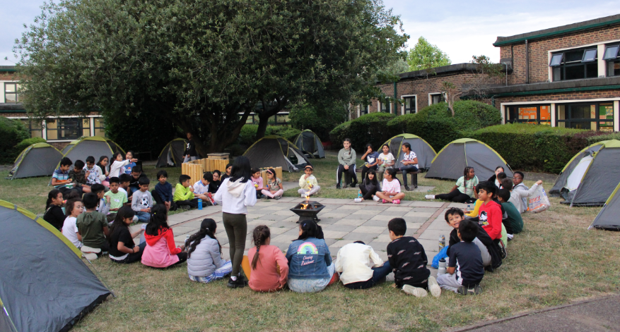

Slide 11
After a good time around the fire, we will send the children to where they are sleeping.
The children have already been told about whether they are sleeping inside or outside. Some children will be inside as we wanted to open the experience to as many people as possible.
There are 8 adults staying the night and they will be checking on the children during the evening to ensure safety – and to ensure the children do get some sleep! As it said on the letter, local community police have been notified about the event as well.
Q from the children – who is staying?
Mr. Curtis, Miss. Dhinsa, Mr. Henry,
Mr. Boddy, Mr. H, Mrs. Speller, Ms. Gash
Mrs. Pierson

Slide 12
When children wake up on the Saturday, they will have their books to read, games to play or may just choose to chat.
The school will be providing breakfast food which we will have informally between 7am and 8am.
Children will be collected at 8:30am. It is vital that you are prompt to collect children as Stagecoach, a drama club, will begin arriving soon after that time.

