Slide 1
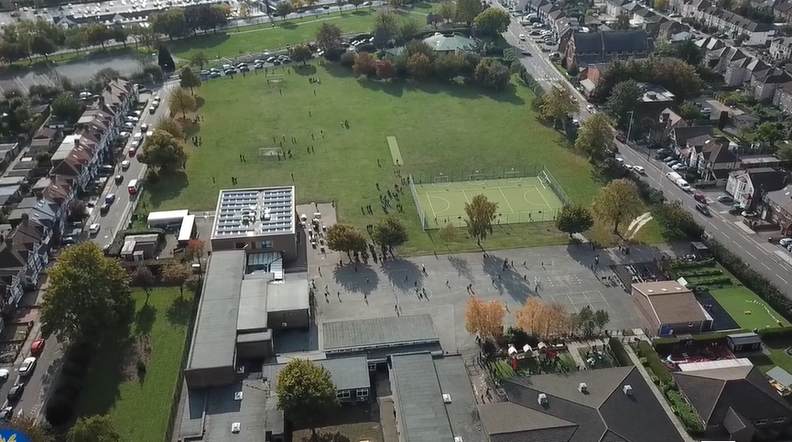
Parent Curriculum Meeting Year 6 16th April 2024

Slide 2
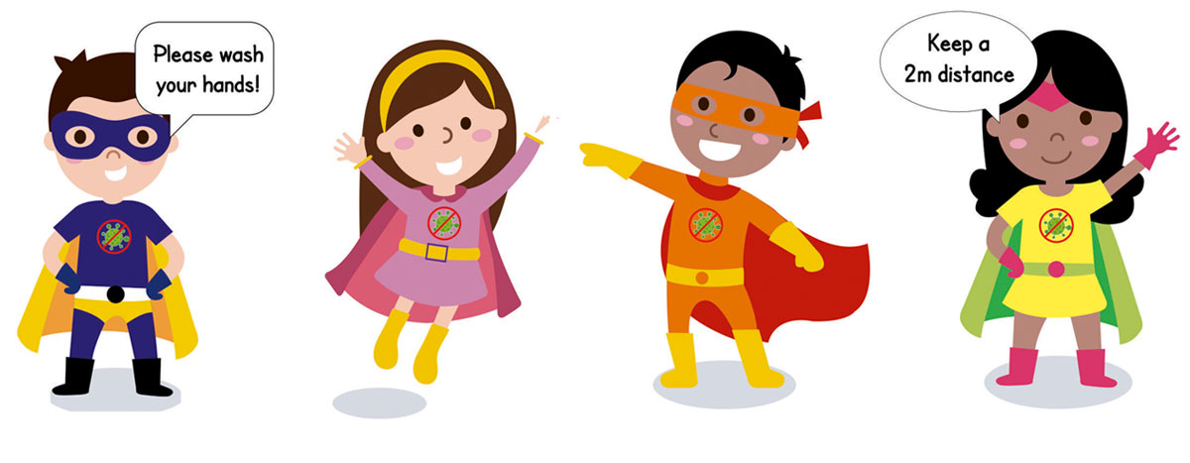
School Vision and Motto
At Barley Lane Primary School it is important that we all work together to ensure that everyone feels happy, safe and ready to learn.
Our School Motto
Believe in yourself, Learn together, Persevere and Succeed

Slide 3
Meeting Outline
1. Welcome
2. Summer Curriculum Topics and Big Question
3. English
4. Maths
5. Science
6. Foundation Subjects
7. RHE
8. SATs
9:Transition
10. Questions

Slide 4
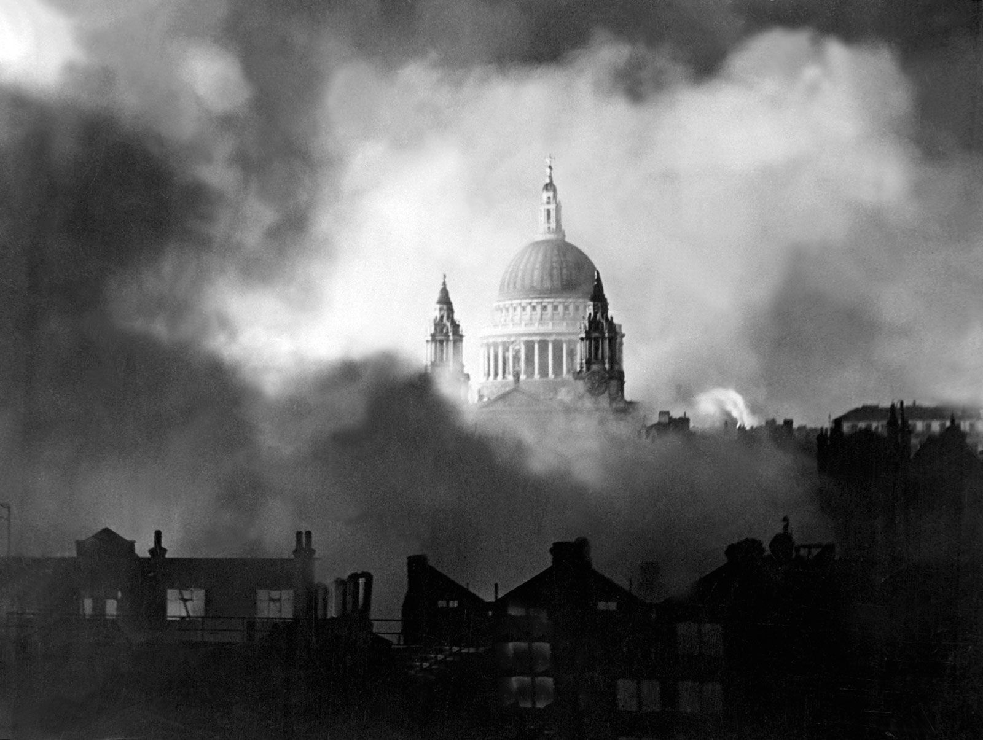
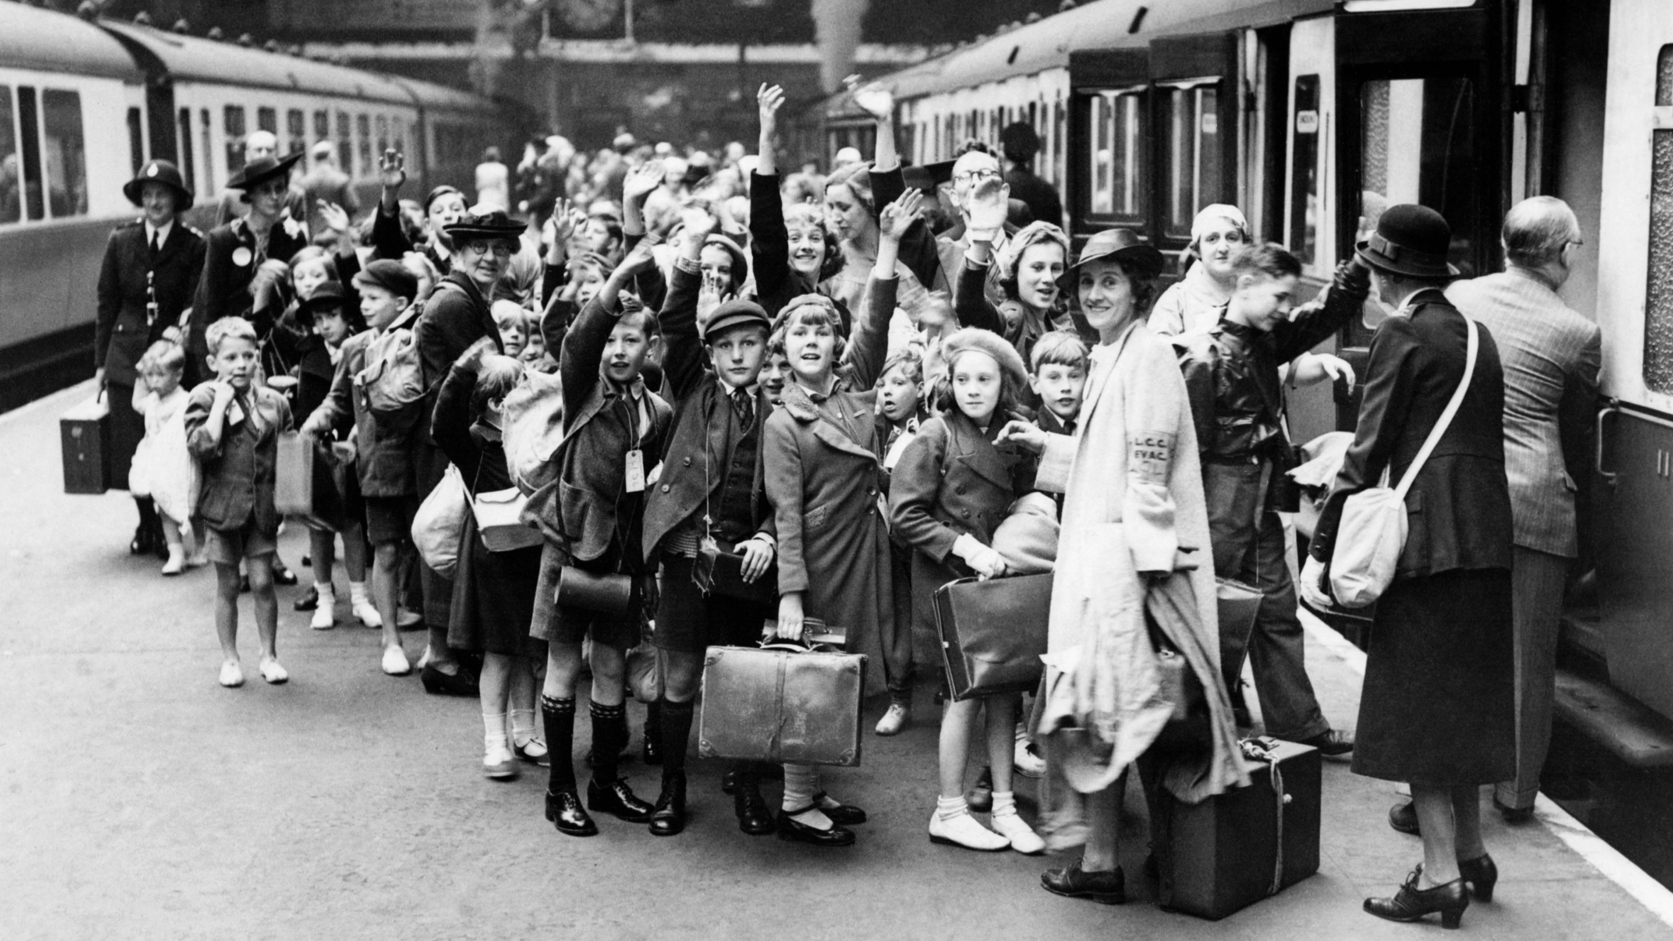
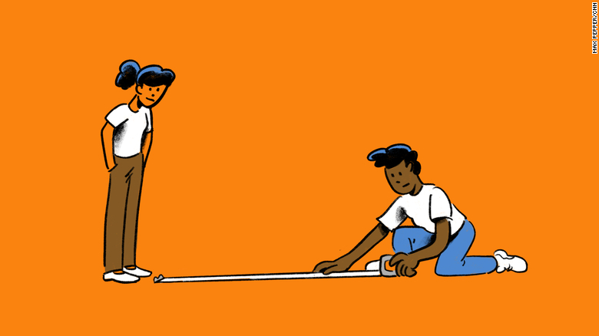
Summer Curriculum Topics
Summer Topic:
World War Two
Big Question: 'Should ideologies dictate our lives?'
Notes:
Office.Admin: sending out letters, building and analysing surveys, answering queries, advising ov everchanging guidance and answering emails and phone calls
Premises staff: working tirelessly mornings, afternoons, evenings to create safe bubbles, signage, cleaning
LTAs working via zoom with their children, taking resources home to prepare, joining in on zooms
Catering staff: on furlough, Bal agreeing to come in
Fellow SLT: managing remote learning, staff welfare, keeping up with guidance

Slide 5
Vocabulary for the term:

Slide 6
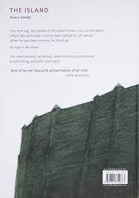
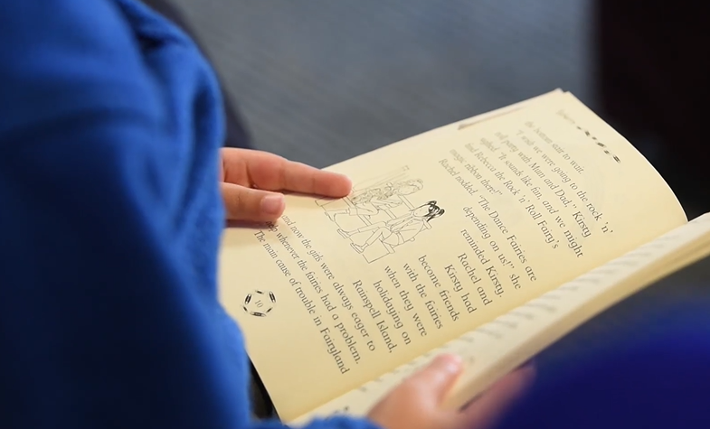
English
For the first couple of weeks, we will be continuing to explore Kensuke’s Kingdom – it transitions nicely to our war topic due to links with the atomic bomb being used in Hiroshima and Nagasaki.
Our key teaching text will be the classic: 'Goodnight Mr., Tom' by Michelle Magorian.
From this the children will be working on extended writing pieces that encompass setting descriptions (and comparisons); first person writing in the form of diaries and letters and non-fiction writing connected to key events of the war.
The children will also examine some famous speeches from various stages of the war which will lead into them writing their own on a given topic.
Linked to our continuous work on diversity and inclusivity we will also be using the text 'The Island' by Armin Greder to further support development of reading skills.
War poetry is extensive, and we will be delving into well-known and lesser-known pieces– the poets of the Great War, such as Wilfred Owen and Siegfried Sassoon, but also poets of modern times such as Carol Ann Duffy.

Slide 7
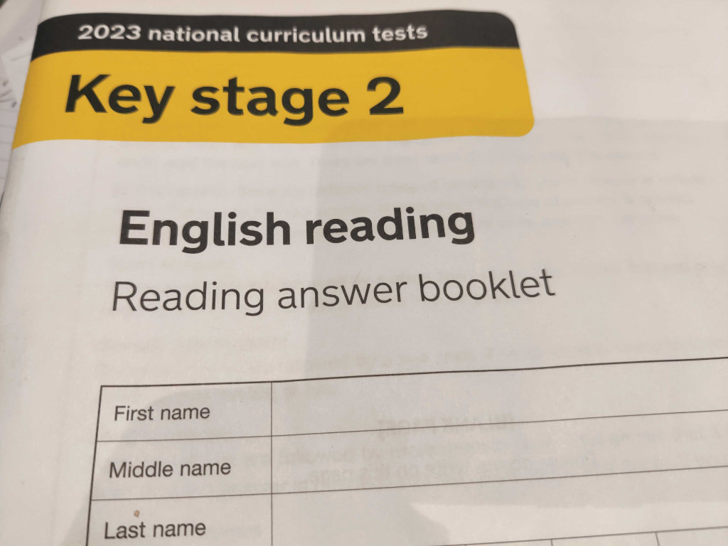
English SATS Prep
In the first few weeks after Easter, we will be allowing lots of opportunities for revision, alongside their curriculum content.
13th May – Grammar Test. Children should keep using their CGP books. In lessons, we will be looking at gaps that the children still need to work on. Weaker areas include determiners, apostrophes, different types of tense and word class. They will also be completing the spelling test on this day and should continue to look at the rules e.g. double consonants and certain word endings.
14th May – Reading Test. In lessons, we will continue to look at specific question types including sequencing events, true and false and answering 3-mark questions. A poem has not been covered since 2018 so there is a likelihood one may come up.
Boosters and Lexia will be continuing as they have been for the past term.

Slide 8
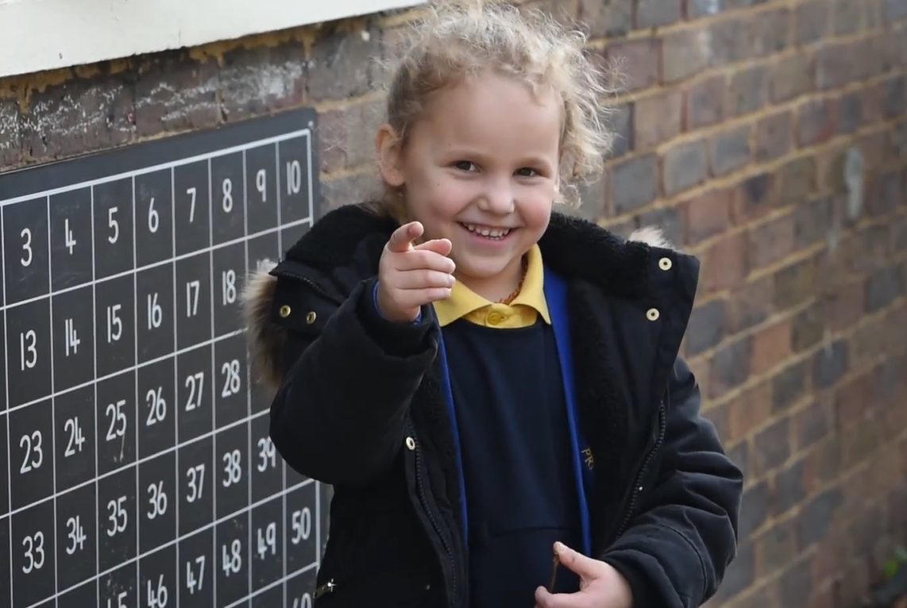
Maths
This term, having covered the Year 6 maths curriculum in preparation for SATs, the children will be consolidating their mathematical knowledge through practical tasks
They will undertake longer investigations linked to real world application with one of them being an apprentice-style business task.
There will be lots of opportunities to link maths with a wider topics such as converting wartime currency; looking at ratio with wartime recipes and looking at how numbers were used in the enigma code.
We will also be providing some creative art-based maths through the exploration of parabolic curves.
Despite maths content being covered, we recognise the importance of keeping their number skills fluent in preparation for real world application and for their transition to year 7 content.
Children need to know , and use, correct vocabulary and they need to be able to spell this vocabulary. Some of the more able children may be exposed to GCSE level work.
Practise in arithmetic will remain a key focus because this centres around using formal written methods confidently which is important for the transition to Year 7.

Slide 9
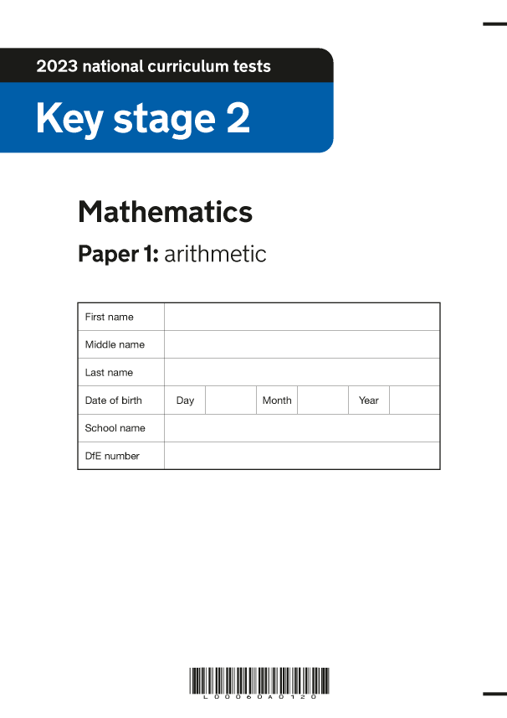
Maths SATs Prep
In the first few weeks after Easter, we will be consolidating previously taught knowledge and gaps that we have identified through mocks and other assessments. Key weaknesses are ratio, multi-step problems, geometry and division.
15th May (before break) – Arithmetic
15th May (after break) – Reasoning 1. Lots of different question sources will be used to aid the children feel more confident with applying their maths. Children should continue to use their CGP books to aid their revision.
16th May (before break) – Reasoning 2.

Slide 10
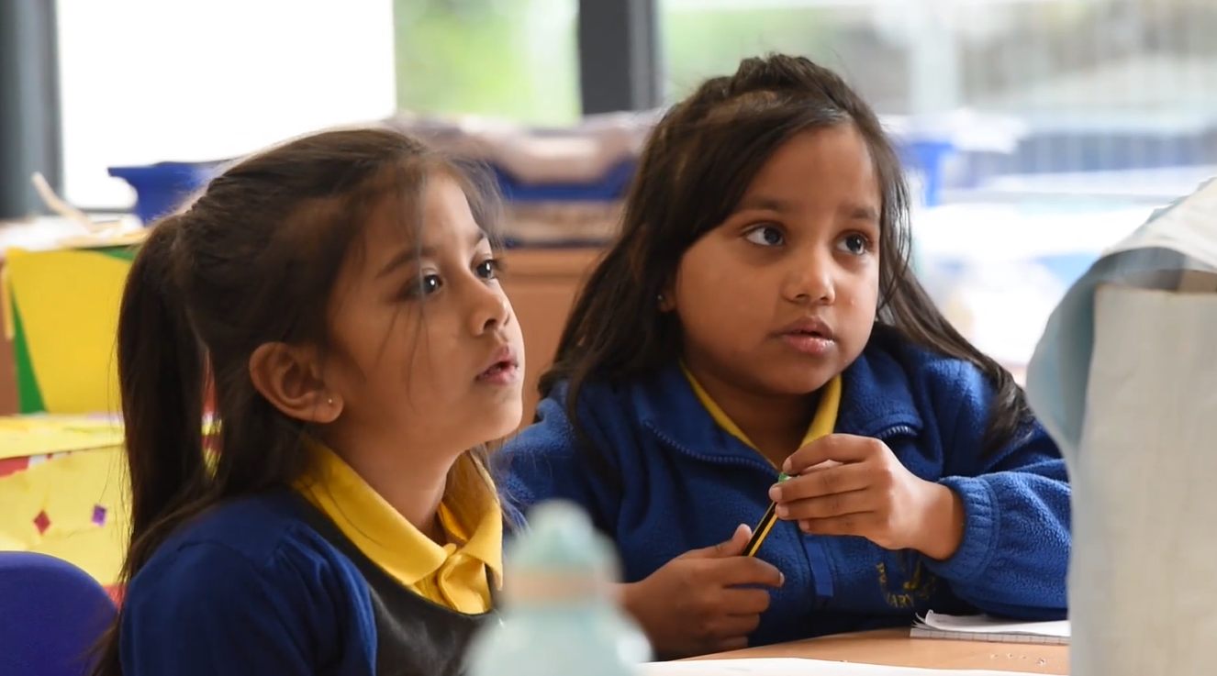
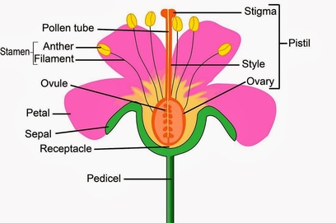
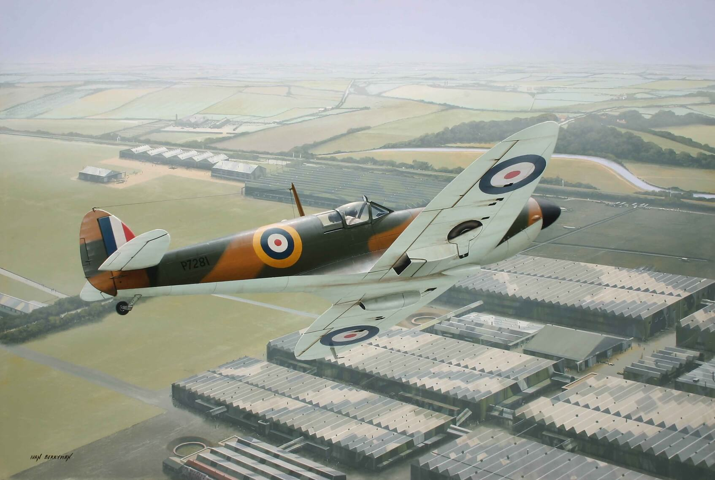
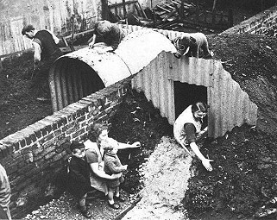
Science
As with the rest of the year, children will continue to revise previously taught topics such as plants (seed dispersal, parts and reproduction), forces and space.
As with maths, there will be opportunities to link their science knowledge to practical enquiries including the making of different forms of WW2 shelter and looking at what forces helped the spitfire to be a formidable war vehicle.
Children will be assessed on their science knowledge to ensure that they are ready for the next stage of their science studies in Year 7.

Slide 11
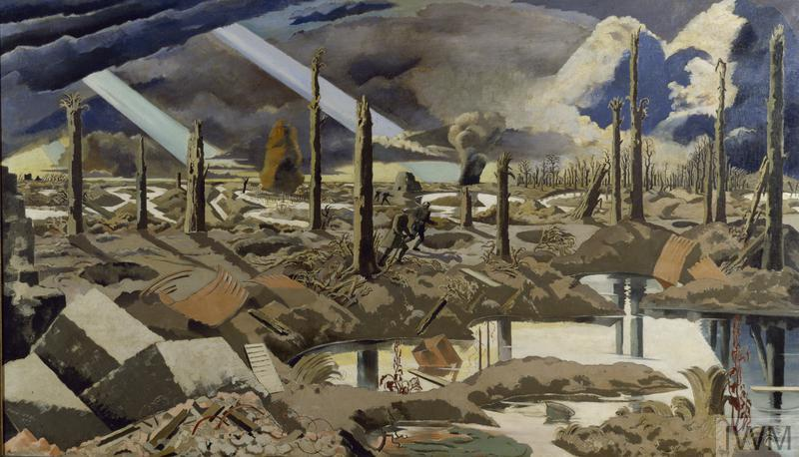
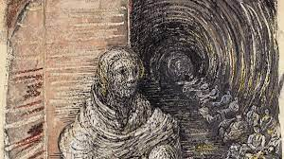
Foundation Subjects
History and Geography
Introducing why war happens in general through exploration of modern and ancient warfare.
Exploring the causes of WW2 and categorizing them under headings.
Understanding the Allies and the Axis, their motivations and ambitions
Looking at Operation Pied Piper and how evacuation happened; discussing the emotional ramifications of this policy.
D Day landings and the strategic planning that went into them
The Blitz! Looking at primary sources detailing the catastrophic events.
The Home Front. Looking at the role of different sectors of society and exploring how propaganda was used to enforce certain messages.
Forgotten war heroes
The Windrush Generation
Art and Design and Technology
Life and artwork of Paul Nash – exploring how he depicted war landscapes using surrealist techniques
Photography – Shahidul Alam
The Blitz Pictures of Henry Moore
The Windrush Collection
R.E -
Interfaith work within the community.
Compare different faiths' views on respect and responsibility

Slide 12
RHE
Peer pressure – why it happens and how to navigate situations where they are put under peer pressure. Exploring different scenarios related to possible experiences in secondary school.
Being aware of stereotypes and that these can be negative, unfair or destructive – linking this to WW2 and the plight of Jewish people (and others) during the awful holocaust.
Relationships – exploring different types of relationships, including how marriage is used to represent commitment and promises.

Slide 13
SATs Week Beginning 13th May
Day/Time | Test
Monday 13th May (before break) | Grammar (50)
 | Spelling (20)
Tuesday 14th May (before break) | Reading (50)
Wednesday 15th May (before break) | Arithmetic (40)
‘ ‘ (after break) | Reasoning 1 (35)
Thursday 16th May (before break) | Reasoning 2 (35)
Friday 17th May | Science Assessment
 | SATs celebration

Slide 14
Transition To Secondary School
During the Summer Term, Y6 teachers will be communicating with the schools that children will be attending in Y7 either face to face or through written communication.
As with previous years, children will have the opportunity this year to visit their new schools on designated transition days. All schools have slightly different formats so look out for communication from the secondary school.
Some children who would benefit from additional support will be part of a transition programme and this will be shared with adults.
There will be opportunities to celebrate their time at Barley Lane through a production and an end of year trip.

Slide 15
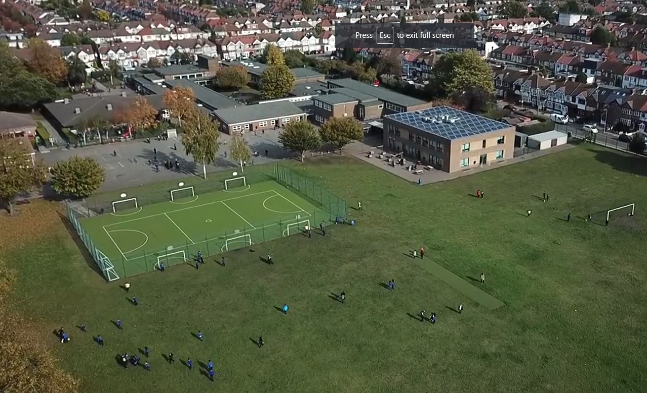
Any questions?
Notes:
Office.Admin: sending out letters, building and analysing surveys, answering queries, advising ov everchanging guidance and answering emails and phone calls
Premises staff: working tirelessly mornings, afternoons, evenings to create safe bubbles, signage, cleaning
LTAs working via zoom with their children, taking resources home to prepare, joining in on zooms
Catering staff: on furlough, Bal agreeing to come in
Fellow SLT: managing remote learning, staff welfare, keeping up with guidance

