Slide 1
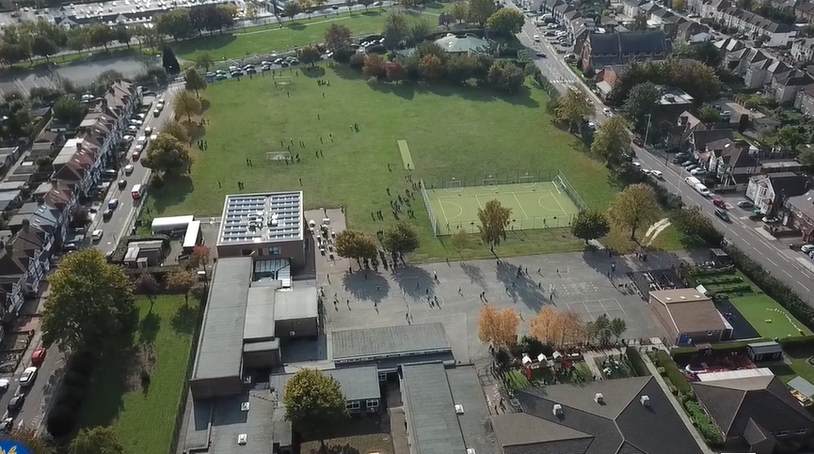
Parent Curriculum Information Year 5 Summer 2024

Slide 2
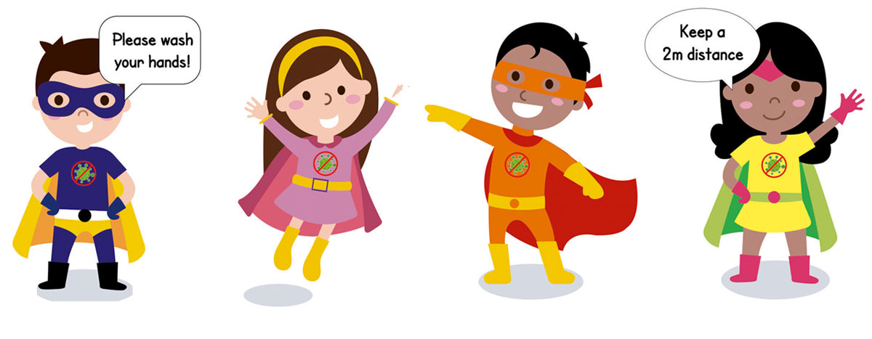
School Vision and Motto
At Barley Lane Primary School it is important that we all work together to ensure that everyone feels happy, safe and ready to learn.
Our School Motto
Believe in yourself, Learn together, Persevere and Succeed

Slide 3
Meeting Outline
1. Welcome
2. Summer Curriculum Topics and Big Question
3. English
4. Maths
5. Science
6. Foundation Subjects
7. Communication
8. Questions

Slide 4
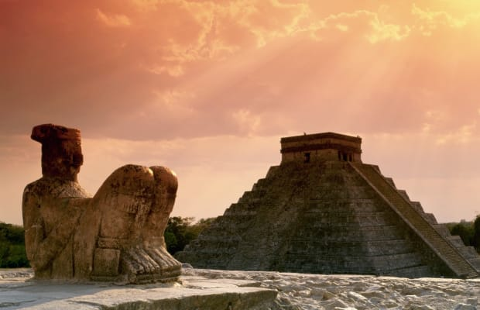
Summer Curriculum Topics
Summer Topic: Mysterious Maya
Big Question: Can something lost, always be rediscovered?
Notes:
Office.Admin: sending out letters, building and analysing surveys, answering queries, advising ov everchanging guidance and answering emails and phone calls
Premises staff: working tirelessly mornings, afternoons, evenings to create safe bubbles, signage, cleaning
LTAs working via zoom with their children, taking resources home to prepare, joining in on zooms
Catering staff: on furlough, Bal agreeing to come in
Fellow SLT: managing remote learning, staff welfare, keeping up with guidance

Slide 5
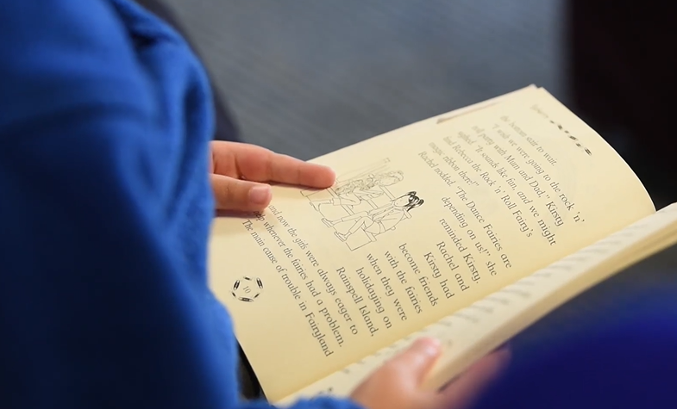
English
In reading, we will be continuing to read The Boy at the Back of the Class. Later in the term, we will be reading Mayan myths and legends.
Our key text for reading is ‘Journey to the River Sea’ by Eva Ibbotson.
We will also be learning about Mayan myths too.
Both reading texts link well with our Mysterious Maya topic, consolidating the children’s learning in a cross-curricular manner. All texts will allow children to deepen their critical thinking, enhance their inference skills and strengthen their knowledge within their extended pieces of writing.
Using these texts children complete extended pieces of writing including
story writing, descriptive writing, diary entries and poetry.

Slide 6
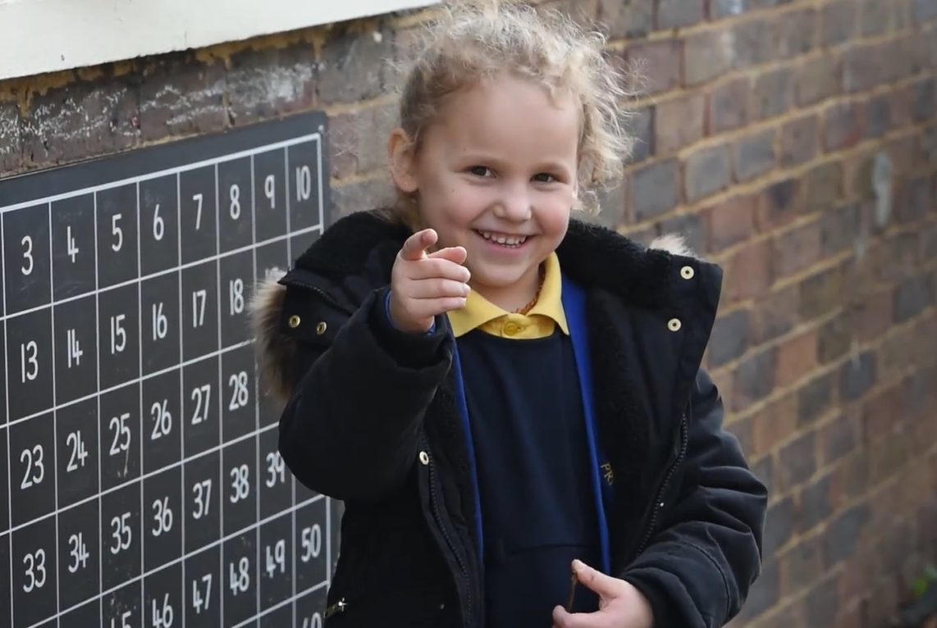
Maths
Summer 1 – Number: Decimals
Solve problems involving number up to three decimal places
Multiply and divide whole numbers and those involving decimals by 10, 100 and 1000
Use all four operations to solve problems involving measure [ for example, length, mass, volume, money] using decimal notation
Summer 2 – Geometry: Properties of Shapes and Angles
Identify 3D shapes, including cubes and other cuboids, from 2D representations
Distinguish between regular and irregular polygons based on reasoning about equal sides and angles.
Know and draw angles measured in degrees: estimate and compare acute, obtuse and reflex angles.
Measurement: Convert between different units of metric measure [for example, km and m; cm and m; cm and mm; g and kg; l and ml]

Slide 7
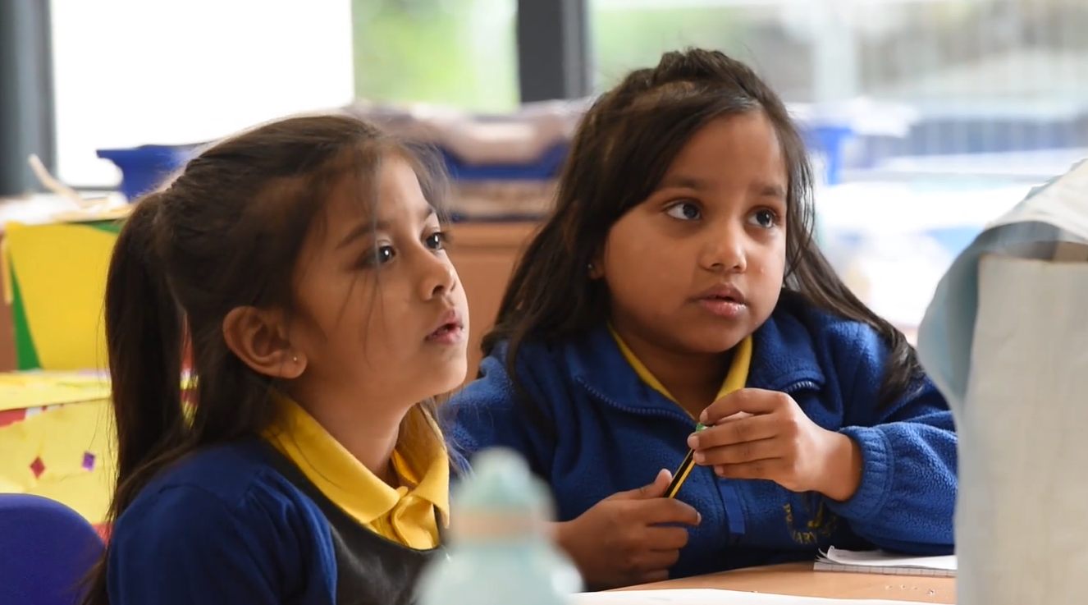
Science
Summer 1 – Living Things and Their Habitats
Describe the differences in the life cycles of a mammal, an amphibian, an insect and a bird
Describe the life process of reproduction in some plants and animals
Record data and results of increasing complexity using scientific diagrams, labels and classification keys
Summer 2 – Animals Including Humans
Describe the changes as humans develop to old age
Plan different types of scientific enquiries to answer questions, including recognising and controlling variables where necessary
Take measurements, using a range of scientific equipment, with increasing accuracy and precision, taking repeat readings when appropriate

Slide 8
Foundation Subjects
History & Geography – The Maya civilisation, identifying where they came from using maps. Making comparisons between everyday Mayan life and life today.
RE – Why is prayer important for religious believers? Why are sources of wisdom important to religious people?
ART & DT - Beatriz Milhazes, contemporary Brazilian art.
We will also be designing and then creating Mayan inspired masks in DT.
PSHE – Relationships topic: characteristics of family life, skills to maintain positive relationships including what makes a good friend and how to be one. Coping with changes and transition. Two sessions on puberty as part of the RHE curriculum.
Computing – Cryptographers and Adventure Gamers.
Music – Celebrations and performance.
PE – Swimming and athletics.

Slide 9
Communication with Parents
Homework and spellings are set every Friday on Purple Mash, please support your children in completing their home learning. Homework is due on Wednesday and children should bring their homework books to school. Children also have the option of taking a reading book home each week, which they should bring back to school on a Thursday. In addition to supporting your child with their homework, please encourage them to read for at least fifteen minutes each day.
Swimming days are 5B and 5M every Thursday. 5T and 5HS every Friday. Please ensure children have the correct swimming kit.
We hope that this information has given you an insight into our learning for this term. If you have any other questions about the curriculum, please arrange a meeting with your child’s class teacher, this can be done via the school office.
You can also find our Summer Topic Web on the school website, this will provide you with an overview of topics taught.

Slide 10
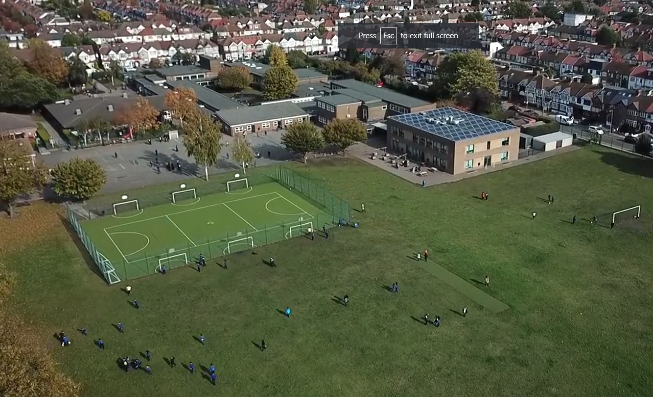
Any questions?
Please do not hesitate to contact us if you have any further questions.
We have parent meetings on Thursday , please bring any questions along with you.
We hope you found the information shared useful.
Thank you for your support
Notes:
Office.Admin: sending out letters, building and analysing surveys, answering queries, advising ov everchanging guidance and answering emails and phone calls
Premises staff: working tirelessly mornings, afternoons, evenings to create safe bubbles, signage, cleaning
LTAs working via zoom with their children, taking resources home to prepare, joining in on zooms
Catering staff: on furlough, Bal agreeing to come in
Fellow SLT: managing remote learning, staff welfare, keeping up with guidance

