Slide 1
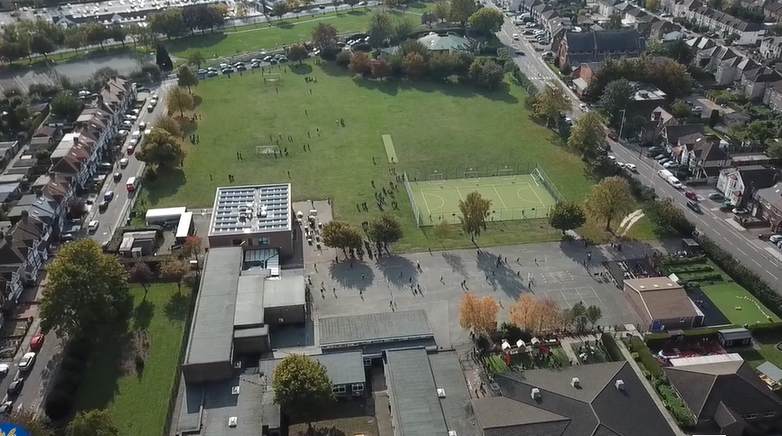
Parent Curriculum Meeting Year 3 Summer Term – Wednesday 17th April

Slide 2
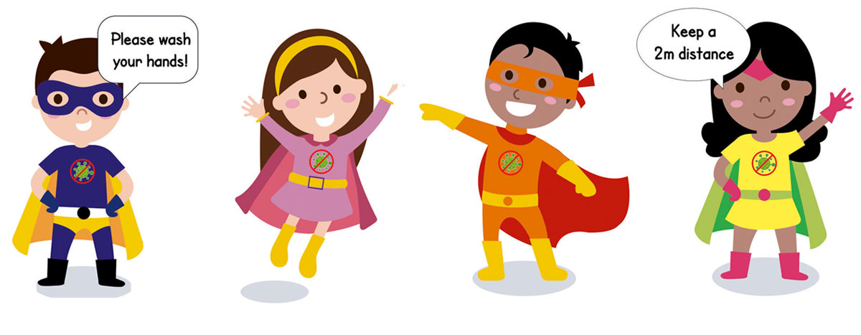
School Vision and Motto
At Barley Lane Primary School it is important that we all work together to ensure that everyone feels happy, safe and ready to learn.
Our School Motto
Believe in yourself, Learn together, Persevere and Succeed

Slide 3
Meeting Outline
1. Welcome
2 School vision and ethos
3. Meeting outline
4. Summer term topic and BIG question
5. English and reading
6. Maths
7. Science
8. Geography and history
9. Art and design technology
10.R.E.
11. Computing, Pshe, P.e. and music
12.RHE
13.Information
14.Communication

Slide 4
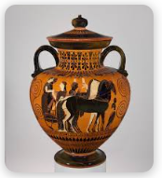
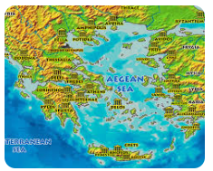
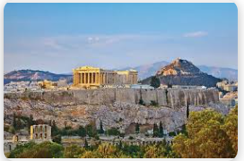
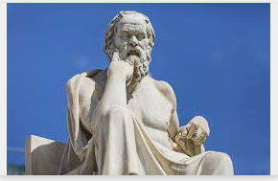
Summer Curriculum Topics
Summer Topic: Ancient Greece
Our big question :
Who Am I?
Notes:
Office.Admin: sending out letters, building and analysing surveys, answering queries, advising ov everchanging guidance and answering emails and phone calls
Premises staff: working tirelessly mornings, afternoons, evenings to create safe bubbles, signage, cleaning
LTAs working via zoom with their children, taking resources home to prepare, joining in on zooms
Catering staff: on furlough, Bal agreeing to come in
Fellow SLT: managing remote learning, staff welfare, keeping up with guidance

Slide 5
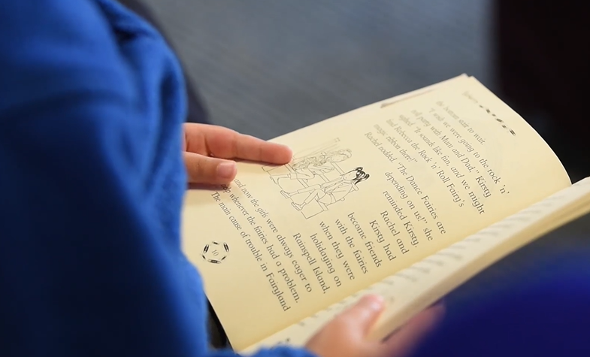
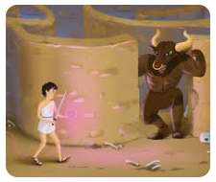
English and Reading
Reading and writing
Investigate what is known about the historical setting and events and their importance to the story.
Deduce from the evidence in the text what characters are like.
Explain and discuss understanding of books.
We will be reading Greek myths , in particular 'Theseus and the Minotaur', which will lead to our writing.
Children will:
Develop their writing skills through writing for a range of purposes e. g: re-telling a myth, writing a speech.
Ensuring descriptions have enough detail.
Have opportunities to plan, draft, edit/improve and redraft their writing
Extending vocabulary knowledge
We will be composing our poems based on Greek myths.
We will also be reading the story 'The Corinthian Girl' and making comparisons to 'The Egyptian Cinderella'.
Speaking and listening
Speaking and listening skills are equally as important as reading and writing. We regularly plan lessons which involve discussion. Children are encouraged to communicate ideas in an organized and logical way and speak with good diction.

Slide 6
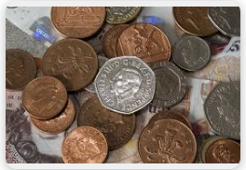
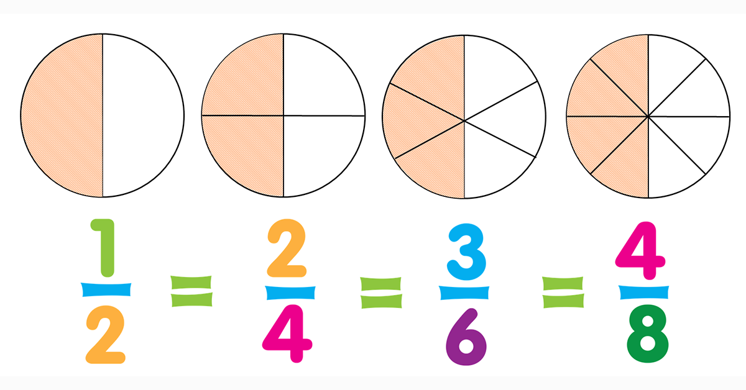
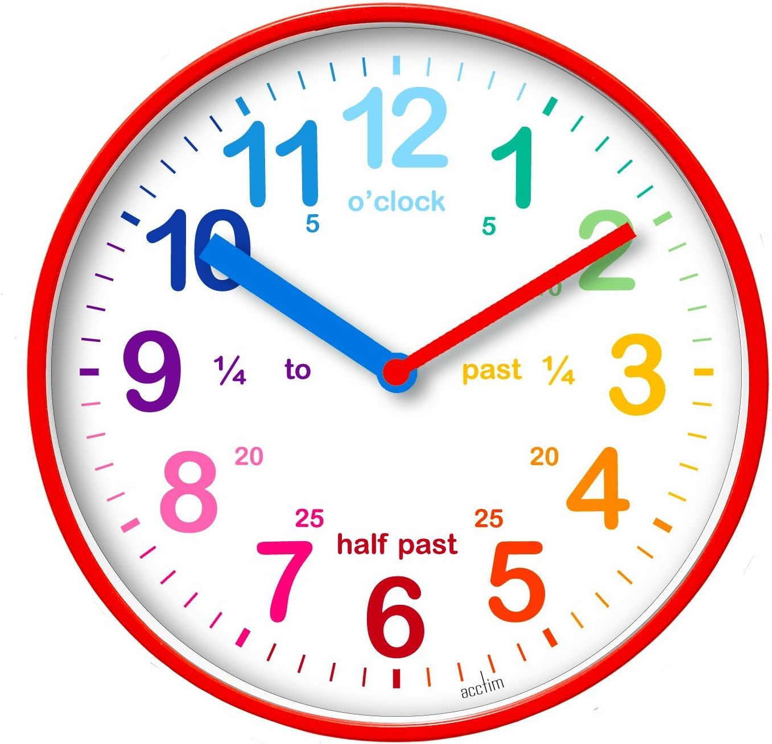
Maths
In the summer term we continue to learn about fractions. We will start to compare and order fractions and understand the concept of unit fractions (1/4, 1/2 , 1/15 etc) and equivalent fractions.
We continue to look at measurement which includes revising telling the time to the minute, finding and comparing durations and problem solving with time. We’ll also measure, compare, add and subtract mass and capacity.
We will be using money to add and subtract amounts and give the correct change.
In geometry we’ll recognise angles as a property of shape or a description of a turn;
identify right angles, recognise that two right angles make a half-turn, three make three quarters of a turn and four a complete turn; identify whether angles are greater than or less than a right angle.
All lessons include a range of varied fluency, reasoning and problem solving questions including solving unfamiliar word problems, identifying patterns between numbers and explaining their thinking.
By the end of Year 3 children should know the 2,3,4,5,8 and 10 multiplication tables.

Slide 7
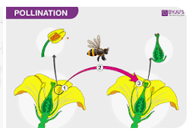
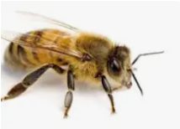
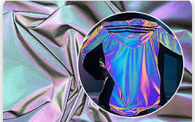
Science
Our science topic this half term is plants-
observe a range of different flowers closely using magnifiers
understand that flowers vary in size, colour, shape and form but all play a crucial role in reproduction
pollination and the role of bees
how new seeds are made
seed dispersal
Next half-term our topic is light -
how light travels
sources of light
dangers of looking directly at the sun
investigation with reflective materials

Slide 8
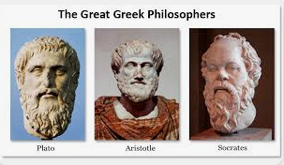
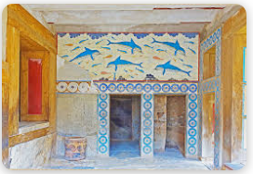
Foundation Subjects
Geography and History
Location of Greece and ancient cities
Chronology of the era
Arthur Evans and the discovery of Knossos
Who were the Ancient Greeks?
Comparison of Athens and Sparta
The Battle of Marathon
Origins of the Olympic games
Greek philosophers – Aristotle, Socrates and Plato

Slide 9
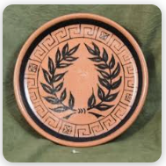
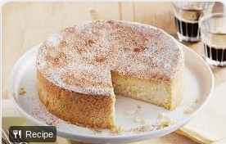
Art, Design and Food Technology
ART
In art, we will be exploring Greek designs on plates and vases and the story behind them. Children will sketch their own designs and paint them .
Featured artists Rashid Karachi and Toyin Ojih
TECHNOLOGY
Mechanical toys
Creating a moving protype
Exploring the use of mechanisms
FOOD TECHNOLOGY
Making cheesecake

Slide 10
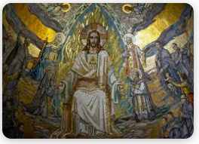
R.E.
R.E.
We will be looking at Hinduism and the importance of Diwali for Hindus.
Learning about the meaning of dharma and karma in the Hindu faith.
We will then be moving on to learning about art, poetry and music in Christianity.
Also, we will find out how Muslims express their beliefs through art.
The significance of pilgrimage will also be looked at.

Slide 11
Foundation subjects
Computing
We are co- authors (producing a wiki) and We are opinion pollsters (Collecting and analysing data)
PSHE
In PSHE, we will be exploring feelings and emotions and how to respond to these appropriately.
We will then move onto maintaining a healthy relationship including friendships. Understanding stereotypes and different types of families.
P.E
In PE we will be practising skills for sports' day as well as a range of outdoor and adventure activities.
Music
In music we will be listening to music from around the world and composing music

Slide 12
RHE
RHE
We will be discussing that-
Their bodies belong to them and that they can say 'no' to a touch they don't like, i.e. establishing personal boundaries like pushing or touching of hair.
Their body parts covered by their underwear/pants are
private ( the body parts will not be named, only the term
private parts used).
In BLP we use the PANTS approach-

Slide 13
Year 3 Information
We will continue to set homework weekly. The spellings and information for the tasks will be uploaded on Purple Mash every Friday.
Children to complete homework in the blue books and return the following Wednesday.
We expect children to be reading daily at home.
Year 3 PE day:
3R – Monday and Wednesday
3A – Monday and Thursday
3D – Monday and Tuesday
3K – Monday and Wednesday
Please ensure children come to school in their PE kit on their PE day.

Slide 14
Communication with Parents
Hopefully, this information has given you an insight into key aspects of your children's learning this term.
Our Year 3 topic web will be on the school website as a reminder of the key subject topics.
If there are any queries with aspects of the curriculum or any questions at all, please talk to us at the end of the school day.

