Slide 1
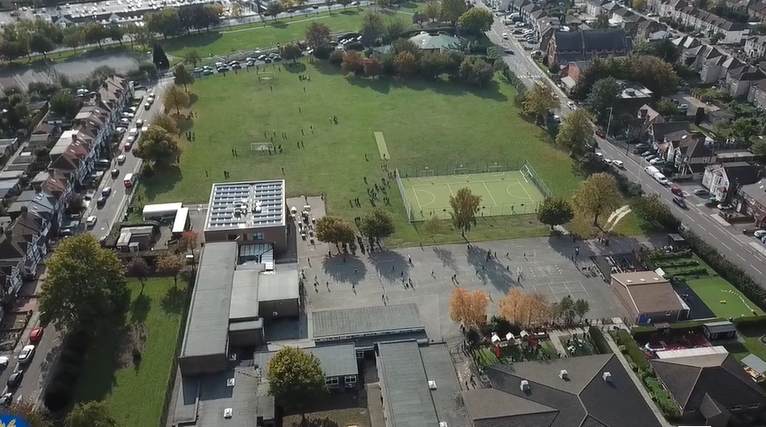
Parent Curriculum Meeting Year 1 Summer Term 2024

Slide 2
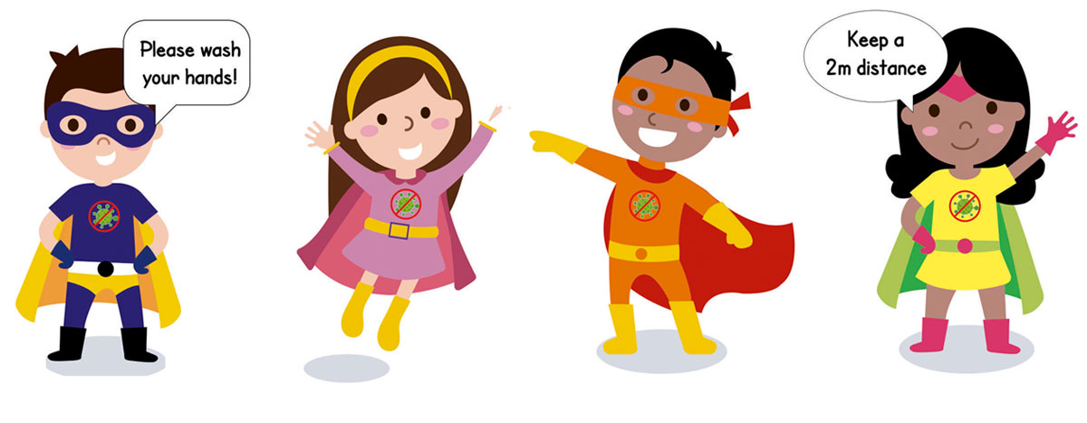
School Vision and Motto
At Barley Lane Primary School it is important that we all work together to ensure that everyone feels happy, safe and ready to learn.
Our School Motto
Believe in yourself, Learn together, Persevere and Succeed
Notes:
Mrs Rohim

Slide 3
Meeting Outline
Summer Curriculum Topic and Big Question
Phonics
Reading
English
Maths
Foundation Subjects
Science
Vocabulary
Homework
Notes:
Mrs Rohim

Slide 4
Summer Curriculum Topic
Summer Topic: Wonderful World
Big Question: Is our world wonderful?
Notes:
Mrs Rohim

Slide 5
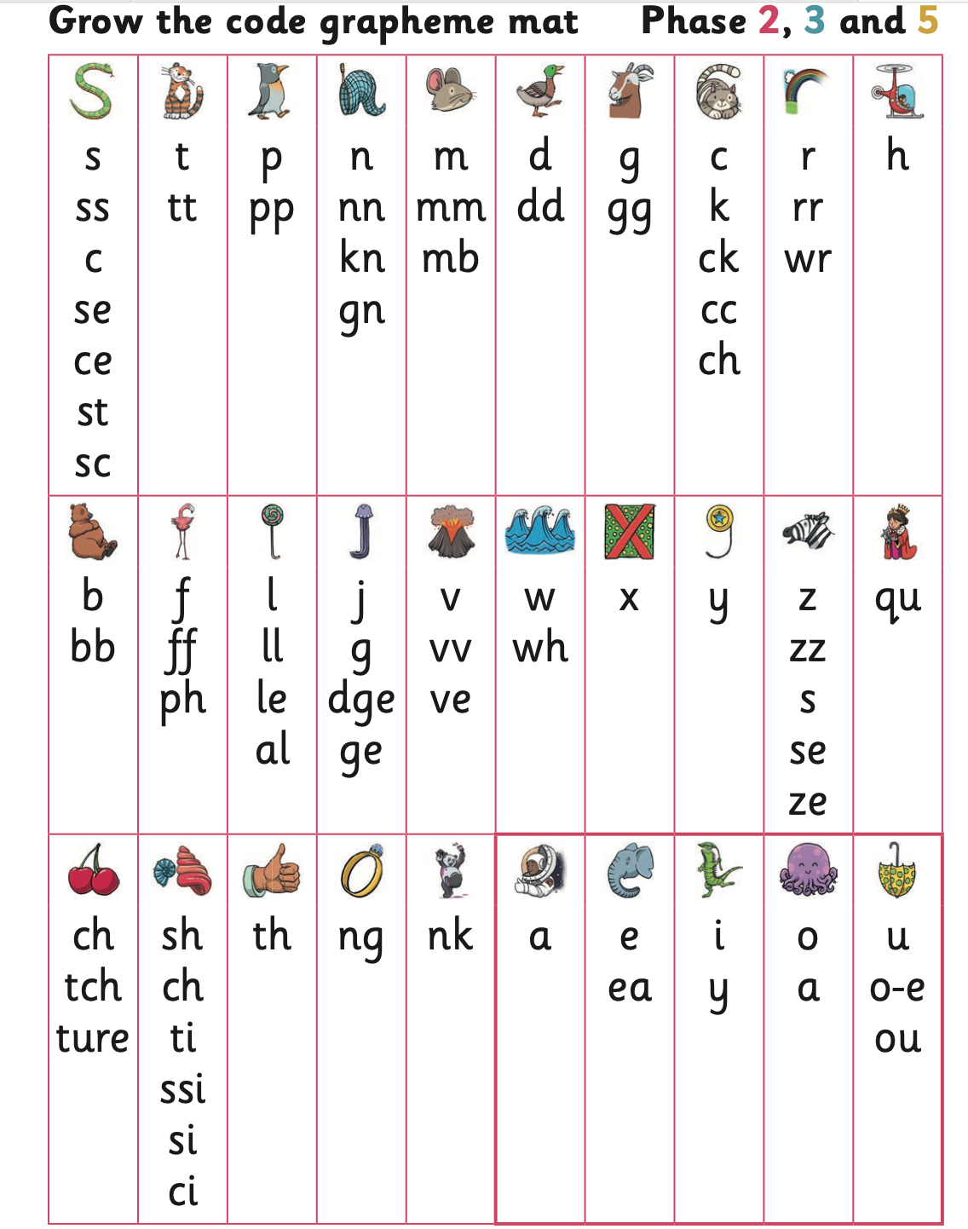
Phonics is a way of teaching children how to read and write. A phonics session takes place each day in school.
This term most children in year 1 will be taught phase 5 phonemes
Children learn to-
Segment words e.g h ea d qu i ck
Blend the sounds (phonemes) of letters (grapheme) together to read unfamiliar words.
Write and spell words containing sounds learnt
Read words accurately
Recognise and use alternative ways of pronouncing the graphemes (visual symbol) and spelling the phonemes (oral sound) already taught
Phonics

Slide 6
This term we will be preparing children for the ‘Phonics Screening Check’
The Year 1 Phonics Screening Check is designed to identify which pupils need additional support with certain areas of phonics as they progress.
Children need to learn phase 5 phonemes in order to pass the phonics screening test.
Encourage your child to ‘sound out’ when reading or writing. Focusing particularly on spotting more unusual sound patterns.
Letters and Sounds for Home and School – Year 1 Phonics Screening Check past paper
https://www.youtube.com/channel/UCP_FbjYUP_UtldV2K_-niWw/playlists
https://www.gov.uk/government/collections/national-curriculum-assessments-practice-materials#phonics-screening-check-resources
Phonics

Slide 7
Reading sessions takes place daily during the afternoon
Develop comprehension skills through questions.
Explain clearly their understanding of what is read to them
Predict what might happen on the basis of what has been read so far
Encourage children to read with expression, noticing punctuation – Exclamation marks, question marks, and full stops.
Begin to draw inferences from the text and/or the illustrations.
Re-read books to build up their fluency and confidence in word reading.
Reading books are given each week and should be returned by your child‘s allocated day. Children should read their reading book at home three times to build up their fluency.
We recommend you read or listen to your child read at least for 10 minutes a day.
Oxford Reading Tree - https://www.oxfordowl.co.uk
Please sign the reading records to inform us of how your child is getting on with reading at home each week. After three books have been read and signed by an adult at home, your child will receive a house point.
Children visit the school library to borrow a book weekly.
Reading

Slide 8
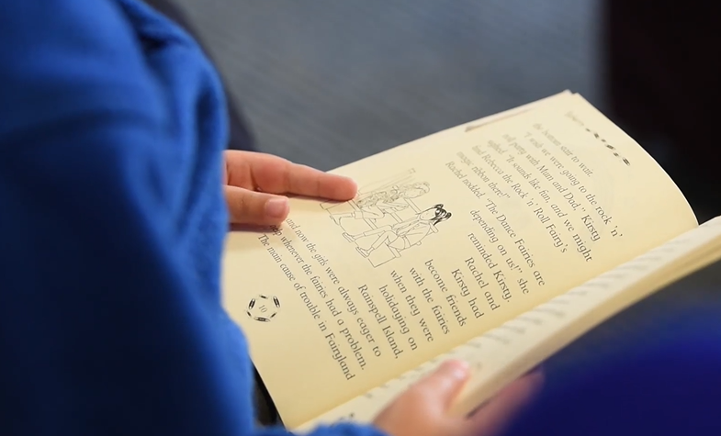
English
Our key texts this term are : ‘Snail and the Whale’ and ‘On a Magical Do Nothing Day’. This links with our Science topic on ‘Plants’ and ‘seasonal changes’ as well as other areas of the curriculum such as geography
Through this text, children will be taught many reading skills such as making predictions, making inferences, retelling, clarifying meanings of words and asking and answering questions.
Children will be encouraged to write sentences:
Saying out loud what they are going to write about
Re-reading what they have written to check that it makes sense.
Discuss what they have written with the teacher or other pupils
Writing in first person by taking on the role of the character.
Spell common exception words
They will be encouraged to ‘write independently and have a go’ at spelling, by phonetically sounding out words.
Using persuasive language
Practise letter formation
Punctuate sentences
Conjunction ‘and’
Children will be writing for different purposes and writing in different genres such as story writing, persuasive letters, instructions .
Using a capital letter for names of people, places, the days of the week, and the personal pronoun ‘I’ .
Use the suffixes – ed,ing, es,
Use the prefix un
Notes:
Ms Munir

Slide 9
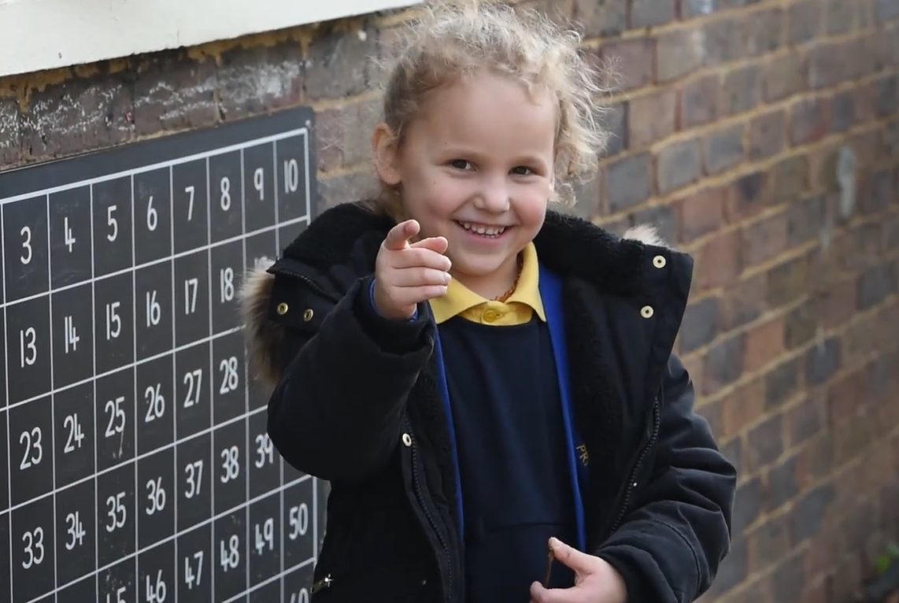
Maths
Mathematics is important in everyday life, and with this in mind, we intend to provide a curriculum which is inclusive and caters for the needs of individuals.
The focus of mathematical teaching in Year 1 is to ensure that children develop confidence and mental fluency with whole numbers, counting and place value.
The following topics will be covered this term:
Place value :
Count, read and write numbers to 100 in numerals and count in multiples of twos, fives and tens.
Represent and use number bonds and related subtraction facts within 20, partition numbers into tens and ones
Addition and subtraction :
Solve one-step problems that involve addition and subtraction using concrete objects, pictorial representations and missing number problems.
Measurement: Measure and begin to record capacity and volume
Fractions: Recognise, find and name a half and quarter as of a number, shape and quantity
Time : Measure and begin to record time to the hour and half past the hour
Money: Recognise and know the value of different denominations of coins and notes
Notes:
Mrs Rohim

Slide 10
Foundation Subjects
History- Children will be comparing the seaside from today and the past. We will also look at significant British Monarchs from the past such as Queen Victoria and Elizabeth I. We will be using timelines to make comparisons between various periods of history.
Geography-geographical features of the seaside, both human and physical. Children will learn about seaside environments; finding out where they are located in the United Kingdom using maps. Children will learn about the similarities and differences between seaside resorts and our local area.
RE- In what ways are a church and mosque important to believers? We will learn about the features and artefacts found in the church and the mosque and the importance of special or sacred places in their own lives. Who is a Christian and what do they believe? We will learn why the Bible is sacred for Christians and what this means and learn stories that Jesus told about how to live.
Notes:
Ms Dhir

Slide 11
Foundation Subjects
PSHE- Relationships, identifying their special people, communicating with others about their feelings.
RHE - Understand that parts of our bodies that are covered are private.
Art/DT- Use a range of materials and skills to design and create a placemat and a coaster.
Exploring and discussing artists work– Eddy Kamaunga Illunga, Sayed Haider Raza and Gunta St¨olzl .
Exploring weaving from Pakistan, Bangladesh and Africa.
DT children will learn about fruits and vegetables. They will then prepare and make a salad.
Computing- Record audio on a digital device, program sprites to playback recorded audio in Scratch, program Scratch to create repeating rhythms and experiment with a range of virtual instruments.
PE- Outdoor and adventure activities, sports day, throwing and catching skills
Notes:
Ms Dhir

Slide 12
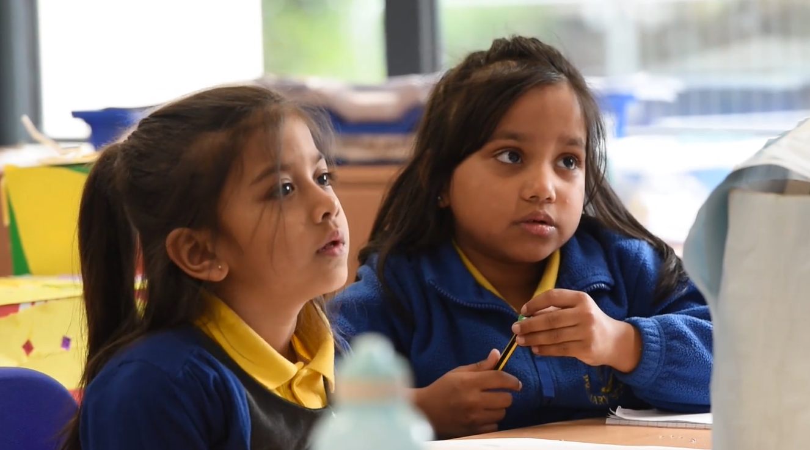
Science
Science
This term our Science topic is ‘ Plants and Seasons’.
Children will be exploring and learning:
Different plants and name different parts of a plant.
Understand what plants need to grow and difference between evergreen and deciduous trees.
Name the four seasons and describe how they are different
Understand how trees change with the seasons.
Understand how seasonal changes affect humans and animals
Explain how the length of the day varies by the seasons.
Through this topic children will also develop scientific enquiry skills such as-predicting, observing and measuring, planning different enquiries, performing tests, using equipment, identifying and classifying
Notes:
Mrs Arya

Slide 13
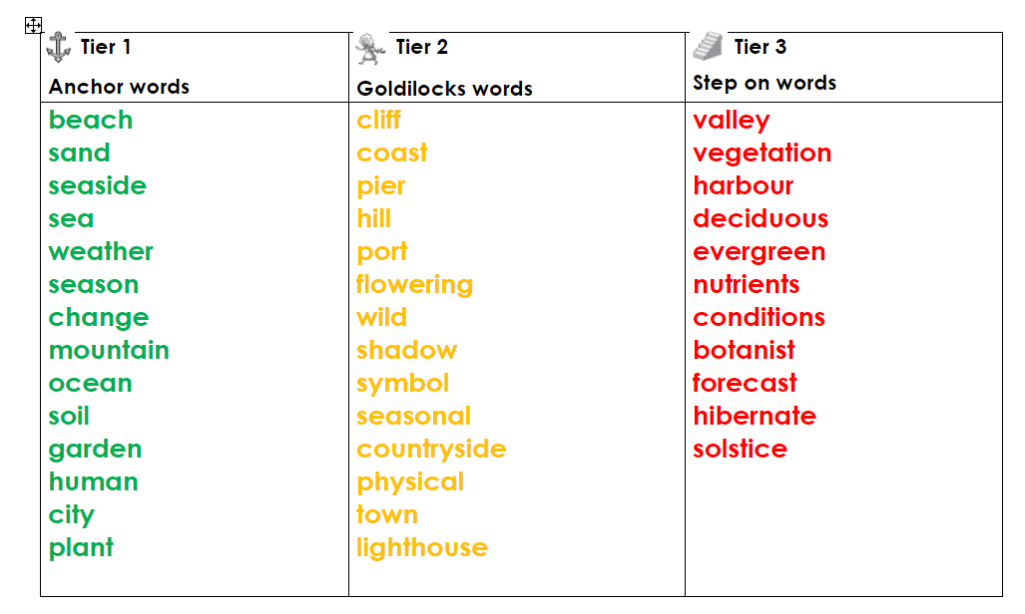
Vocabulary
Developing children’s vocabulary is a key priority in school this year. Vocabulary and new words are explored across each subject. This term as part of our topic learning, children will explore the following words.
Anchor words- words we are most likely familiar with
Goldilocks words- new vocabulary that is just right to know for the topic
Step on words- further challenging words.

Slide 14
Homework
Homework is set every Friday on Purple Mash and should be completed in homework books and handed in by the following Wednesday. Homework activities may cover different subjects of the National Curriculum. These may be written, practical or creative tasks. The activities set will help to consolidate learning in class that week or to familiarise children with the following week’s learning in class.
Weekly spellings are also given on Purple Mash every Friday and spelling tests take place the following Friday.
This half term children will be preparing for their ‘Phonics Screening Check’ due in June. We will be giving children phonics activities to complete in their homework book.
Notes:
Mrs Arya

Slide 15
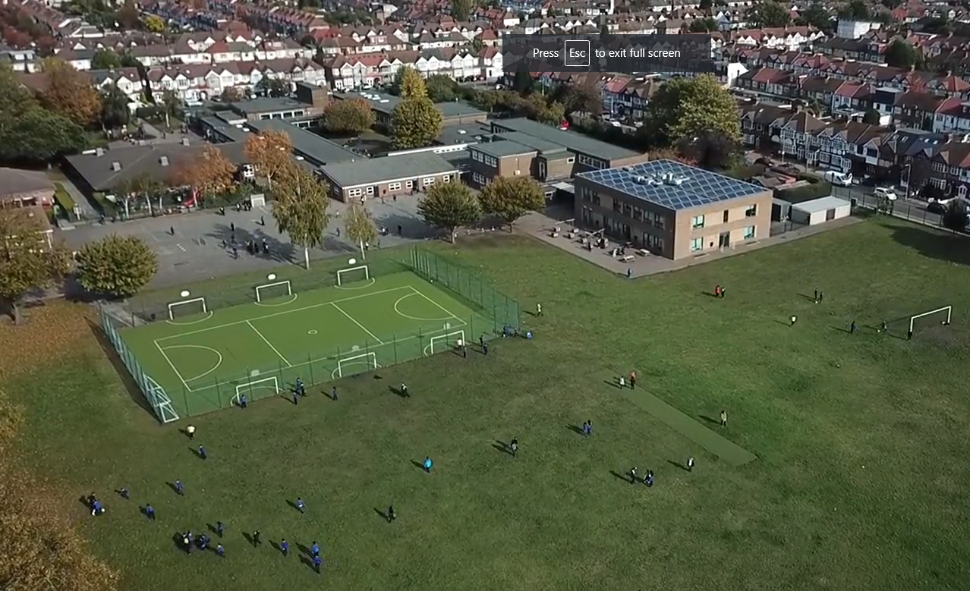
Any questions?
Notes:
Office.Admin: sending out letters, building and analysing surveys, answering queries, advising ov everchanging guidance and answering emails and phone calls
Premises staff: working tirelessly mornings, afternoons, evenings to create safe bubbles, signage, cleaning
LTAs working via zoom with their children, taking resources home to prepare, joining in on zooms
Catering staff: on furlough, Bal agreeing to come in
Fellow SLT: managing remote learning, staff welfare, keeping up with guidance

