Slide 1
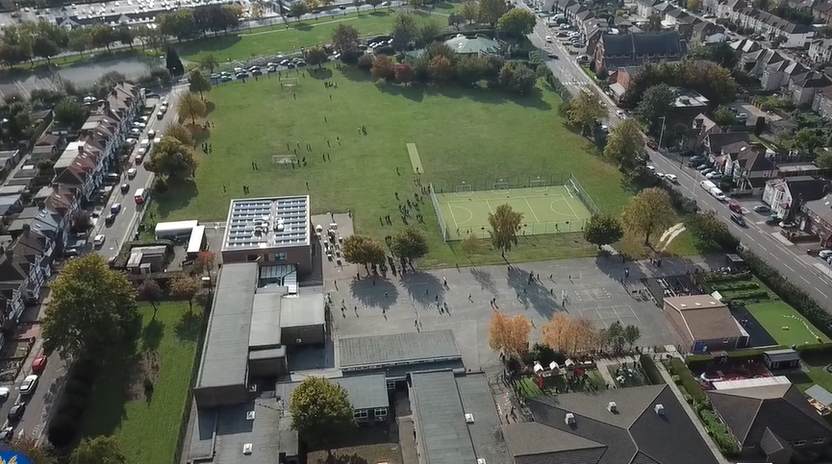
Parent Curriculum Meeting Reception April 2024

Slide 2
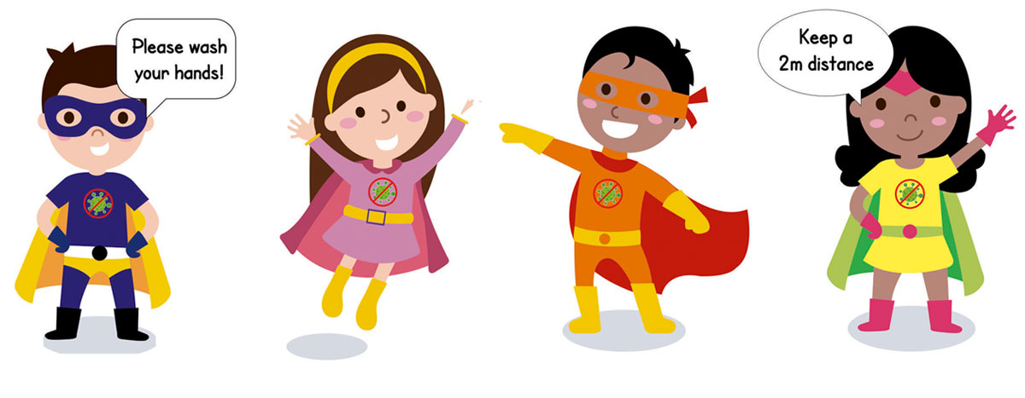
School Vision and Motto
At Barley Lane Primary School it is important that we all work together to ensure that everyone feels happy, safe and ready to learn.
Our School Motto
Believe in yourself, Learn together, Persevere and Succeed

Slide 3
Information Outline
1. Welcome
2. Summer Curriculum Topics and Big Question
3. Literacy/Phonics
4. Maths
5. Other areas of Learning
6. Questions

Slide 4
Summer Curriculum Topics
Summer Topic:
Fairy Tale (Summer 1& 2)
Big Question:
Is there always a happy ending? (Summer 1 & 2 )

Slide 5
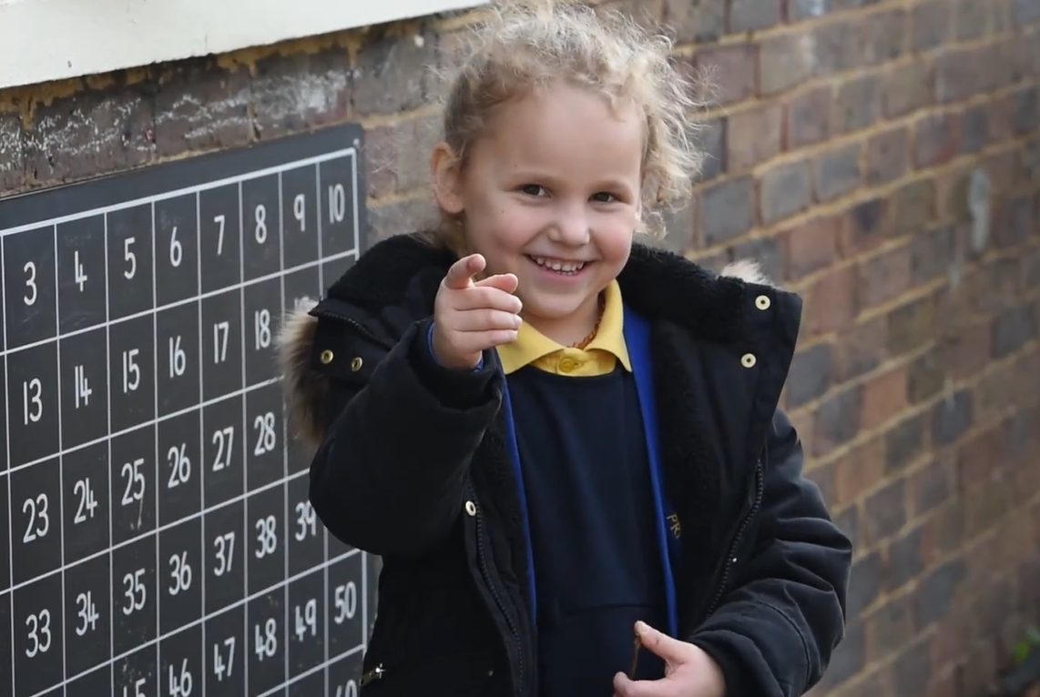
Maths
Number: Counting and recognition to 20 and back
Introduction to a 100 square
Counting on from different starting points up to 20 and beyond
Counting in 2’s
Number: addition within 10 and beyond
Ordering numbers to 20
Number bonds to 10
Subtraction with 20
Using objects, fingers, number line and mentally
Number bonds to 10Numbers: Doubling,
Halving / Sharing
Position and distance:
In front, top, bottom in up ‘behind’ or ‘next to’
Even and odd numbers
Number formation

Slide 6
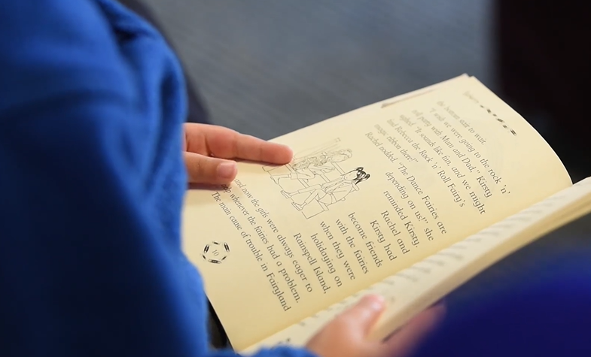
Literacy/Phonics Communication and Language
Fairy Tales - we will be focusing on different fiction text.
Cursive writing and weekly hand writing practise
Daily Reading
Phase 2/3 phonics revision
Phase 2/3 diagraphs and trigraph
Communication and Language
Listening
Understanding and responding appropriately
Speaking skills (having conversations in full sentences)
Turn taking

Slide 7
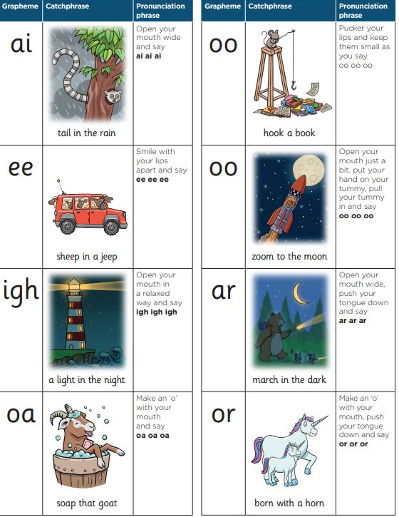
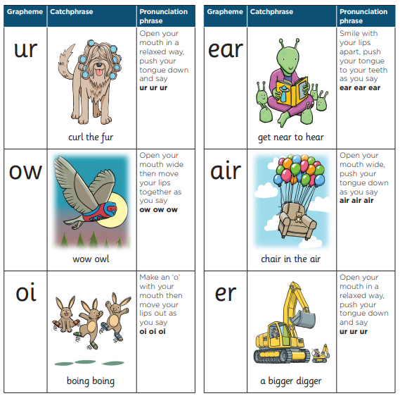
Phonics
Phonics is a way of teaching children how to read and write.
Teaches children to blend the sounds (phonemes) of letters (grapheme) together to read unfamiliar words.
Children are expected to read a range of common words fluently by the end of Reception
Website Links
https://www.littlewandlelettersandsounds.org.uk/resources/for-parents/
Children have phonics lesson every day from 9-9.30
https://www.youtube.com/results?search_query=mr+thorne+letter+sounds
Reading

Slide 8
Reading
Children will be given a stage book based on their reading and comprehension ability. These books will be changed weekly and we recommend you read or listen to your child read at least for 10 minutes a day.

Slide 9
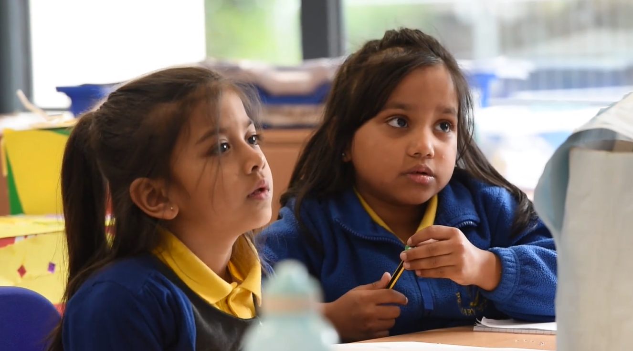
Other areas of Learning
Understanding of the World (Science, History, Geography, Computing and Religious Studies)
Expressive Art and Design
Personal, Social, Emotional Development
Physical Development – Fine Motor, Gross Motor

Slide 10
Communication with Parents
Our Reception term topic web is available on the website as a reminder of our key subject topics.
If there are any queries regarding your child’s learning or other aspects , class teachers can be contacted after school.
If you require an extended conversation, please book a meeting through the office.
Thank you for your continued support.

Slide 11
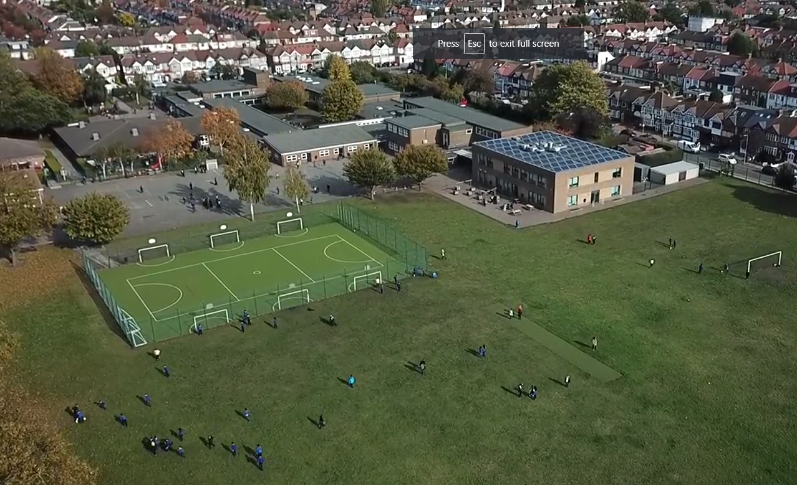
Any questions?

