Slide 1
Parent Forum April 17th 2024 Parent Survey Results

Slide 2
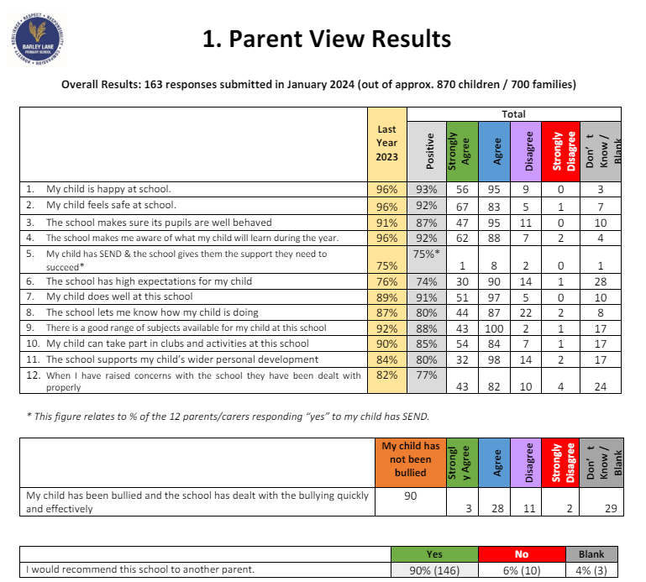
MH

Slide 3
90s %
93%: My child is happy at school
92%: My child feels safe at school
92%: The school makes me aware of what my child will learn during the year
91%: My child does well at this school
90%: I would recommend the school to other parents

Slide 4
80s%
88%: There is a good range of subjects available for my child at this school
87%: The school makes sure its pupils are well behaved
85%: My child can take part in clubs and activities at this school
80%: The school lets me know how my child is doing
80%: The school supports my child's wider personal development

Slide 5
70s%
77%: When I have raised concerns with the school they have been dealt with properly
75%: My child has SEN and the school gives the support they need (out of 12 responses) There is a good range of subjects available for my child at this school

Slide 6
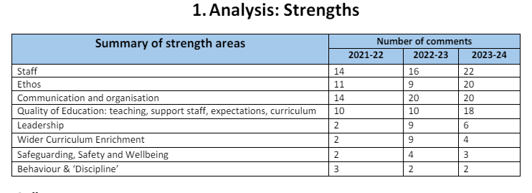

Slide 7
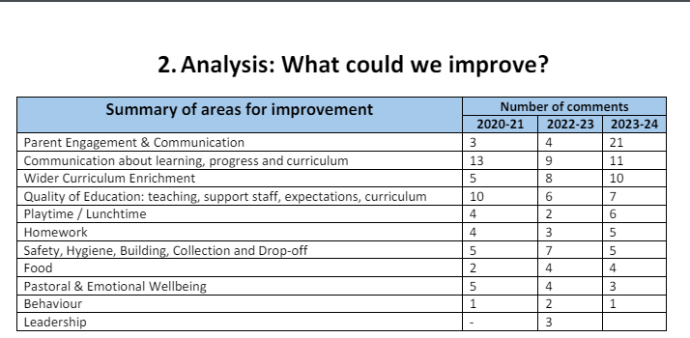

Slide 8
