Slide 1
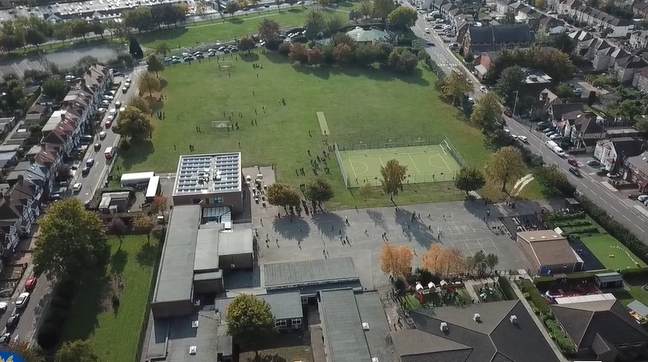
Parent Curriculum Information Year 5 Spring 2024

Slide 2
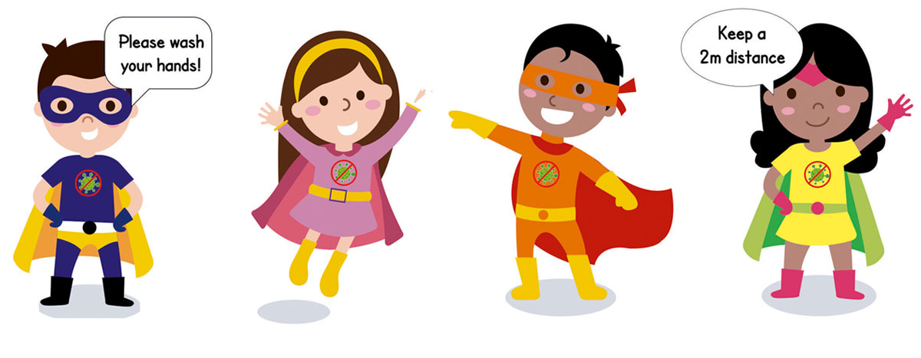
School Vision and Motto
At Barley Lane Primary School it is important that we all work together to ensure that everyone feels happy, safe and ready to learn.
Our School Motto
Believe in yourself, Learn together, Persevere and Succeed

Slide 3
Meeting Outline
1. Welcome
2. Spring Curriculum Topics and Big Question
3. English
4. Maths
5. Science
6. Foundation Subjects
7. Communication
8. Questions

Slide 4
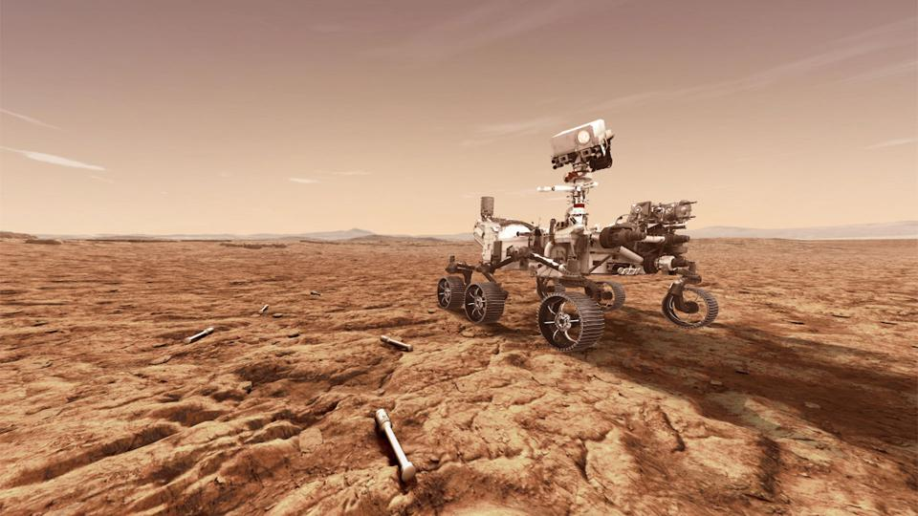
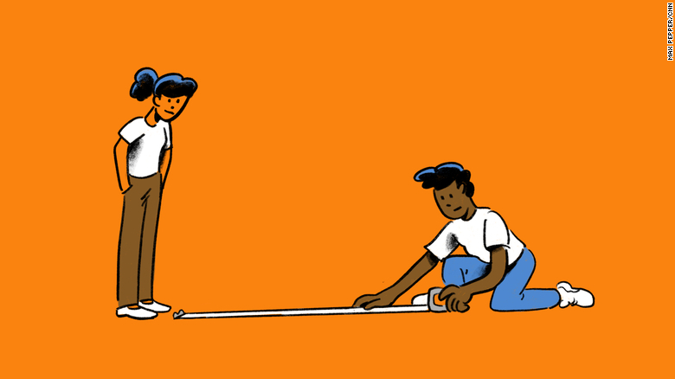
Spring Curriculum Topics
Spring Topic: To infinity and beyond
Big Question: Does exploration know no boundaries?

Slide 5
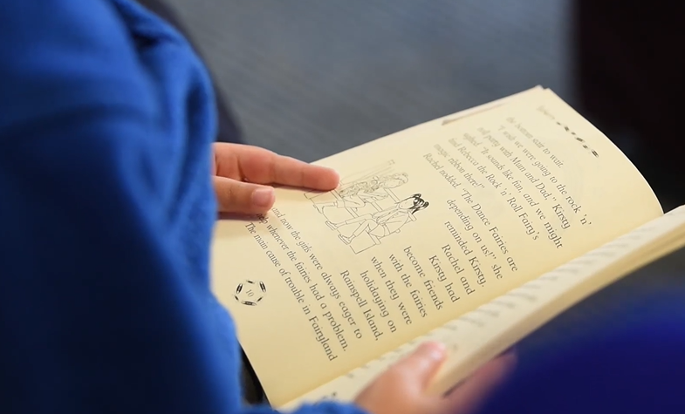
English
Our key texts are:
Writing focus-Curiosity- The Story of a Mars Rover, All Summer in a Day,
Reading focus- Shackleton's Journey
Grammar focus- relative clauses, brackets and dashes for
Parenthesis, commas for clarity.
Speaking and listening- Debate related to 'Does exploration know no boundaries?' Diversity- links to wider world and across historical eras.
Our key texts for spring are ‘Curiosity: The Story of a Mars Rover’ by Markus
Motum and ‘Shackleton’s Journey’ by William Grill.
The key texts link to the topics that we are studying. ‘Curiosity’ is a story of NASA’s Space rover in search for life on Mars. ‘Shackleton’s Journey’ explores Shackleton’s expedition to the Antarctic.
Using these texts children complete extended pieces of writing including job job application forms/cover letters, non-chronological report, descriptive writing, narrative writing and persuasive writing.

Slide 6
Science
Spring 1 – Space ( To infinity and beyond)
Big question – Does exploration know no boundaries?
Explore our solar system and their features
Develop scientific enquiry questions
Describe the movement of Earth/other planets as spherical bodies
Understand the idea of the Earth rotating to explain day and night
Observing, measure, record and identify patterns
Reporting and presenting findings from enquiries, including conclusions
We will be visiting the Science Museum this term. You will be hearing about this soon.
Spring 2 – Materials
Compare and group together everyday materials on the basis of their properties, including their hardness, transparency, and conductivity.
Investigate the insulating properties of a range of materials
Test a range of materials for their absorbency, strength and durability
Planning different types of scientific enquiries to answer questions, including recognising and controlling variables where necessary
Identify scientific evidence

Slide 7
Maths
Spring 1-Multiplication, division and fractions
Multiplication and division using formal written methods
Identify name and write equivalent fractions
Recognise mixed numbers and improper fractions
Ordering and comparing fractions
Spring 2-Fractions and decimals
Add and subtract fractions
Multiply proper fractions and mixed numbers by whole numbers
Read and write decimal numbers as fractions
Solve problems involving fractions
Read, write, order and compare numbers with up to three decimal places.
Mathematical explanations and reasoning throughout.

Slide 8
Foundation Subjects
PSHE – living in the wider world including parts of new RHE curriculum. Discuss how and why laws are made, the role of finance and becoming a responsible citizen. With aspects of E-safety and time spent on devices.
Art & DT – In the first half term we will be designing and making our own Mars rovers, linking to our topic and key text. In the second half term, we will be exploring an artist named Rachid Koraichi, with a focus on skills and techniques used in calligraphy.
RE – The Five Pillars of Islam, the significance of the Qur’an, key religious stories, the importance of sunnah and hadith and comparison with other religious beliefs. (Visit to a local Mosque)
History & Geography - Early Islamic empire from AD 700 with a focus on Baghdad in AD 900. We will be looking at the construction of Baghdad and it's features; everyday life in Baghdad in AD 900 with a comparison to Europe at the time; the Silk Road trade route and the goods exchanged and how this impacts the modern world.
Explorers - Ibn Battuta, in comparison to Ernest Shackleton, this links to our RE/history topic and texts used in class.
Computing – E-safety, VR designers and web developers.
Music – A musical journey through the solar system.
PE – Fitness and circuit training in indoor PE and invasion games in outdoor PE.

Slide 9
Diversity
In Year 5, we are continuing to diversify our curriculum, so that it is representative of the children that we teach and so that they are able to make links to their learning.
When learning about Space and exploration, children will learn about different explorers ranging from Ibn Battuta to modern day explorers, including female explorers. Children will also learn about the role that women have played in shaping NASA.
Through our history and geography curriculum, children will learn about significant Islamic scholars such as Al-Zahrawi, Al-Khwarizmi, Ibn Batutta and their role in the Golden Age of Islam.
Our key artist for this term is Rachid Koraichi, who comes from Algeria. Children will have the opportunity to explore his background and culture, in order to learn about his style of artwork.
In addition to this, one our key texts this term ‘The Boy at the Back of the Class’ is a story about refugees, friendship, kindness and adventure.

Slide 10
Communication with Parents
Homework and spellings are set every Friday on Purple Mash, please support your children in completing their homework online/books . Children also have the option of taking a reading book home each week, which they can change when needed. Children also visit our school library once a fortnight, please remind children to bring library books to school on a Wednesday. In addition to supporting your child with their homework, please encourage them to read for at least fifteen minutes each day.
We hope that this information has given you an insight into our learning for this term. If you have any other questions about the curriculum, please arrange a meeting with your child’s class teacher, this can be done via the school office.
You can also find our Spring Topic Web on the school website, this will provide you with an overview of topics taught.

Slide 11
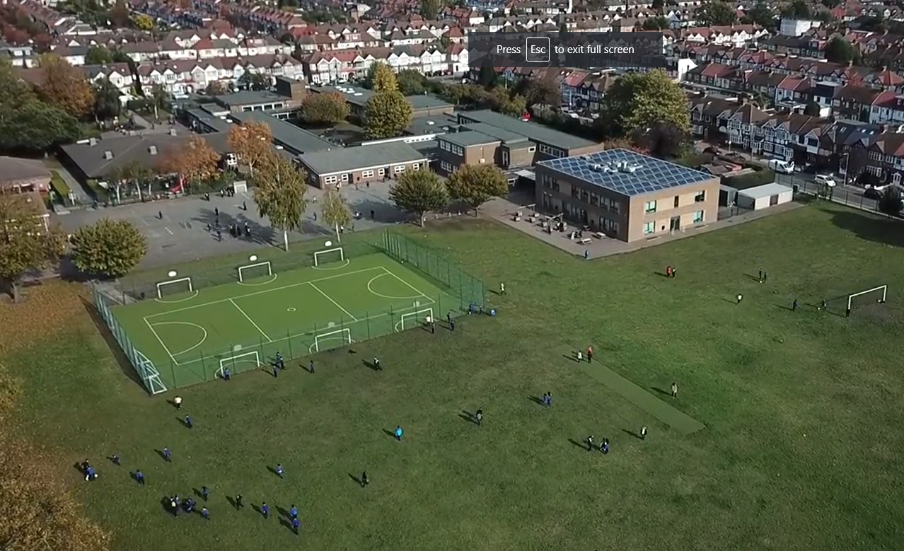
Any questions?
Please do not hesitate to contact us if you have any further questions.
We hope you found the information shared useful.
Thank you for joining.

