Slide 1
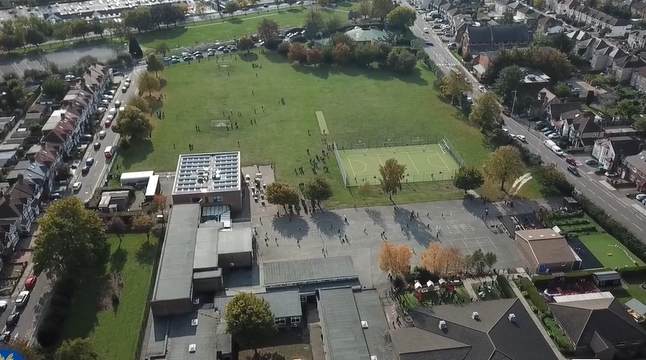
Parent Curriculum Information Year 4 Summer 2024

Slide 2
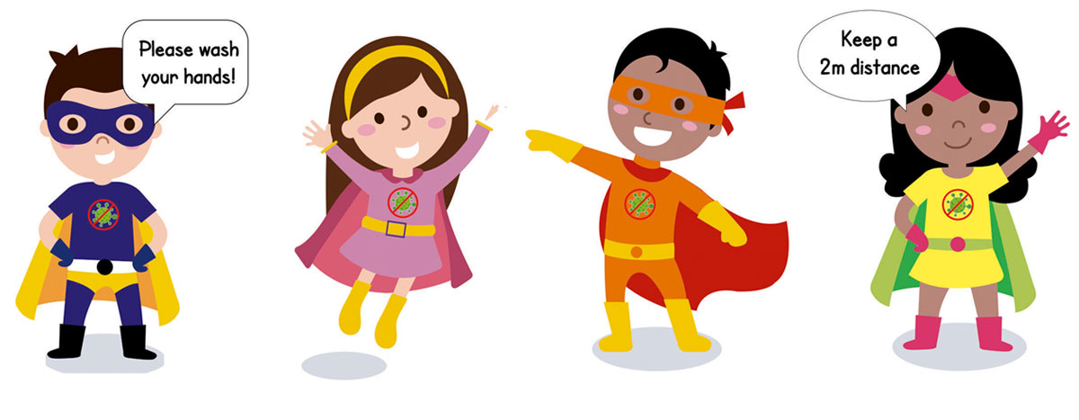
School Vision and Motto
At Barley Lane Primary School it is important that we all work together to ensure that everyone feels happy, safe and ready to learn.
Our School Motto
Believe in yourself, Learn together, Persevere and Succeed

Slide 3
Meeting Outline
1. Welcome
2. Summer Curriculum Topics and Big Question
3. English
4. Maths
5. Science
6. Foundation Subjects
7. Communication
8. Questions

Slide 4
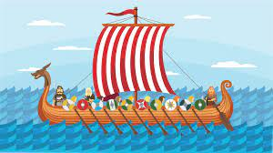
Spring Curriculum Topics
Summer Topic: Vicious Vikings
Big Question: Do you have to be vicious to get ahead?

Slide 5
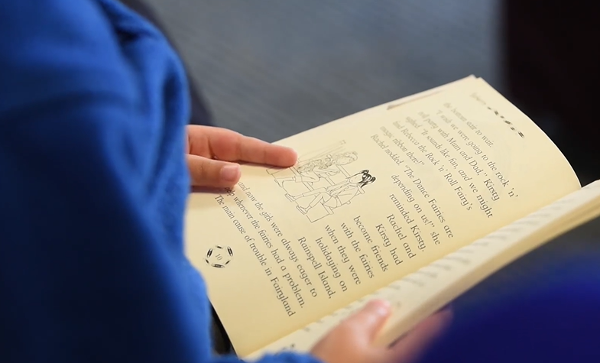
English
Our key texts are:
Writing focus – Beowulf. This is an old Viking poem retold as a story.
Reading focus- Viking Boy by Tony Bradman.
Grammar focus- Beginning sentences using fronted adverbials, using expanded noun phrases and using correct punctuation for direct speech including the use of inverted commas.
Speaking and listening – Performing own compositions using correct volume, tone and intonation, opportunities for role play and drama activities and performance poetry.
The key texts link to the topics that we are studying this term.
Using these texts children complete extended pieces of writing including descriptive writing, diary entries and newspaper reports.
Children will be working on their comprehension skills. Children will be using inference and deduction.

Slide 6
Maths
Summer 1 -
Fractions and decimals
Understanding the whole and counting beyond 1
Compare, order and partition mixed numbers
Understand improper fractions
Convert between mixed numbers and improper fractions
Equivalent fractions
Add and subtract two or more fractions, including mixed numbers
Solve problems involving fractions
Money
Writing money using decimals
Convert between pounds and pence
Compare amounts of money
Solve problems with money
Summer 2 -
Time
Hours, minutes and seconds
Convert between analogue and digital and vice versa
Shape
Identify angles as turns, compare and order angles
Look at 2-D shapes; triangles, polygons
Quadrilaterals
Lines of symmetry
Statistics
Position and direction
Mathematical explanations and reasoning throughout.

Slide 7
Science
Summer – Animals and humans
Food and digestion
The digestive system—different parts of the system and their importance
What do we know about eating and digestion?
Name different parts of the digestive system and find out where they are positioned in the body
Teeth
To identify the different types of teeth in humans and Identify their functions.
Scientific enquiry – looking at the cause and effect of tooth decay.
How can we keep our teeth healthy? Look at hygiene.
Food chains
be able to identify carnivores, herbivores and omnivores.
To be able to construct and interpret a variety of food Chains – look at terminology such as producer and consumer.
looking at energy transfer across the food chain

Slide 8
Foundation Subjects
PSHE – Relationships, including the RHE curriculum. Children will be split for one session in Summer two for a lesson puberty.
Art & DT – Making Viking longboats and looking at animal art (paintings)
RE – Judaism, similarities and differences between worship in major religions
History & Geography – The Viking invasion of Britain, the Anglo- Saxon kings, Danegeld, Viking life, Laws and justice. Comparison to modern day Britain.
The religious beliefs of the Vikings, including gods and goddesses.
Computing – E-safety, we are musicians, and we are artists.
Music – A musical journey through sound.
PE – Outdoor P.E, Sport’s day practise and teacher’s choice.

Slide 9
Communication with Parents
Homework and spellings are set every Friday on Purple Mash, please support your children in completing their home learning online. Children also have the option of taking a reading book home each week, which they should bring back to school on a Tuesday or Thursday. In addition to supporting your child with their homework, please encourage them to read for at least fifteen minutes each day.
As well as this, Year 4 pupils will be taking a multiplication test in June – this will be an online test. Please support your child in learning their times tables up to 12 on a regular basis.
We hope that this information has given you an insight into our learning for this term. If you have any other questions about the curriculum, please arrange a meeting with your child’s class teacher, this can be done via the school office.
You can also find our Summer Topic Web on the school website, this will provide you with an overview of topics taught.

Slide 10
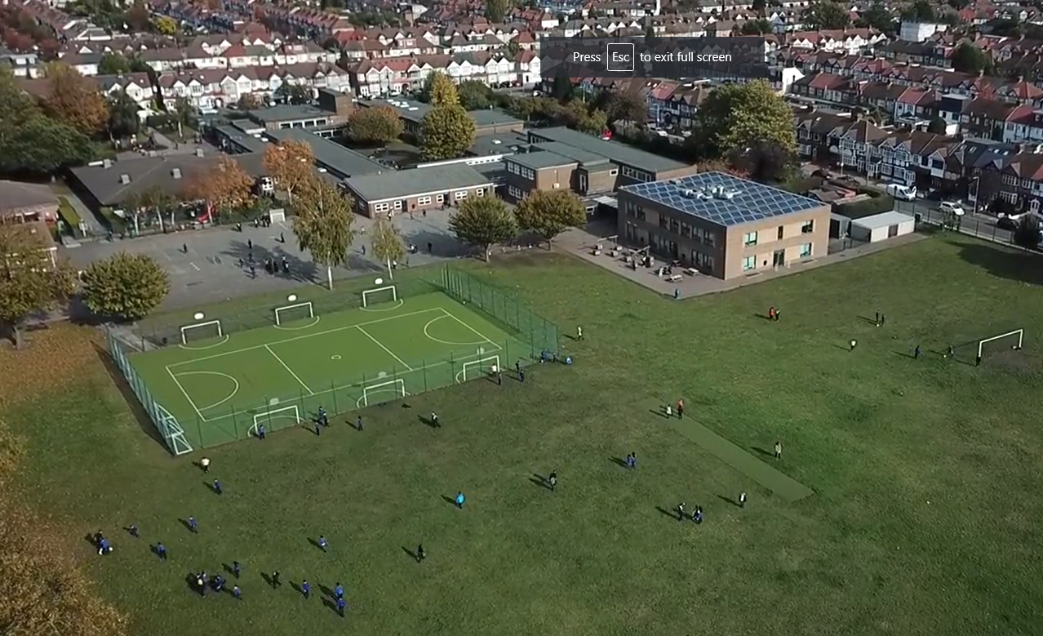
Any questions?
Please do not hesitate to contact us if you have any further questions.
We hope you found the information shared useful.
Thank you for reading.

