Slide 1
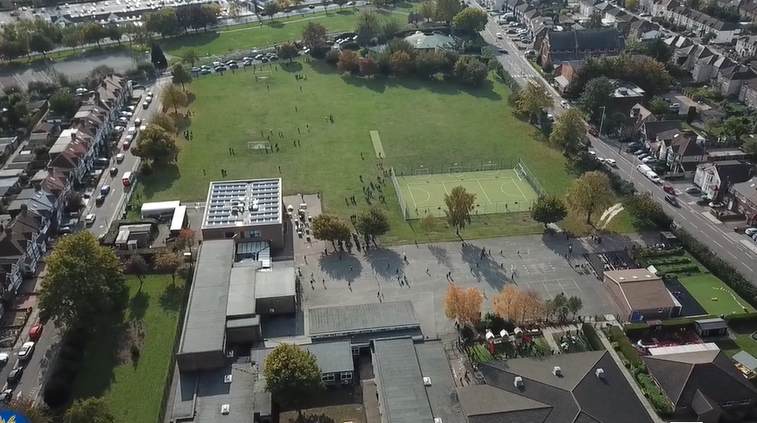
Parent Curriculum Meeting Year 3 ^{10th} January 2024

Slide 2
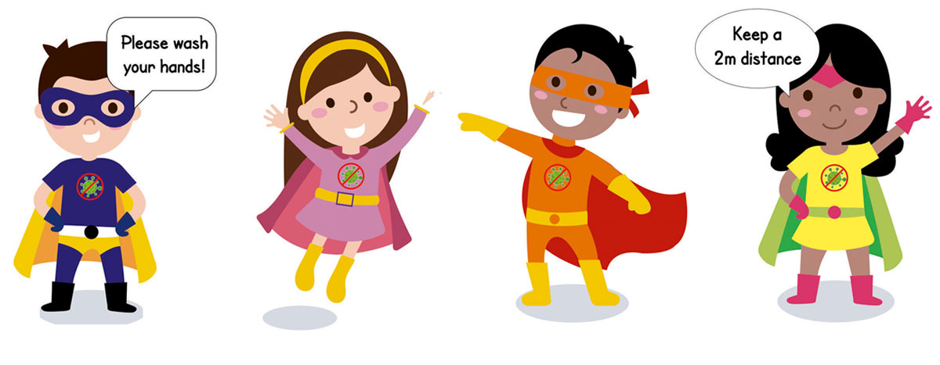
School Vision and Motto
At Barley Lane Primary School it is important that we all work together to ensure that everyone feels happy, safe and ready to learn.
Our School Motto
Believe in yourself, Learn together, Persevere and Succeed

Slide 3
Meeting Outline
1. Welcome
2. School Vision and Motto
3. Meeting Outline
4. Spring Curriculum Topics
5. English
6. Maths
7. Science
8. History and Geography
9.Art, DT and Food Technology
10.Computing
11. R.E.
12.Foundation Subjects
13.Communication With Parents
14. Questions

Slide 4
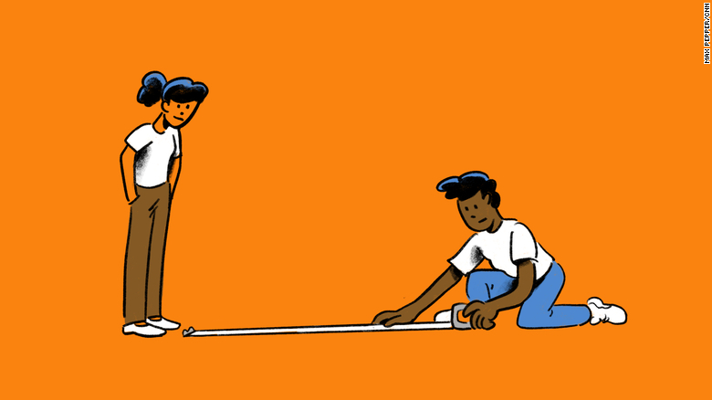
Spring Curriculum Topics
Spring Topic: Ancient Egyptians
BIG Question:
'Should We Dig Up The Past?'
Notes:
Office.Admin: sending out letters, building and analysing surveys, answering queries, advising ov everchanging guidance and answering emails and phone calls
Premises staff: working tirelessly mornings, afternoons, evenings to create safe bubbles, signage, cleaning
LTAs working via zoom with their children, taking resources home to prepare, joining in on zooms
Catering staff: on furlough, Bal agreeing to come in
Fellow SLT: managing remote learning, staff welfare, keeping up with guidance

Slide 5
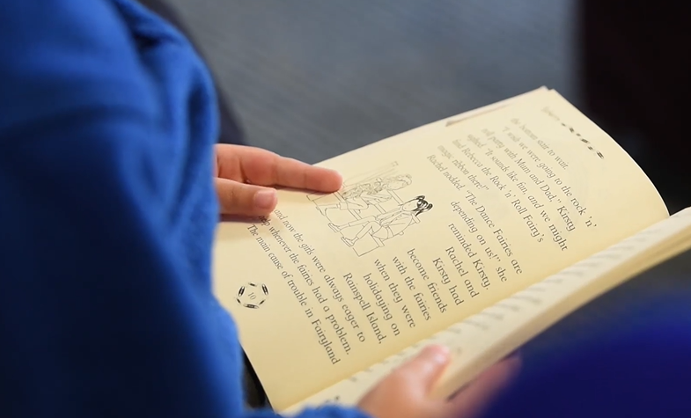
English
Reading Skills
Through our reading sessions, children will be continuing how to:
Infer character's thoughts, feelings and motives using evidence from the text
Make predictions based on details stated and implied
Clarify meaning of new words with a dictionary
Retrieve and record information from a range of texts to enhance their comprehension skills
Identify how structure and presentation of a story contributes to meaning
Writing
Our key texts will be 'The Egyptian Cinderella' and 'I Was There' .
Children will:
Develop their writing skills through writing for a range of purposes e.g. newspaper article, narrative writing, making a persuasive leaflet, writing a biography etc.
Have opportunities to plan, draft, edit/improve and redraft their writing
Use a dictionary for spellings and a thesaurus to up level vocabulary
Handwriting practice is important and will be formally practised each week in line with the Barley Lane policy. Spelling is also a priority, for example homophones- there, their and they’re
Speaking and listening
Speaking and listening skills are equally as important as reading and writing. We regularly plan lessons which involve discussion. Children are encouraged to listen to each other and share their ideas and opinions using an audible voice and being able to articulate their opinions.

Slide 6
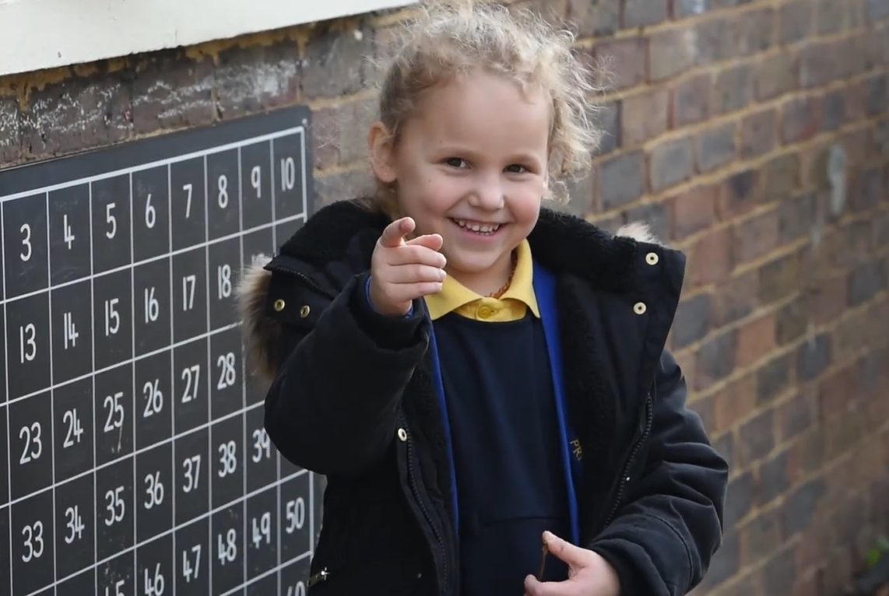
Maths
We are building on from the autumn term , developing our place value skills and knowledge and learning about the following:
Each topic has reasoning and problem-solving opportunities to further extend their thinking and learning.
Multiplication and Division Multiples of 10 Related calculations Reasoning about multiplication Multiply a 2-digit number by a 1-digit number – no exchange Multiply a 2-digit number by a 1-digit number – with exchange Link multiplication and division Divide a 2-digit number by a 1-digit number – no exchange Divide a 2-digit number by a 1-digit number – flexible partitioning Divide a 2-digit number by a 1-digit number – with remainders Scaling How many ways? | Time Tell and write the time from an analogue clock, including 12 and 24 hour clock Use Roman numerals from 1 to X11 Estimate and read time with increasing accuracy to the nearest minute Record and compare time in terms of seconds, minutes and hours Use vocabulary such as o'clock, a.m. ,p. m. morning, afternoon, midnight Know the number of seconds in a minute and the number of days in each month, year and leap year Solve number problems and practical problems involving these
Fractions Understand the denominators of unit fractions Compare and order unit fractions Understand the numerators of non-unit fractions Understand the whole Compare and order non-unit fractions Fractions and scales Fractions on a number line Count in fractions on a number line Equivalent fractions on a number line Equivalent fractions as bar models | Mass and Capacity Use scales Measure mass in grams Measure mass in kilograms and grams Equivalent masses (kilograms and grams) Compare mass Add and subtract mass Measure capacity and volume in millilitres Measure capacity and volume in litres and millilitres Equivalent capacities and volumes (litres and millilitres) Compare capacity and volume Add and subtract capacity and volume

Slide 7
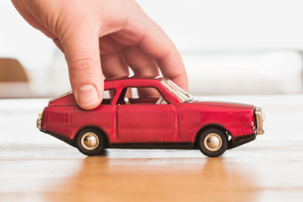
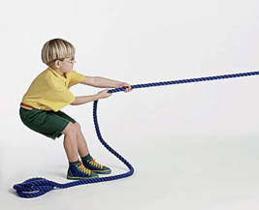
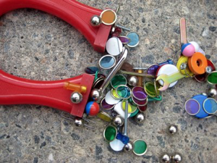
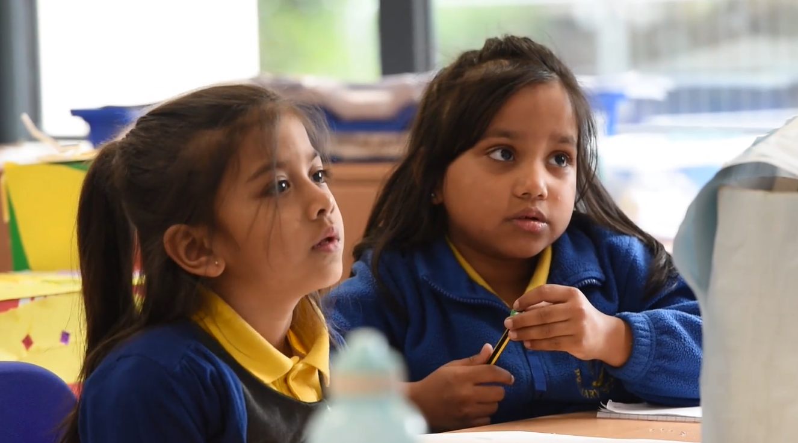
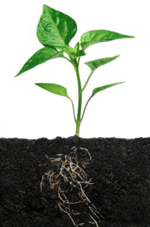
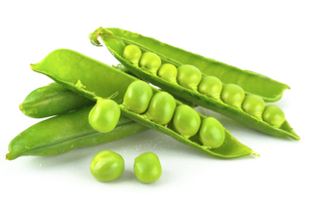
Science
First half term- Forces and Magnets
Working scientifically: planning and investigating to answer questions.
Observe and compare different types of magnets.
Second half term- Plants, fruits and seeds
Working scientifically: explore different parts of a flower and describing its function. Making predictions and carrying out an investigation to draw simple conclusions.

Slide 8
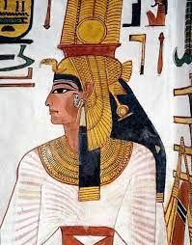
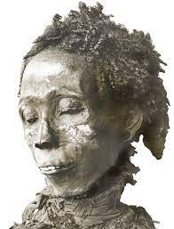
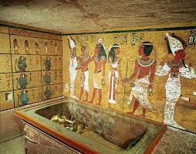
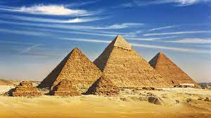
History/ Geography
Geography and History
The Extraordinary Egyptians
Chronology of the period
5000 years ago – comparison to Britain
Significant people – Queen Nefatari and Maihepri
Howard Carter and the tomb of Tutankhamun
Who built the pyramids?
Everyday life
Importance of the River Nile
The Indus Valley
New Kingdom Era

Slide 9
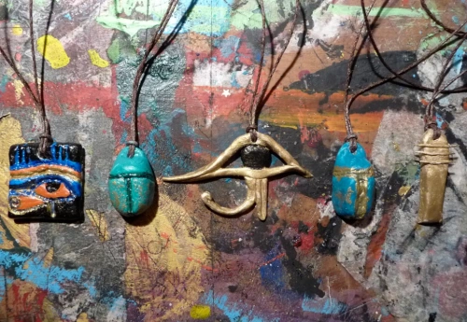
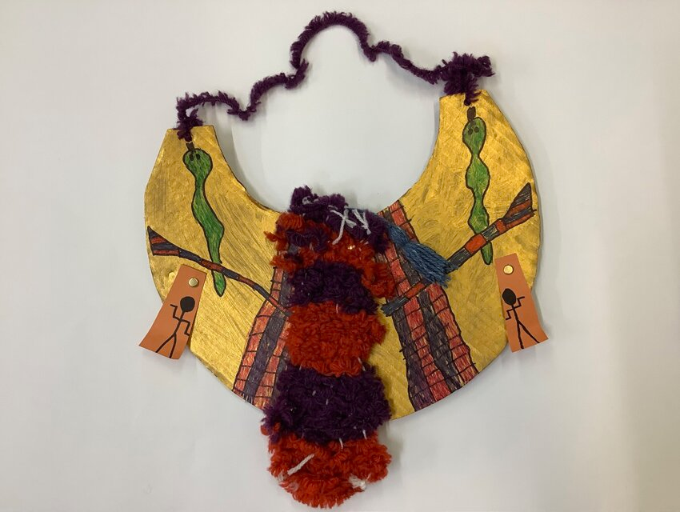
Art, DT and Food Technology
Ancient Egyptian artists – who were they?
Sketching technique
Tissue paper technique
Using mixed media
Significant artist – Lauren Harwell Godfrey
Amulets

Slide 10
Computing
We are presenters
We are who we are
We are aware of our own digital footprint
We are internet detectives

Slide 11
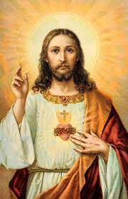
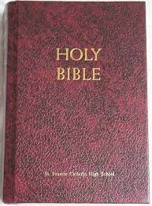
R.E.
Positive qualities in ourselves and other people.
What are the positive qualities of Jesus?
Impact of Jesus' actions – feeding the 5000.
Getting to know the Bible.
Jesus as the foundation for the lives of Christians.
The Beatitudes
Why do we celebrate?
Lent
The Easter Story

Slide 12
Other Foundation Subjects
PSHE/RHE
Positive affirmations
School values linked to choices and behaviour
Emotions as part of everyday life
Anti-social behaviour and how it can affect relationships
P.E
Outdoor - team building, fielding games (rounders, cricket)
Indoor—fitness
Music
Beat many metres
Carillon
Keep in time
Pitch - Hi Lo, Middle lo, Back in time
Branske simple

Slide 13
Communication with Parents
Hopefully, this curriculum talk has given you an insight into key aspects of your children's learning this term.
All Year 3 teachers are happy to talk and discuss whenever it is required.
Homework will be provided regularly and will be accessible via Purple Mash.
Our Year 3 topic web is on the school website as a reminder of the key subject topics.

Slide 14
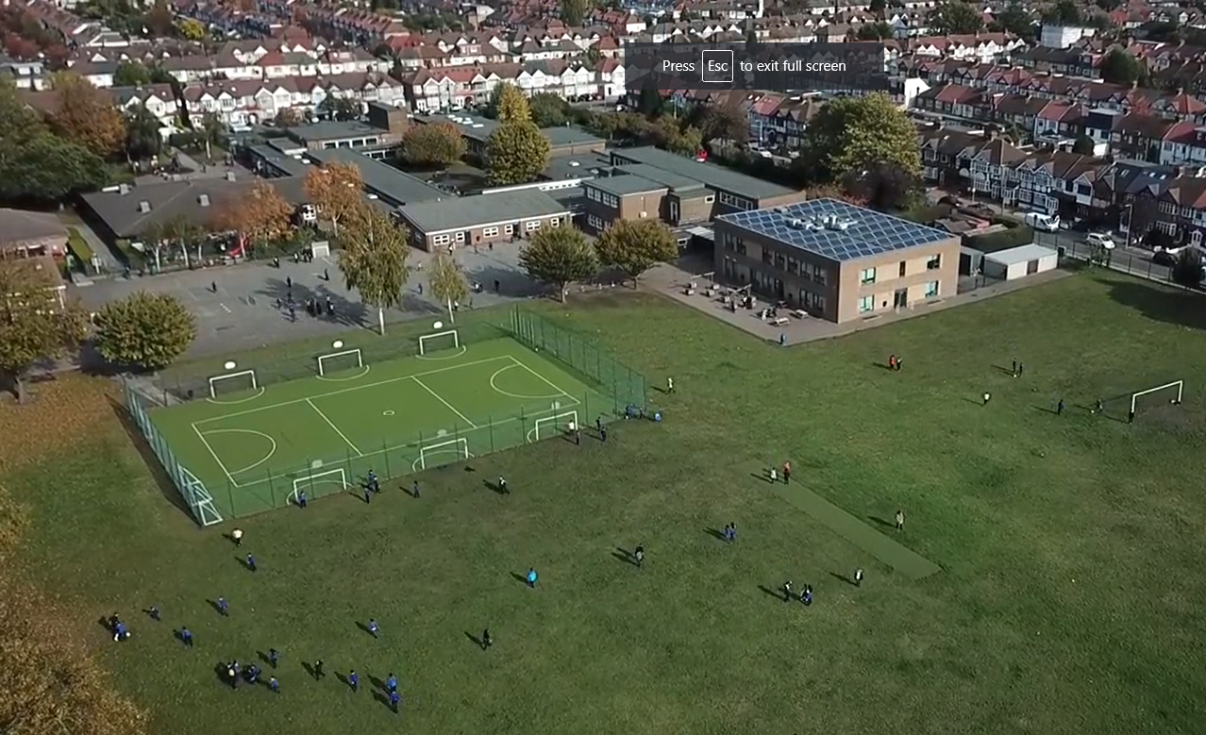
Any questions?
Notes:
Office.Admin: sending out letters, building and analysing surveys, answering queries, advising ov everchanging guidance and answering emails and phone calls
Premises staff: working tirelessly mornings, afternoons, evenings to create safe bubbles, signage, cleaning
LTAs working via zoom with their children, taking resources home to prepare, joining in on zooms
Catering staff: on furlough, Bal agreeing to come in
Fellow SLT: managing remote learning, staff welfare, keeping up with guidance

