Slide 1
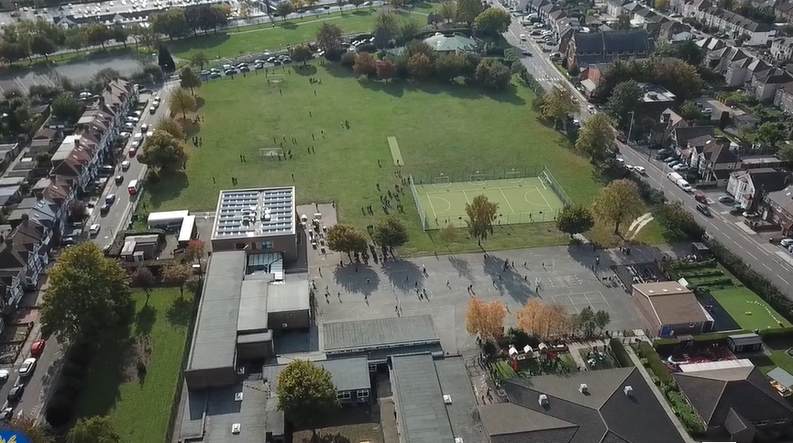
Parent Curriculum Information Summer Term 2024 Year 2

Slide 2
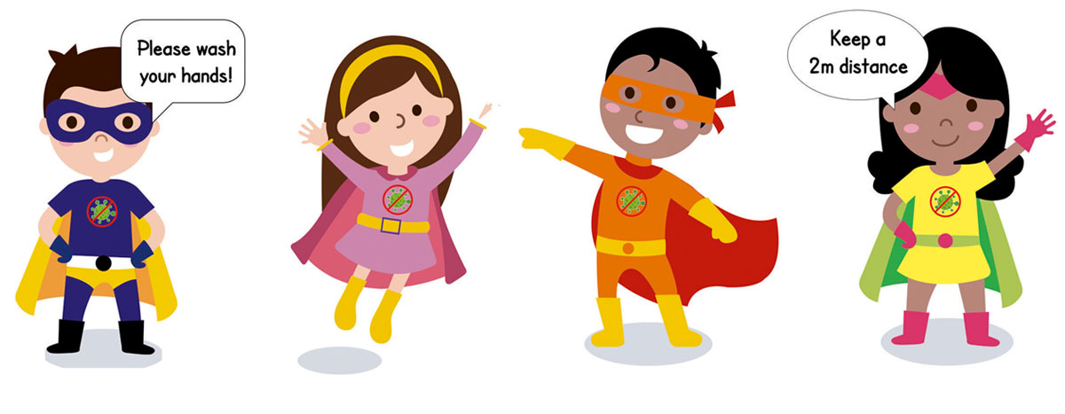
School Vision and Motto
At Barley Lane Primary School it is important that we all work together to ensure that everyone feels happy, safe and ready to learn.
Our School Motto
Believe in yourself, Learn together, Persevere and Succeed

Slide 3
Outline
1. Summer Curriculum Topic and Big Question
2. English
3. Maths
4. Science
5. Foundation Subjects
6. End of key stage 1 assessments
7. Homework
8. Communication

Slide 4
Summer Curriculum Topics
Our Summer Topic is:
The World and Me
Our Big Question is:
How do I find my place?
This links in mainly with Geography, Science as well as other subjects of the National Curriculum.
Year 2 Summer Term Curriculum
The summer term topic web is available on the website.
Notes:
Office.Admin: sending out letters, building and analysing surveys, answering queries, advising ov everchanging guidance and answering emails and phone calls
Premises staff: working tirelessly mornings, afternoons, evenings to create safe bubbles, signage, cleaning
LTAs working via zoom with their children, taking resources home to prepare, joining in on zooms
Catering staff: on furlough, Bal agreeing to come in
Fellow SLT: managing remote learning, staff welfare, keeping up with guidance

Slide 5
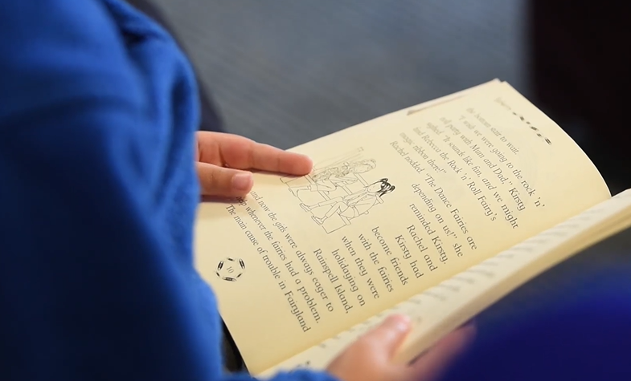
English
Our key texts are stories which are based in different settings or countries linked with our topic The World and Me as well as our learning about animals in Science.
Links will also be made to other areas of the curriculum such as PSHE.
In order for children to fully engage in the activities based around the texts, we kindly request that the texts are not explored at home.
Through these texts, children will continue to develop reading skills such as making predictions, making inferences, retelling, clarifying meanings of words and asking questions. Children will also work on comprehension skills, in particular answering different types of questions about a range of texts such as non-fiction, poetry and stories.
Writing skills will also be developed through writing for different purposes and writing in different genres such as monologues, persuasive writing and story writing. Children will write in the role of characters and explore alternative endings for stories too.

Slide 6
English
To develop children’s writing skills they will be taught to-
discuss and plan ideas including orally rehearsing sentences independently and with their peers
explore and use new vocabulary
use punctuation consistently such as capital letters, full stops, exclamation marks, question marks, apostrophes for possession and commas in a list correctly
use a range of conjunctions correctly to extend sentences e.g. when, or, if, because
use present and past tense correctly and consistently
proof read, edit and evaluate their work independently and with others
form letters correctly and continue to learn handwriting joins in order to join letters accurately
spell common exception words and words with suffixes e.g ful, ness, ment, less
apply phonics knowledge to spell words accurately

Slide 7
Reading
Reading
As well as reading being incorporated into English lessons and across other subjects of the curriculum, reading lessons also take place each day. In these sessions, children are taught specific reading skills.
Reading skills continuing to be taught this term
Decode automatically and read accurately with fluency
Make predictions
Make inferences
Retell events and answer questions
Make links between books
Talk about what has been read and share opinions
Reading books are given each week and should be returned by your child‘s allocated day. Children should read their reading book with an adult at home at least two times to improve their fluency.
We recommend listen to your child read at least 10 minutes a day.
Please sign the reading records to inform us of how your child is getting on with reading at home each week. After three books have been read and signed by an adult at home, your child will receive a house point.
Phonics sessions continue to be taught regularly. Children who did not pass the National Phonics Screening test in Year 1 will be retaking the test in June.
The following can be used to support:
https://www.youtube.com/channel/UCP_FbjYUP_UtldV2K_-niWw/playlists

Slide 8
Speaking and listening
Developing children’s speaking skills will enable children to develop their vocabulary and construct grammatically correct sentences.
This term we will be continuing with a ‘Time to Talk’ activity as part of homework. Each week we will set a topic or question to talk about with your child at home. This will be related to our learning at school or on a current issue.
Children will have the opportunity to talk about the topic in class and share their ideas.
To support this at home, please ensure you have a discussion with the children around the topic set. Ask children related questions and encourage children to respond in full sentences.

Slide 9
Supporting writing at home
Writing continues to be a key focus in Keystage 1 this term.
Some ways to encourage and develop your child’s writing skills are-
Focus on your child’s interests such as, sports, playing with Lego, cartoons, going to the park, animals etc. Engage children in their writing by asking them to write about their interest. Children could write sentences about their trip to the park, instructions on how they made their Lego model or write a description about their favourite TV character.
Try to encourage your child to write a creative story based on their interest. Children can draw their story ideas in sequence or act their story out by making puppets.
You could read part of a story and then write the next part. A picture could be used as a stimulus for writing. Children could even write letters to family members or friends or keep a diary.
Remember talking before writing is important. Support your child to express themselves clearly. When speaking to your child, encourage them to discuss their ideas and listen and respond to their ideas.

Slide 10
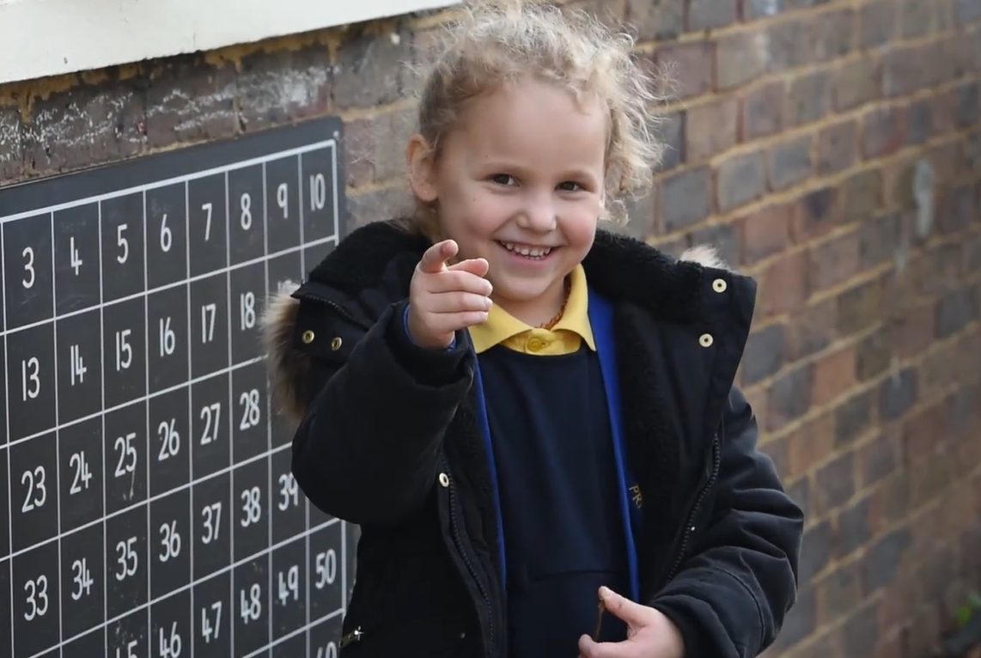
Maths
This term in Maths we will be working on various mathematical concepts .
The following topics will be covered this term-
Position and direction, particularly using vocabulary such as clockwise, anti clockwise, turn, left and right.
Measurement which will include measuring length and height, mass, capacity and temperature. Children will learn how to read varying scales using different measuring equipment and the correct units of measure.
Statistics, where children will collect, record and interpret data through tally charts and block graphs.
Solving missing number calculations such as ___+ 15= 50, 35-___=23
Fractions, with a focus on equivalent fractions
In addition to this, we will revisit and recap on several topics including place value, number sequences and efficient strategies to solve addition, subtraction, multiplication and division calculations. We will continue to practice recall of times table and division facts for the 2,5 and 10 times tables.
Throughout each topic children will be taught new vocabulary relating to the topic taught which they will be using when discussing mathematical concepts. Children will also be taught how to use and apply mathematical skills to mathematical reasoning problems.

Slide 11
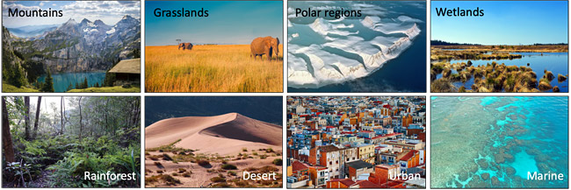
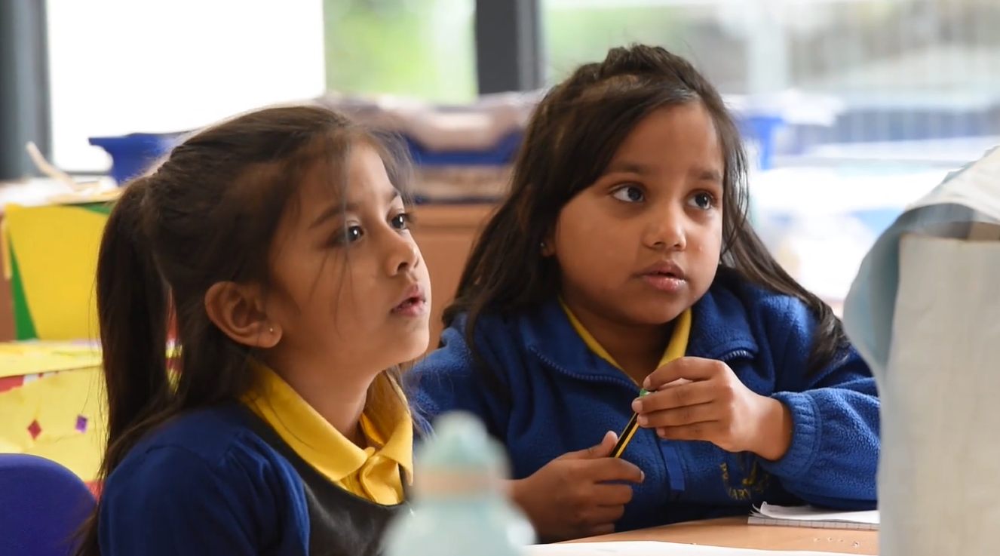
Science
Science is taught weekly.
We will continue with our Science topic from last term – ‘Living things and their habitats’ and our second topic will be ‘Animals including humans’. As part of our Living things and their habitats topic children will :
Identify plants and animals in habitats, including microhabitats
Explore habitats and how they provide for different kinds of plants and animals
Describe how animals obtain their food e.g. Food chains
Identify and name different sources of food
As part of our topic Animals including humans children will :
Describe the importance for humans of exercise, eating the right amounts of different types of foods and hygiene.
Find out and describe the basic needs of animals, including humans for survival
Notice animals have offspring which grow into adults
Through these topics children will also develop scientific enquiry skills such as -
Asking questions and suggesting ways to find things out
Observing closely, using simple equipment
Performing simple tests
Gathering and recording data in different ways including making conclusions
Using scientific vocabulary correctly
Using secondary sources to find information
Discussing whether things happened as they expected

Slide 12
Foundation Subjects
History and Geography
Exploring and researching about Kenya
Revising continents and oceans and locating Kenya on a world map
The history of Kenya and significant people from the country
Researching about National parks in Kenya and in different countries
Discovering African animals
Exploring elements of Maasai life
Comparing Kenya and the UK
Art and DT
Exploring African art and patterns
Exploring and discussing artists work– Esther Mahlangu and Haider Ali
Developing sketching skills inspired by an artist's work
Experimenting with paint and create different tones
Designing, making and evaluating our own vehicles
Making smoothies
RE - In what ways is a Church and Mosque important to believers?
Identifying different symbols and artefacts
Describing similarities and differences between ways in which people worship in a Mosque and in a Church
Reflecting on their own ideas about worship and prayer

Slide 13
Foundation Subjects
Computing Online Safety Units We are online behaviour experts We are Game Raters
We are safe researchers Researching a topic.
We are animators Creating a stop-motion animation.
PE - Sports Day practice and Fundamentals
Practising kicking, throwing, passing, jumping, rolling, controlling, turn taking
Team games
Developing balance and coordination through gymnastics activities
Music – Storytime and Animals
Combining sounds to make musical effect
Identifying and responding to changes in pitch
Playing pitch lines on tuned percussion
Circle time/ PSHE – Relationships
Recognising and sharing feelings
Different types of behaviour and how this can make others feel
Learn that our feelings may be hurt but we may be physically hurt
Listening to others and playing co-operatively
Exploring stereotypes
Understand that parts of our bodies that are covered are private. (using NSPCC PANTS resource)
Recognise that spending time with families is an important part of life

Slide 14
End of key stage 1 assessments- SATS
End of key stage 1 assessments will take place in the month of May. This will include two reading comprehension papers, an arithmetic test and a maths reasoning paper.
These assessments are designed to inform our ongoing teacher assessments and will include areas of the reading and maths curriculum which children have been taught.
Children are familiar with the layout of the tests and are part of the class activities for the day. There are no strict time limits to the tests and children are given regular breaks.
At the end of the term, you will receive your child’s assessment which is based on the class teachers assessments.

Slide 15
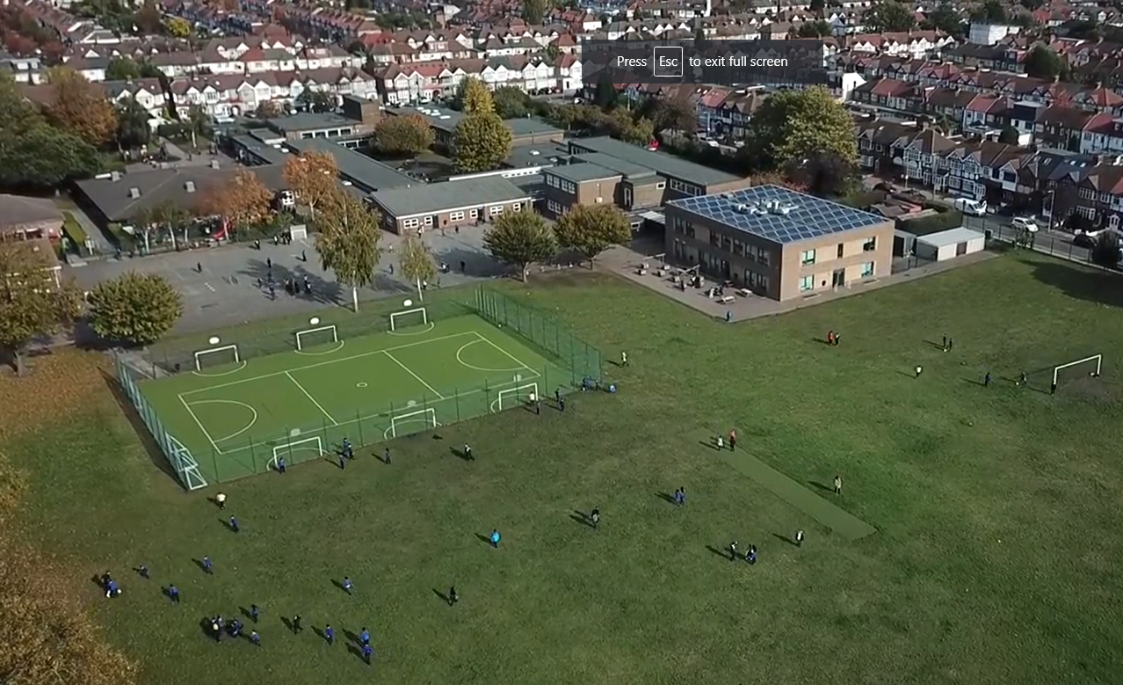
Homework
Homework is set every Friday on Purple Mash and should be completed by the following Wednesday. Homework activities may cover different subjects of the National Curriculum. These may be written, practical or creative tasks and some are to be completed in homework books. The activities set will help to consolidate learning in class that week or to familiarise children with the following week’s learning in class.
Homework also includes a weekly time to talk topic which is discussed further in class. Please spend some time discussing the topic, encouraging your child to speak in full clear sentences.
Spellings are uploaded on Purple Mash on Friday and spelling tests take place the following Thursday. Please help your child to practice reading and writing the words correctly. Writing sentences with the spellings can help to understand meanings of words too. Spelling sheets will give a brief outline of the following week’s English and Maths learning if you would like to explore the topics with your child at home.
Reading books are given throughout the week. Each week, your child will also be able to choose a book from the key stage 1 library and should be returned on their library day.
Notes:
Office.Admin: sending out letters, building and analysing surveys, answering queries, advising ov everchanging guidance and answering emails and phone calls
Premises staff: working tirelessly mornings, afternoons, evenings to create safe bubbles, signage, cleaning
LTAs working via zoom with their children, taking resources home to prepare, joining in on zooms
Catering staff: on furlough, Bal agreeing to come in
Fellow SLT: managing remote learning, staff welfare, keeping up with guidance

Slide 16
Communication with Parents
Our Year 2 summer term topic web is available on the website as a reminder of our key subject topics.
If there are any queries regarding your child’s learning or other aspects , class teachers can be contacted after school.
If you require an extended conversation, please book a meeting with the class teacher.
There will be further communication later this term regarding events and key dates e.g final parent's evening.
Thank you for your continued support.
.

