Slide 1
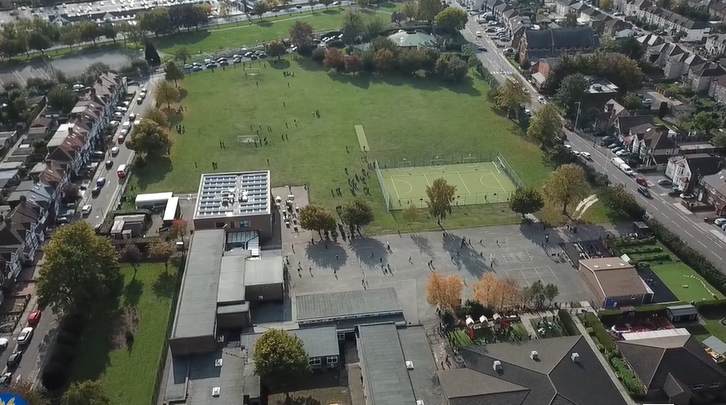
Parent Curriculum Meeting Year 2 9th January 2024

Slide 2
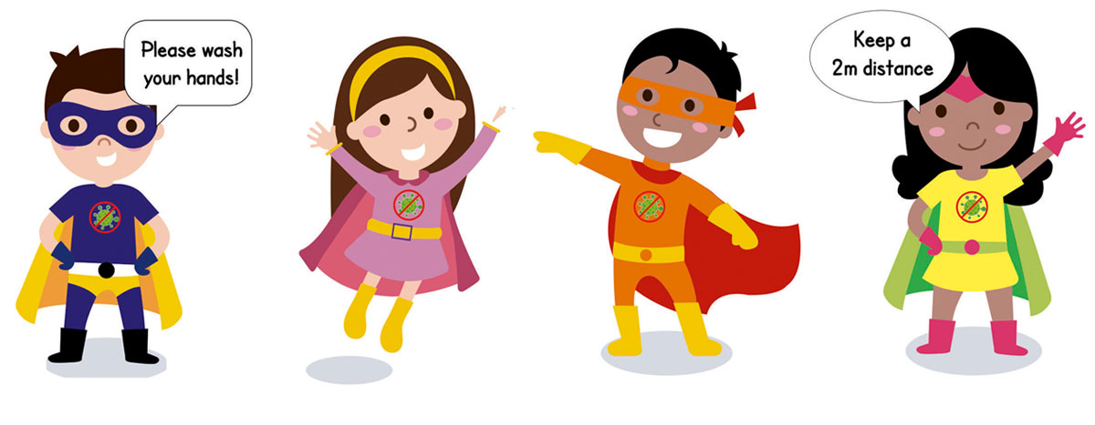
School Vision and Motto
At Barley Lane Primary School it is important that we all work together to ensure that everyone feels happy, safe and ready to learn.
Our School Motto
Believe in yourself, Learn together, Persevere and Succeed

Slide 3
Meeting Outline
1. Welcome
2. Spring Curriculum Topics and Big Question
3. English
4. Maths
5. Science
6. Foundation Subjects
7. Homework
8. Communication
9. Questions

Slide 4
Spring Curriculum Topics
Spring Topic: Then and Now
Big Question
How can the past help us today?
The Year 2 spring term curriculum topic web is available on the school website.
Notes:
Office.Admin: sending out letters, building and analysing surveys, answering queries, advising ov everchanging guidance and answering emails and phone calls
Premises staff: working tirelessly mornings, afternoons, evenings to create safe bubbles, signage, cleaning
LTAs working via zoom with their children, taking resources home to prepare, joining in on zooms
Catering staff: on furlough, Bal agreeing to come in
Fellow SLT: managing remote learning, staff welfare, keeping up with guidance

Slide 5
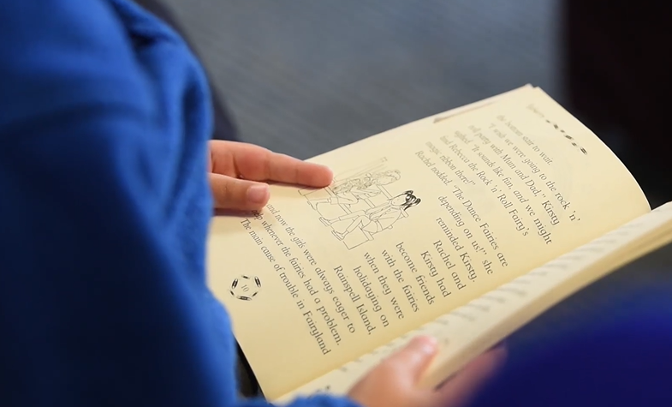
English
Our key texts this term link with our Science topics as well as other areas of the curriculum such as PSHE.
Through these texts, children will be taught many reading skills such as making predictions, making inferences, retelling, clarifying meanings of words and asking and answering questions.
Writing skills will also be developed through writing for different purposes and writing in different genres such as diaries, letters and story writing as well as non fiction pieces of work.

Slide 6
English
To develop writing skills, children will be encouraged and taught to-
discuss and plan ideas including orally rehearsing sentences
explore and use new vocabulary
use punctuation such as capital letters, full stops, exclamation marks, question marks, apostrophes and commas in a list correctly
use a range of conjunctions e.g. When, or, if, because
use present and past tense correctly
proof read, edit and evaluate their work
form letters correctly and begin to join letters
spell common exception words and words with suffixes e.g ful, ness, ment

Slide 7
Supporting writing at home
Writing is a key focus in Keystage 1 this year.
Some ways to encourage and develop your child’s writing skills are-
Focus on your child’s interests such as, sports, playing with Lego, cartoons, going to the park, animals etc. Engage children in their writing by asking them to write about their interest. Children could write sentences about their trip to the park, instructions on how they made their Lego model or write a description about their favourite TV character.
Try to encourage your child to write a creative story based on their interest. Children can draw their story ideas in sequence or act their story out by making puppets.
You could read part of a story and then write the next part. A picture could be used as a stimulus for writing. Children could even write letters to family members or friends or keep a diary.
Remember talking before writing is important. Support your child to express themselves clearly. So when speaking to your child, encourage them to discuss their ideas and listen and respond to their ideas.

Slide 8
Speaking and listening
Developing children’s speaking skills will enable children to develop their vocabulary and construct grammatically correct sentences.
This term we will be continuing with a ‘Time to Talk’ activity as part of homework. Each week we will set a topic or question to talk about with your child at home. This will be related to our learning at school or on a current issue.
Children will have the opportunity to talk about the topic in class and share their ideas.
To support this at home, please ensure you have a discussion with the children around the topic set. Ask children related questions and encourage children to respond in full sentences.

Slide 9
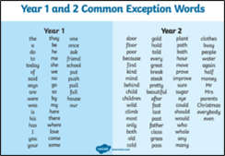
Reading
Reading every day and a range of texts will enable children to decode accurately, read fluently, develop comprehension skills and increase their knowledge of vocabulary too. Reading phase books will be continued to be changed every week.
Please sign the reading records to inform us of how your child is getting on with reading at home each week. After three books have been read and signed by an adult at home, your child will receive a star/sticker on the reading reward chart
Children have the opportunity to borrow a book of their choice from the KS1 library each week.
Regular phonics sessions take place which will develop reading and writing skills.
Mr Thorne Does Phonics - Pronunciation of the sounds
https://www.youtube.com/results?search_query=mr+thorne+letter+sounds

Slide 10
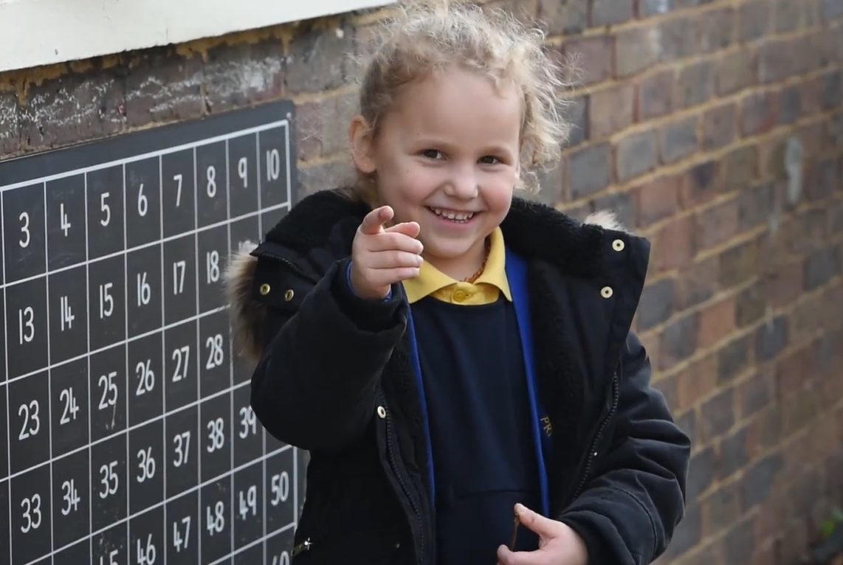
Maths
We will be covering several new curriculum topics this term including multiplication and division using equal groups and repeated addition, which the children have already been showing good progress in through their Maths lessons.
We will also be covering odd and even numbers, halving, fractions of shapes, telling the time to the nearest 5 minutes and properties and comparing of 2D and 3D shapes.
We will also be revisiting areas of the maths curriculum which will help children consolidate their learning. These areas of learning are revising 2, 5 and 10 times tables, addition and subtraction and place value work.
Our key focus is to continue working on maths fluency skills. In addition to this, our practical tasks will also focus on practice of concepts and reasoning problems.
We will continue to introduce new vocabulary which will help children with their reasoning abilities.

Slide 11
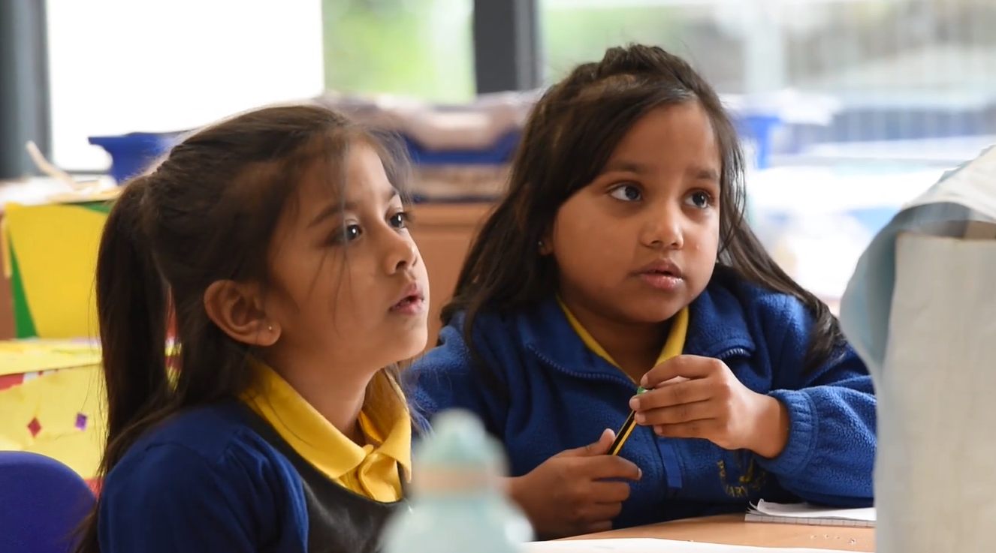
Science
Science is taught weekly.
Our two Science topics this term are ‘Plants’ and ‘Living things and their habitats’
As part of our Plants topic children will be:
Observing and describing how seeds and bulbs grow
Describing how plants need water, light, a suitable temperature to grow and be healthy.
As part of our Living things and their habitats topic children will :
Compare things that are living, dead or never been alive
Identify plants and animals in habitats, including microhabitats
Explore habitats and how they provide for different kinds of plants and animals
Describe how animals obtain their food e.g. Food chains
Through these topics children will also develop scientific enquiry skills such as-
Asking questions and suggesting ways to find things out.
Observing closely, using simple equipment
Performing simple tests
Gathering and recording data including making conclusions
Using scientific vocabulary

Slide 12
Foundation Subjects
History and Geography
Researching on significant people in the past and present from different backgrounds and ethnicities
Exploring the role of a nurse
Comparing medical artefacts in the past and comparing them to the present Researching and discussing about hospitals in the past and present
The life of Florence Nightingale and Mary Seacole and where they have travelled throughout their lives- linking to geography.
Art and DT
Exploring artists work and comparing styles of Vincent Van Gogh to artist Thakur Singh Ganga
Using different media — sketching pencils, watercolours, crayons
Making observational botanical drawings and sketches
Designing and creating clay plant pots
RE
Discussing who and what is important in my life
Researching on how Muslims show what they believe in.
Reading about the life and stories of Prophet Muhammad
Researching what Christians do at Easter and why is it important to them.

Slide 13
Foundation Subjects
PSHE/RHE - Living in the wider world
Having discussions about belonging to different communities
Thinking about the special people in our community – and contacting people in emergencies.
Discussing ways in which we are unique or the same as others. Sharing our similarities and differences.
Thinking about our rights and responsibilities
Discussing the role of money in our lives
Thinking of ways to care for our environment
Knowing how to develop respectful relationships
Exploring friendships
Computing –
Online Safety Units - We are Safe Searchers We are Code Masters
Curriculum Units We are Zoologists – Collecting Data We are Astronauts - Programming
PE
Invasion games
Fundamentals– Making up games with a partner.
Aiming, hitting and kicking skills.
Fitness
Athletics
Music – Weather
Exploring sounds
Creating patterns and beat

Slide 14
Homework
Homework is set every Friday on Purple Mash and should be completed by the following Wednesday. Homework activities may cover different subjects of the National Curriculum. These may be written, practical or creative tasks. The activities set will help to consolidate learning in class that week or to familiarise children with the following week’s learning in class.
Spellings are also put on Purple Mash with the homework.Spelling tests take place the following Thursday. Please help your child to practice reading and writing the words correctly. Writing sentences with the spellings can help to understand meanings of words too.

Slide 15
Communication with Parents
Our Year 2 spring term topic web is available on the website as a reminder of our key subject topics.
If there are any queries regarding the curriculum, class teachers can be contacted via email or through appointment.
There will be further communication later this term such parent evening to discuss the progress your child is making.
Thank you for your continued support.
.

Slide 16
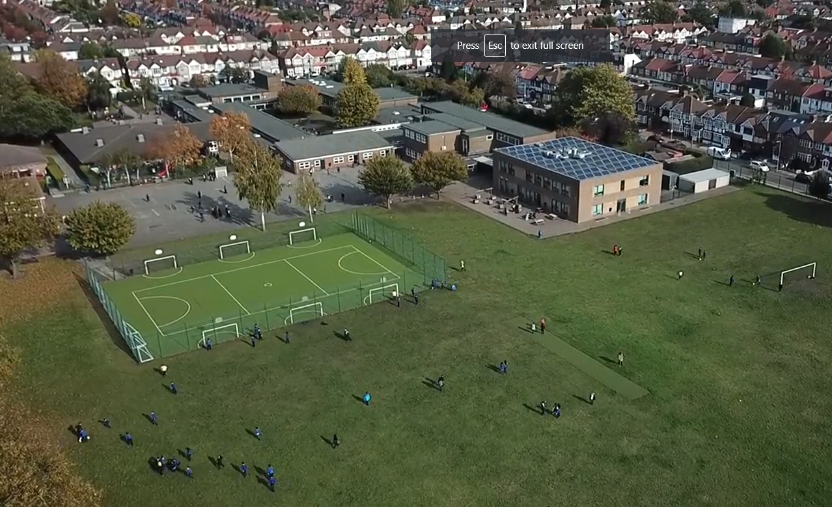
Questions
Notes:
Office.Admin: sending out letters, building and analysing surveys, answering queries, advising ov everchanging guidance and answering emails and phone calls
Premises staff: working tirelessly mornings, afternoons, evenings to create safe bubbles, signage, cleaning
LTAs working via zoom with their children, taking resources home to prepare, joining in on zooms
Catering staff: on furlough, Bal agreeing to come in
Fellow SLT: managing remote learning, staff welfare, keeping up with guidance

