Slide 1
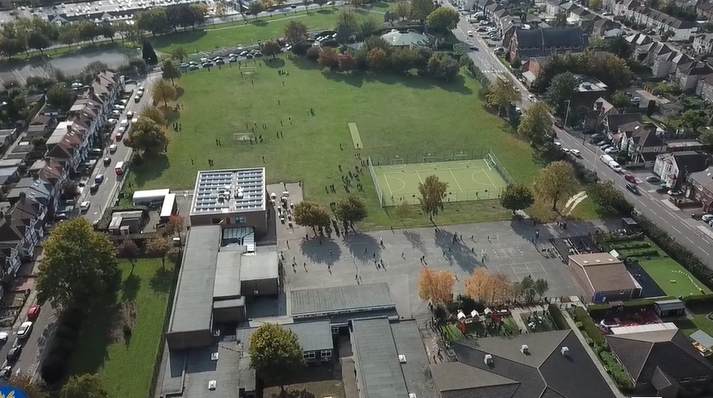
Spring Parent Curriculum Meeting Year 1 January 2024

Slide 2
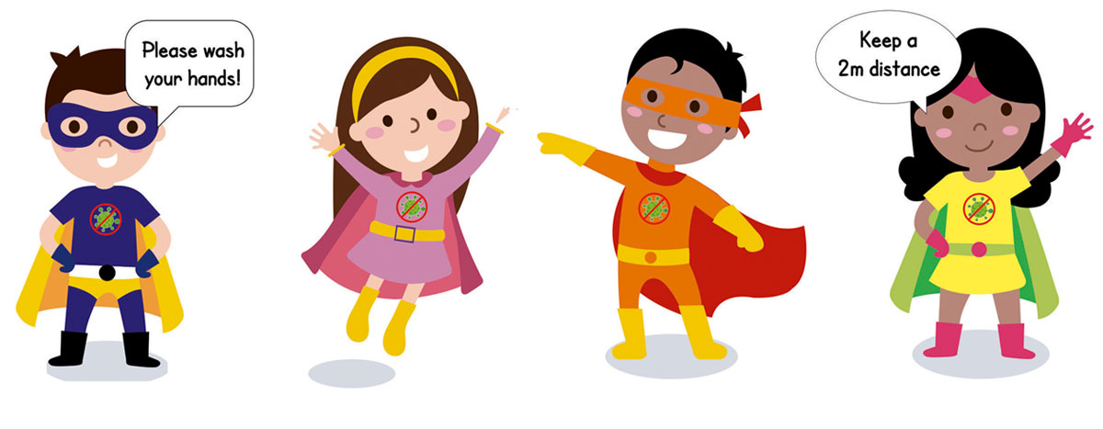
School Vision and Motto
At Barley Lane Primary School it is important that we all work together to ensure that everyone feels happy, safe and ready to learn.
Our School Motto
Believe in yourself, Learn together, Persevere and Succeed

Slide 3
Meeting Outline
Spring Curriculum Topic and the ‘Big Question’- AB
English - AB
Phonics- PA
Reading- PA
Speaking and Listening-SW
Maths-SW
Science- MG
Foundation Subjects- MG
Homework - MG
Questions

Slide 4
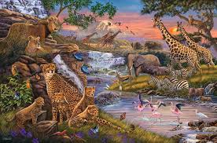
Spring Curriculum Topics
Spring Topic: Animal Kingdom
Big Question: Are humans more dangerous than animals?
Notes:
Office.Admin: sending out letters, building and analysing surveys, answering queries, advising ov everchanging guidance and answering emails and phone calls
Premises staff: working tirelessly mornings, afternoons, evenings to create safe bubbles, signage, cleaning
LTAs working via zoom with their children, taking resources home to prepare, joining in on zooms
Catering staff: on furlough, Bal agreeing to come in
Fellow SLT: managing remote learning, staff welfare, keeping up with guidance

Slide 5
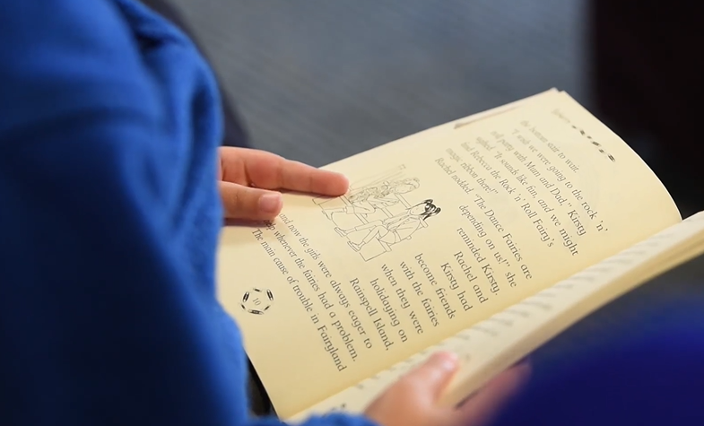
English
Our key texts for this term are: Hot Hippo, The Elephant and Handa’s Surprise.
Children will be encouraged to write sentences by:
Saying out loud what they are going to write about
Re-reading what they have written to check that it makes sense.
Discuss what they have written with the teacher or other pupils
Spell common exception words
Write independently and spell words by phonetically sounding out words.
Practise correct letter formation
Punctuate sentences using capital letters, full stops, question marks and exclamation marks.
Use the conjunctions ‘and’ ‘because’
Use a capital letter for the names of people, places, the days of the week, and the personal pronoun ‘I’.
Use interesting adjectives and verbs.
Use ed for the past tense
Children will be writing for different purposes and writing in different genres such as letters, stories, factual writing and monologues.

Slide 6
Supporting writing at home
Some ways to encourage and develop your child’s writing skills are-
Focus on your child’s interests such as sports, playing with Lego, cartoons, going to the park. Engage children in their writing by asking them to write about their interests. Children could write sentences about their trip to the park, instructions on how they made their Lego model or write a description of their favourite TV character.
Try to encourage your child to write a creative story based on their interest.
Children can draw their story ideas in sequence or act their story out by making puppets. You could read part of a story and then write the next part. A picture could be used as a stimulus for writing. Children could even write letters to family members or friends or keep a diary.
Remember talking before writing is important. Support your child to express themselves clearly. When speaking to your child, encourage them to discuss their ideas and listen and respond to their ideas.

Slide 7
Phonics is a way of teaching children how to read and write.
Teaches children to blend the sounds (phonemes) of letters (grapheme) together to read unfamiliar words.
Teaches children to spell.
Read accurately by blending sounds in unfamiliar words.
Phonics

Slide 8
Phonics Sound Mat
Mr Thorne Does Phonics - Pronunciation of the sounds
https://www.youtube.com/results?search_query=mr+thorne+letter+sounds
‘Phonics Screening Check’: Week commencing Monday 10th June 2024
Parents Meeting: Monday 5th February 2024

Slide 9
Say what they like or dislike about a text.
Check that the text makes sense to them as they read.
Explain what they understand about a text.
Re-read a passage if unhappy with own comprehension.
Begin to draw inferences from the text and/or the illustrations.
Re-read books to build up their fluency and confidence in word reading.
Reading books are given each week and should be returned by your child‘s allocated day. Children should read their reading book at home three times to build up their fluency.
We recommend you read or listen to your child read at least for 10 minutes a day.
Oxford Reading Tree - https://www.oxfordowl.co.uk
Reading Challenge- Please sign the reading records to inform us of how your child is getting on with reading at home each week. After three books have been read and signed by an adult at home, your child will receive a sticker on the reading challenge board.
Reading

Slide 10
Common Exception Words
Children are expected to read a range of common words fluently by the end of Year 1.

Slide 11
Speaking and Listening
Developing children’s speaking skills will enable children to develop their vocabulary and construct grammatically correct sentences.
This term we will be introducing a ‘Time to Talk’ activity as part of homework. Each week we will set a topic or question to talk about with your child at home. This may be related with our learning at school.
Children will then have the opportunity to talk about the topic in class and share their ideas.
To support this at home, please make sure you have a discussion with the children around the topic set. Ask children related questions and encourage children to respond in full sentences.

Slide 12
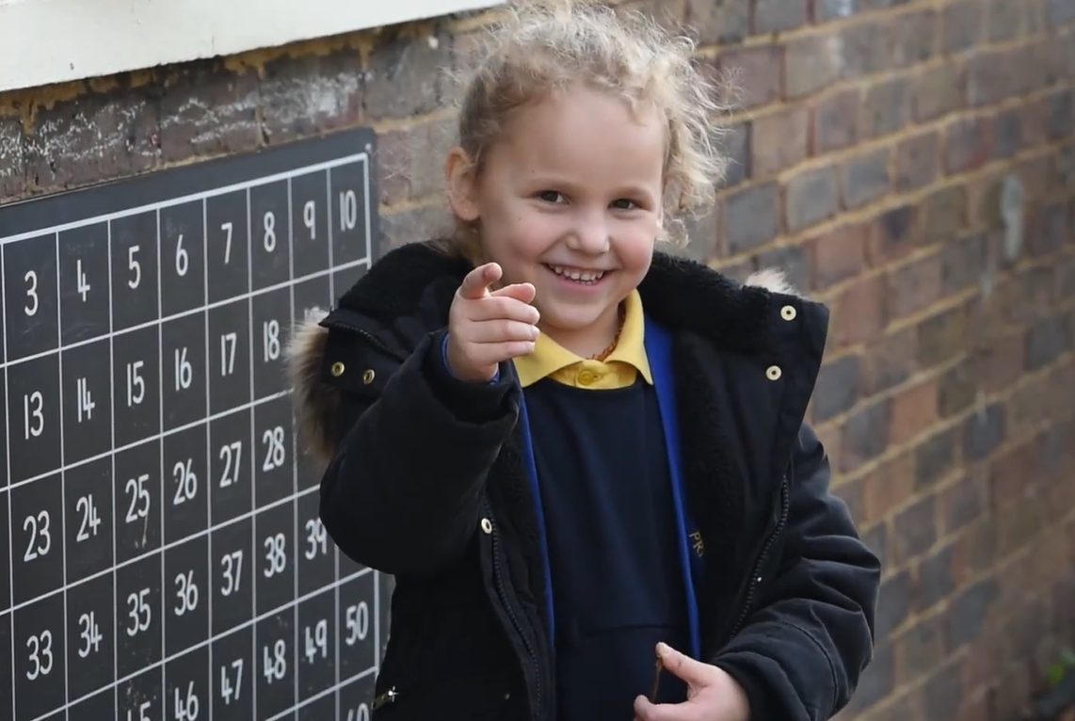
Maths
Place value : Count, read and write numbers to 100 in numerals and count in multiples of twos, fives and tens
Represent and use number bonds and related subtraction facts within 20
Use the language of: equal to, more than, less than (fewer), most, least and partition numbers into tens and ones
Addition and subtraction : Add and subtract one-digit and two-digit numbers
Solve one-step problems that involve addition and subtraction using concrete objects, pictorial representations and missing number problems.
Length and height : Measure and begin to record lengths and heights (non standard). Use and understand the language of length such as long, longer, short, shorter, tall, taller and compare lengths and height.
Weight and volume: Hold objects and describe them using vocabulary such as heavy, light, heavier than, lighter than, less, more, equal.
Use weighing scales to find heavier and lighter objects.

Slide 13
Foundation Subjects
Children are taught foundation subjects weekly.
History- Significant people and what makes them significant. These include Rosa Parks, Mary Anning and Malala Yousafzai.
Geography- Maps, simple compass directions, hot and cold climates, recapping continents and oceans.
RE- Christianity (what is important to a Christian?) and how different religions celebrate the birth of a baby.
PSHE- Living in the wider world and the different groups/communities we come from.
Art/DT- Primary and secondary colours, recreating a painting, making moving pictures using different mechanisms.
Computing- Becoming digital artists. Using different applications on I-pad and computer to create paintings inspired by the work of famous artists. Purple Mash – teach your child to login independently.
Music- Recognising and developing a sense of steady beat through using voices and body percussion, understanding pitch and making high and low vocal sounds.
PE- throwing/ catching a ball, fundamentals, team building games.

Slide 14
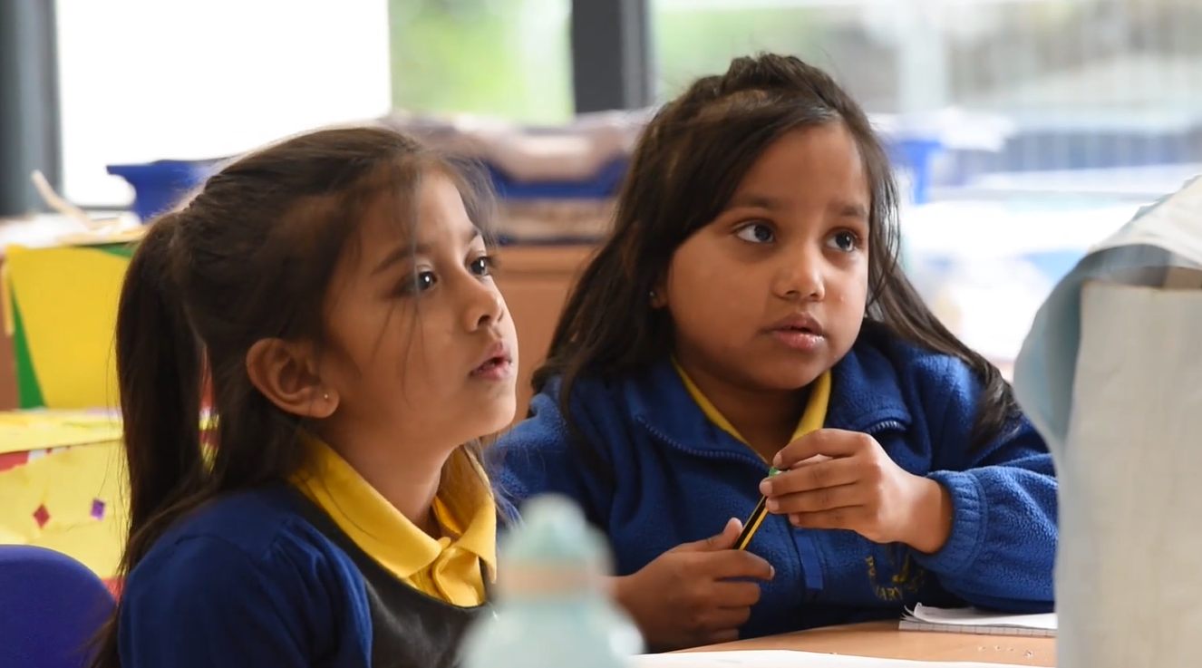
Science
Science
Science is taught weekly to children. Each term, the Science topic is changed. This term our topic is ‘ Animal Kingdom’.
Children will be exploring:
Describe and compare the structure of a variety of common animals (fish, amphibians, reptiles, birds and mammals, including pets).
Identify and name a variety of common animals including fish, amphibians, reptiles, birds and mammals.
Identify and name a variety of common animals that are carnivores, herbivores and omnivores.
Discuss the habitats of a variety animals.
Understand the diet of animals.

Slide 15
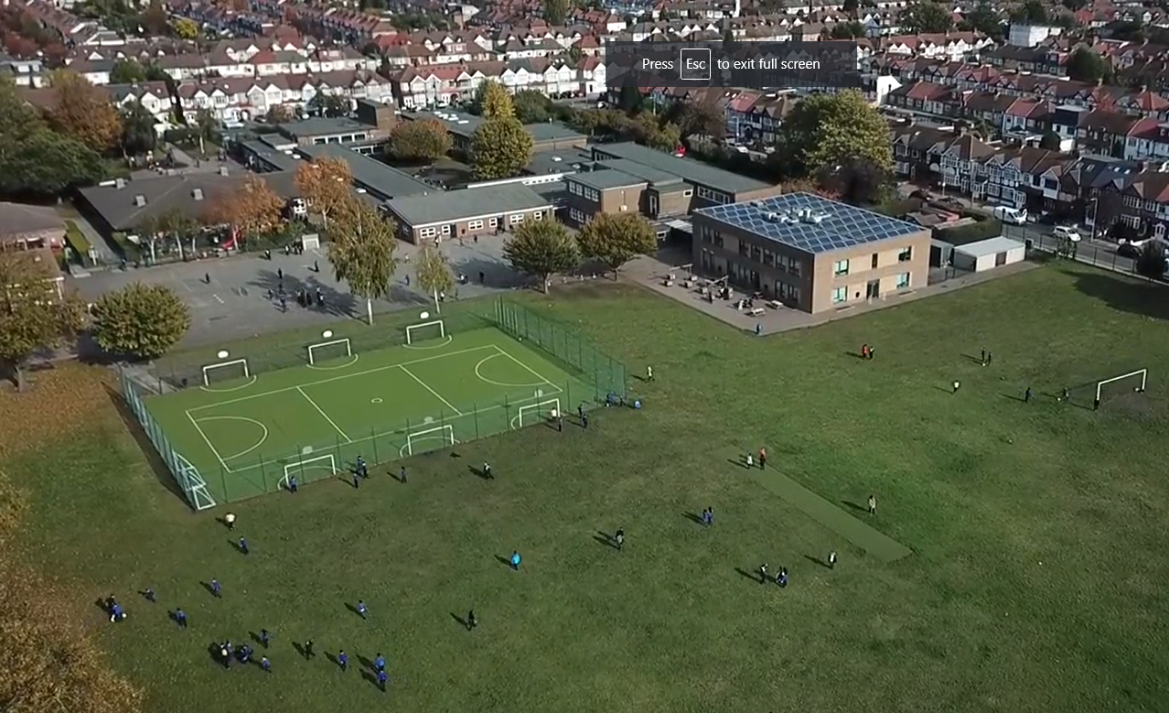
Homework
Homework is set every Friday on Purple Mash and should be completed and handed in by the following Wednesday. Homework activities may cover different subjects of the National Curriculum. These may be written, practical or creative tasks. The activities set will help to consolidate learning in class that week or to familiarise children with the following week’s learning in class.
Spellings are set on Purple Mash every Friday for children to learn and spelling tests will take place the following Friday. Please help your child practice reading and correctly writing the words in their homework book using look, cover, write and check. Writing sentences with the spellings can help to understand the meanings of words too.
Notes:
Office.Admin: sending out letters, building and analysing surveys, answering queries, advising ov everchanging guidance and answering emails and phone calls
Premises staff: working tirelessly mornings, afternoons, evenings to create safe bubbles, signage, cleaning
LTAs working via zoom with their children, taking resources home to prepare, joining in on zooms
Catering staff: on furlough, Bal agreeing to come in
Fellow SLT: managing remote learning, staff welfare, keeping up with guidance

Slide 16
Communication with Parents
Our Year 1 spring term topic web is available on the website as a reminder of our key subject topics.
If there are any queries regarding the curriculum, class teachers can be contacted at the end of the day after all the class children have been dismissed. If your child’s class teacher is unable to speak to you after school please make an appointment.
Thank you for your continued support.
.

Slide 17
Any questions?
Notes:
Office.Admin: sending out letters, building and analysing surveys, answering queries, advising ov everchanging guidance and answering emails and phone calls
Premises staff: working tirelessly mornings, afternoons, evenings to create safe bubbles, signage, cleaning
LTAs working via zoom with their children, taking resources home to prepare, joining in on zooms
Catering staff: on furlough, Bal agreeing to come in
Fellow SLT: managing remote learning, staff welfare, keeping up with guidance

