Slide 1
Year 1 Phonics Screening Check Information session for parents
Year 1 Teachers
Mrs Bansal, Ms Warraich, Ms Gheewala and Mrs Arya

Slide 2
Meeting Outline
What is phonics?
High-frequency words
Two-syllable words
Year 1 phonics screening check
What the phonics check looks like
What happens to the result?
How you can support your child at home
Phonics buster workbook
Questions

Slide 3
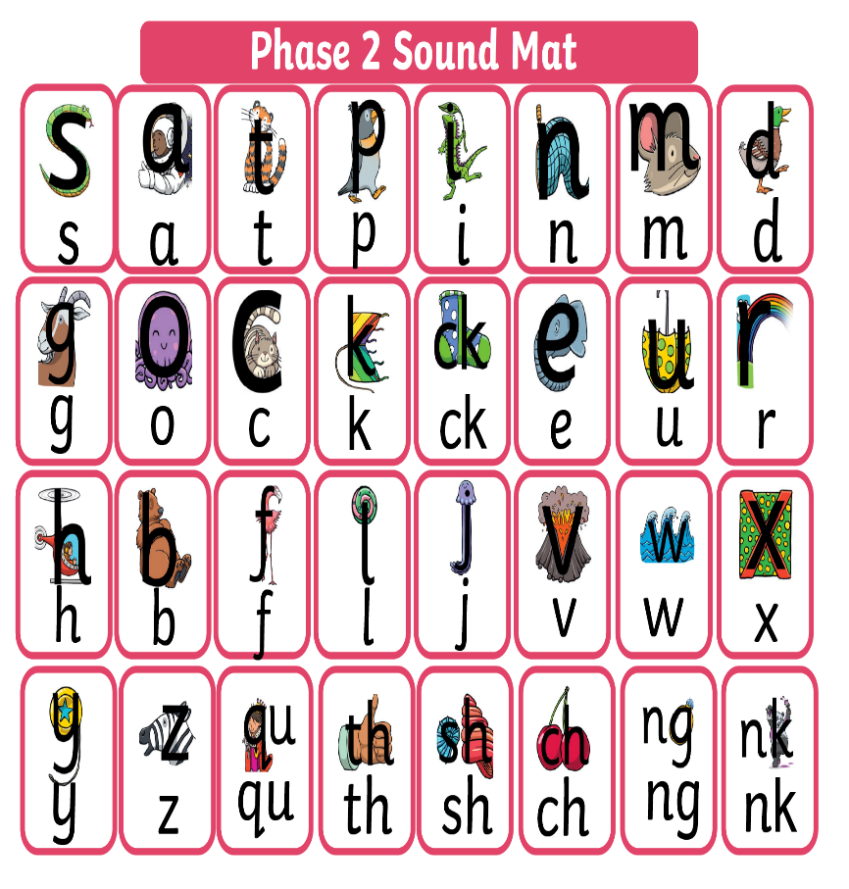
What is phonics?
Blending skills - the phonemes c-a-t into the word cat
Segmenting skills - eg. Word him say the phonemes h-i-m and work out how to write each sound to create the word
Children have a 30 mins phonics lesson each day and they are encouraged to use these strategies to read and write in other lessons.
https://www.littlewandlelettersandsounds.org.uk/resources/for-parents/
Children need to learn phase 5 phonemes in order to pass the phonics screening test.

Slide 4
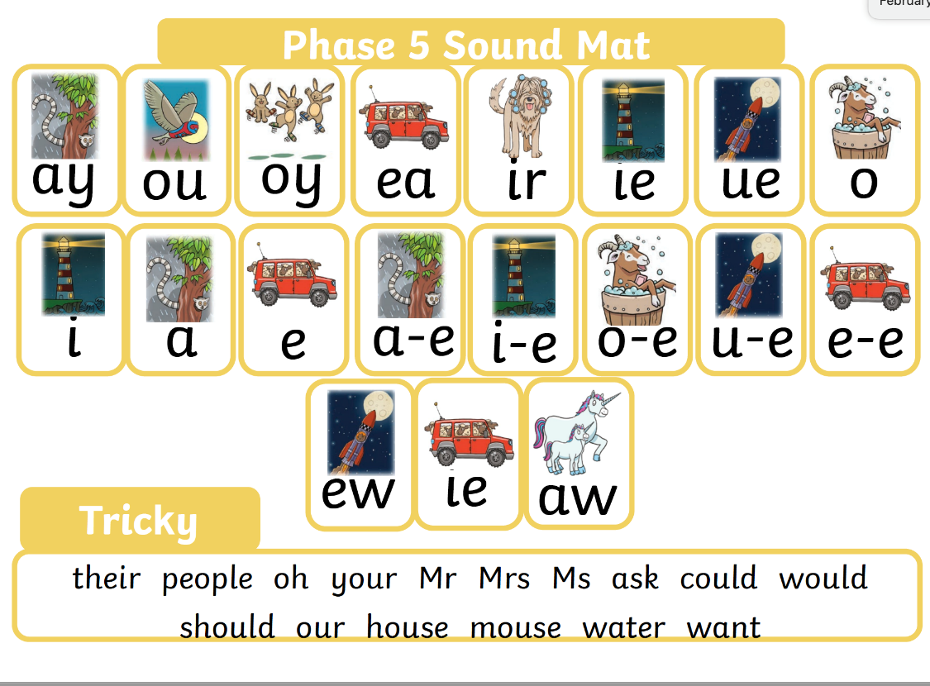
Phase Five Phonics
Teaching children to recognise and use alternative ways of pronouncing the graphemes (visual symbol) and spelling the phonemes (oral sound) already taught.
Notes:
Phase 5 continues throughout Year 1. Lots of opportunities to secure this, and to revisit learning from Reception.
Same letters making different sounds – mean, bread, read (?)
Same sound represented by different letters – may, make, pain, etc.
See long vowels sounds sheet – teachers to plot words on the sheet.

Slide 5
Same sound, different letters
may
make
pain

Slide 6
Same letters, different sounds
mean
bread

Slide 7
Reading and spelling high-frequency words
Decodable words such as c__a__t
and tricky high-frequency words need lots of practice so that children will be able to read them ‘automatically’ as soon as possible.
Purple Mash - First 100 high-frequency (common) words

Slide 9
Practise reading two-syllable words
Children learn to blend the phonemes in each syllable
i.e. princess is split as prin/cess
pr-in
c-e-ss
pic/nic
sing/er

Slide 10
What is year 1 phonics screening?
The Year 1 phonics screening check is designed to identify which pupils need additional support with certain areas of phonics as they progress
The Year 1 phonics screening check is not a formal test, but a way for teachers to ensure that children are making sufficient progress with their phonics skills

Slide 11
What’s on the Phonics screening check?
The checks consist of 40 words and non-words that your child will be asked to read one-on-one with a teacher.
The 40 words and non-words are divided into two sections – one with simple word structures of three or four letters, and one with more complex word structures of five or six letters.

Slide 12
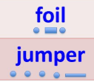
What will the children be expected to do?
Children will be asked to read words aloud.
They will be allowed to use ‘sound out’ before trying to say the whole word if this helps them. Children are allowed to draw sound buttons under the words to help them segment and blend.
E.g.
The phonics screening check will take place during the week commencing 10th June 2024. There is no time limit for children to complete the test in.
The check will take place in a quiet area of
the school.

Slide 13
The phonics screening check will be constructed of 20 real words and 20 non-words.
What will the check look like?
The non-words will be presented with a picture prompt (a picture of an imaginary creature) and children will be asked to name the type of creature.

Slide 14
The check will begin with simple words and moves on to more complex words.
Sound out and blend graphemes in order to read words.
Simple CVC words and nonsense word, for example, ‘vap’.
Words containing split digraphs such as ‘phone’ or ‘slide’.
Words with alternative spellings of phonemes such ‘day’ and ‘trains’.
Two- syllable words such as ‘dentist’ or ‘starling’

Slide 15
What happens to the result?
Individual children’ results will be made available to parents, so that parents are kept informed about their child’s progress in developing word reading skills.
You can download the Department for Education's official website:
https://www.gov.uk/government/collections/national-curriculum-assessments-practice-materials#phonics-screening-check-resources
to get an idea of what your child will be asked to read.

Slide 16
How can you support your child at home?
Encourage your child to ‘sound out’ when reading or writing. Focusing particularly on spotting more unusual sound patterns.
For example
Digraphs- 2 letters making one sound cow
Trigraphs- 3 letters making one sound night
Split digraphs- 2 vowels with a consonant in between
spine - i_e
Encourage your child to use their sound mat when writing.
Children can practise their phonics by playing games online.

Slide 17
REMEMBER: Phonics is not the only thing needed to become a fluent reader.
Please continue to read with your child each day and encourage them to:
Sound out
Re-read to check it makes sense.
Use pictures for clues.
Ask questions about the book.
Shared reading of their library book.

Slide 18
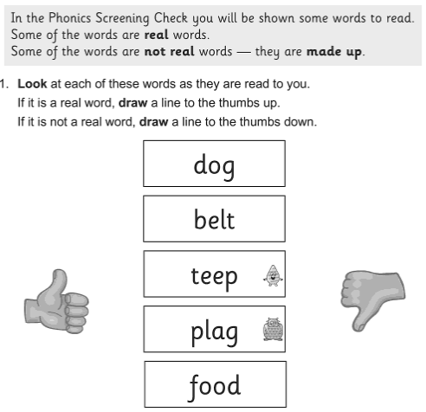
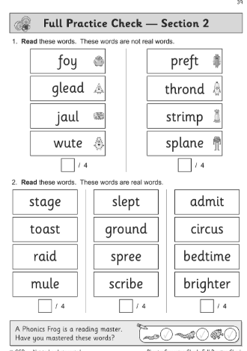
CPG Phonics Buster Workbook
CPG Phonics Buster Workbook is available to purchase from school for approximately £2.50
If you wish to purchase the book, please do so through parent pay.
Once you have ordered the book, it will be given to your child in school to take home.

Slide 19
Mr Thorne does phonics
https://www.youtube.com/watch?v=uoNGJHValg4
The School Run
https://www.theschoolrun.com/what-parents-need-know-about-year-1-phonics-screening-check
Letters and Sounds for Home and School
https://www.youtube.com/channel/UCP_FbjYUP_UtldV2K_-niWw/playlists
And most importantly ENJOY READING!

Slide 20
Questions?

