Slide 1
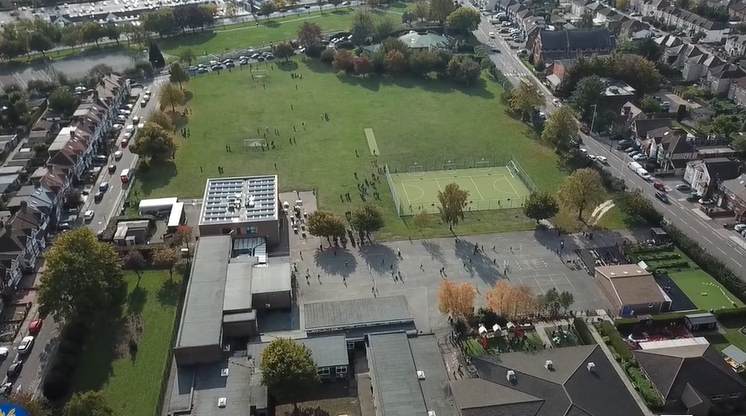
Parent Curriculum Meeting Nursery January 2024

Slide 2
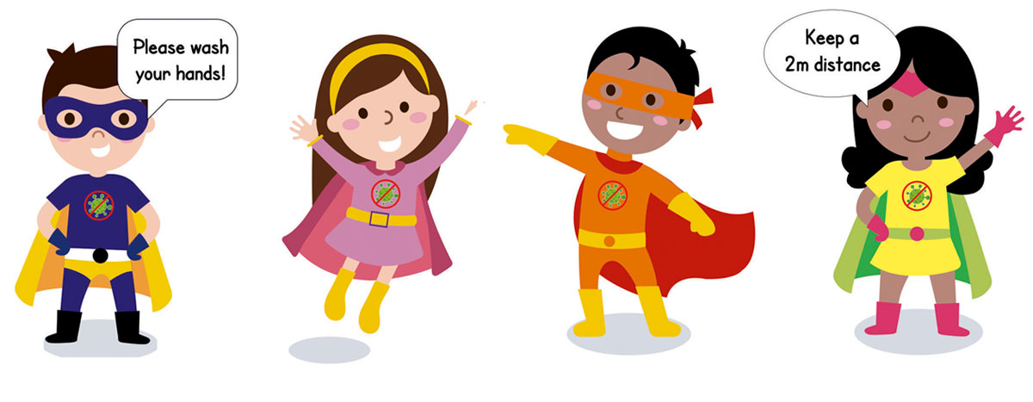
School Vision and Motto
At Barley Lane Primary School it is important that we all work together to ensure that everyone feels happy, safe and ready to learn.
Our School Motto
Believe in yourself, Learn together, Persevere and Succeed

Slide 3
Information Outline
1. Welcome
2. Spring Curriculum Topics and Big Question
3. Literacy/Phonics
4. Maths
5. Other areas of Learning
6. Questions

Slide 4
Spring Curriculum Topics
Spring Topic:
Nursery Rhymes (Spring 1) Growing (Spring 2)
Big Question:
How do Nursery Rhymes help us learn? (Spring 1)
How do we grow? (Spring 2)
Notes:
Office.Admin: sending out letters, building and analysing surveys, answering queries, advising ov everchanging guidance and answering emails and phone calls
Premises staff: working tirelessly mornings, afternoons, evenings to create safe bubbles, signage, cleaning
LTAs working via zoom with their children, taking resources home to prepare, joining in on zooms
Catering staff: on furlough, Bal agreeing to come in
Fellow SLT: managing remote learning, staff welfare, keeping up with guidance

Slide 5
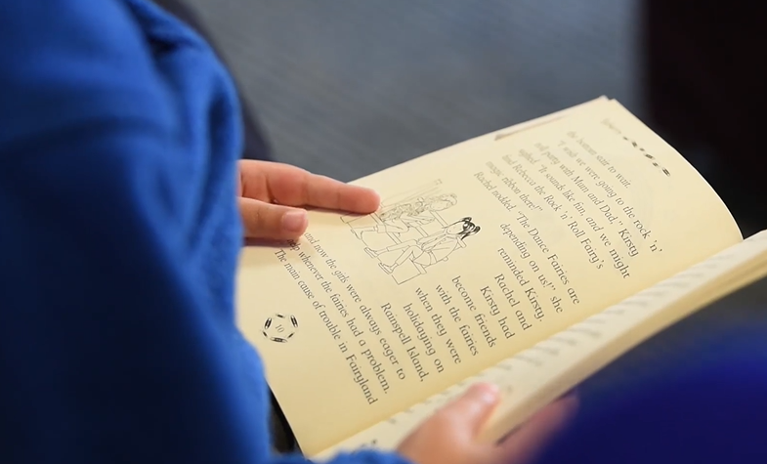
Literacy/Phonics Communication and Language
Nursery Rhymes- we are focusing on a variety of well known traditional, familiar Nursery Rhymes, concentrating on rhyming and extending vocabulary. Alongside this we are listening to and familiarising ourselves with traditional rhymes from diverse cultures.
Cursive writing and weekly cursive hand writing practise
Reading and introducing stage 1 books that focus on picture cues.
Phase 1 and oral blending
Tuning into sounds
Communication and Language
Listening
Understanding and responding appropriately
Speaking skills (having conversations in full sentences)
Turn taking
Notes:
Emphasis on name writing practise and pencil control and explain intervention

Slide 6
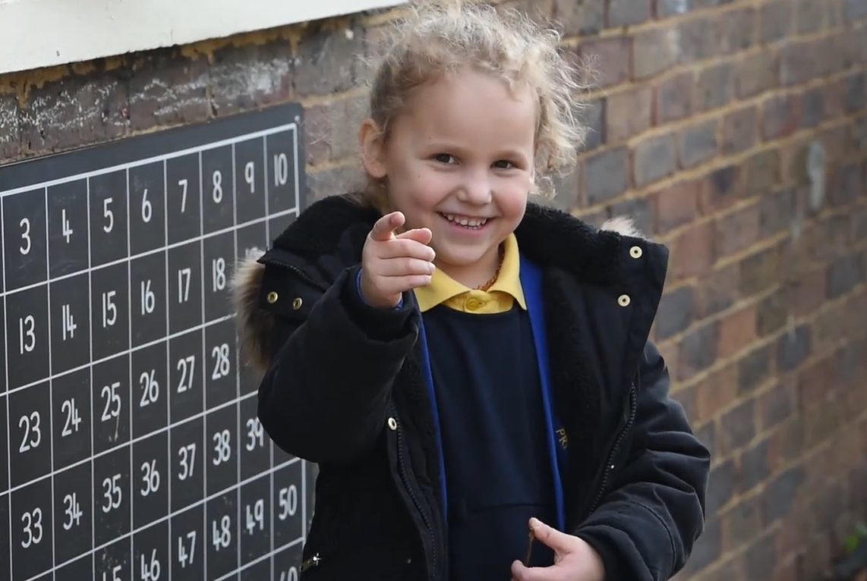
Maths
Recognising numbers and shapes in the environment
Daily counting to 10
Singing songs
Writing numbers (forming correctly)
Recognising numerals and amounts of objects up to 5
Identifying 2D shapes
Measuring length and height
Ordering items by size
Identify and create repeated patterns
Identify more and less of a number and comparing quantities
Adding 1 more and finding 1 less
Notes:
Emphasise the number recognition and explain interventions

Slide 7
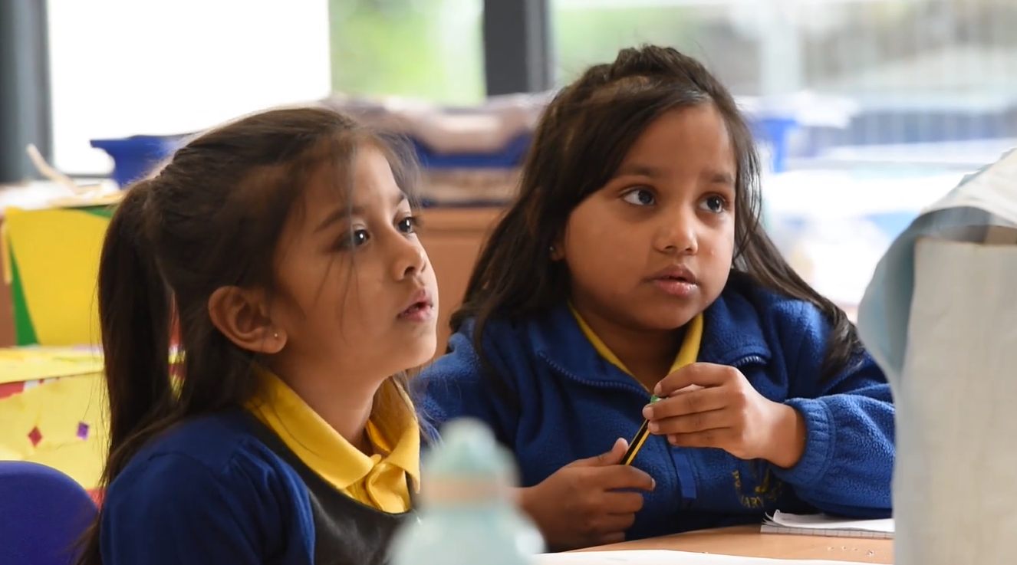
Other areas of Learning
Understanding of the World (Science, History, Geography, Computing and Religious Studies)
Expressive Art and Design
Personal, Social, Emotional Development
Physical Development – Fine Motor, Gross Motor
Introducing Our Class Bear – A motivating tool for talking and sharing. A record book (like a Scrap Book) will come home with the bear and the aim is that all children will have at least 1 photo with the class bear in the book and a records of all the great things they did with the bear during his stay by the end of the year.
Please remember to pay a contribution towards cooking ingredients and consumables such as play dough on Parentpay.
Notes:
Independence and self care. Talk about travelling back and forth to school walking and the problem with buggies at this age Explain concerns with high numbers of children still not toilet trained and ways forward

Slide 8
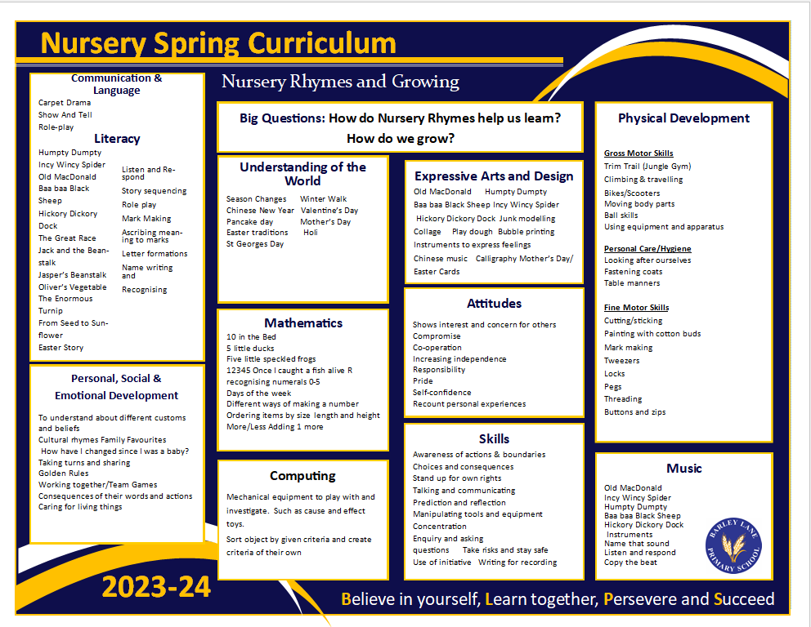
Spring Term Topic Web

Slide 9
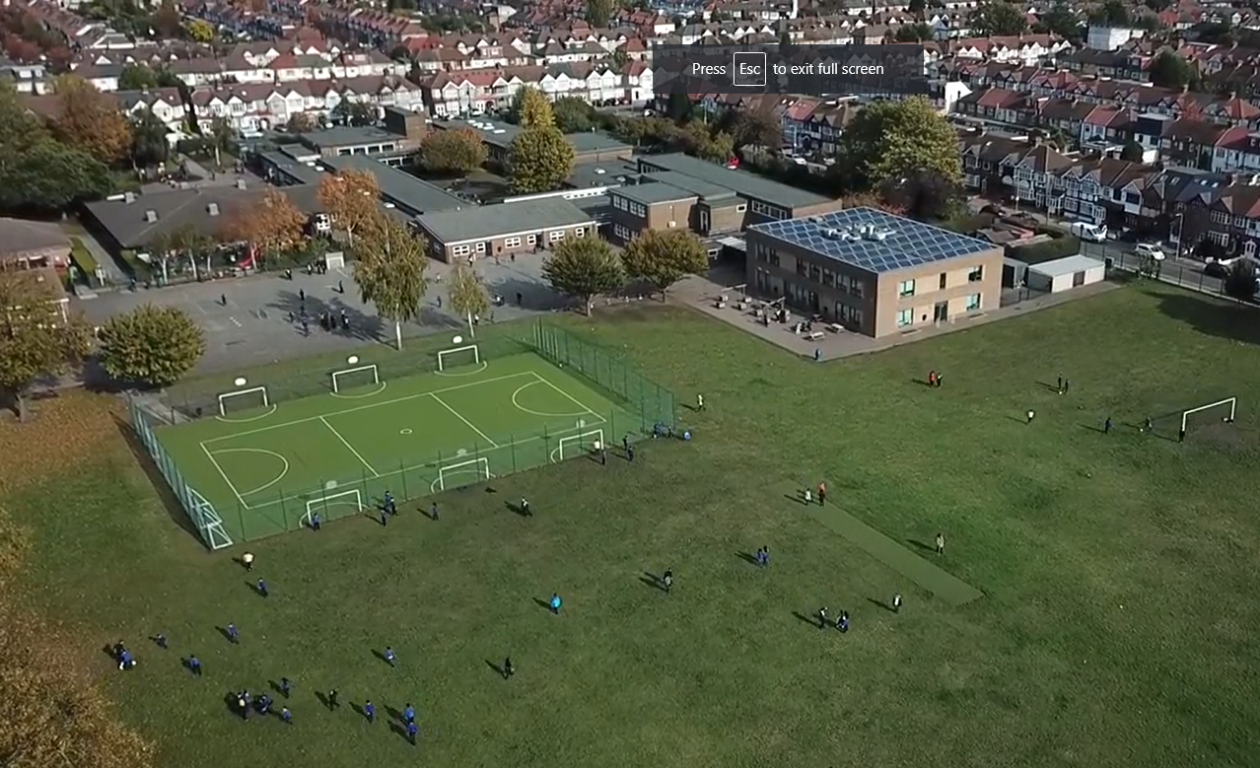
Any questions?
If you have any questions please email the Class Teachers.
Schoolnursery@barleylane.Redbridge.sch.uk
You can also speak to the Nursery Staff at the end of each session.
If you think your query will take a longer, please ask to make an appointment to speak to Mrs Warlow or Mrs Christian at the end of the school day at 3.30 pm.

