Slide 1
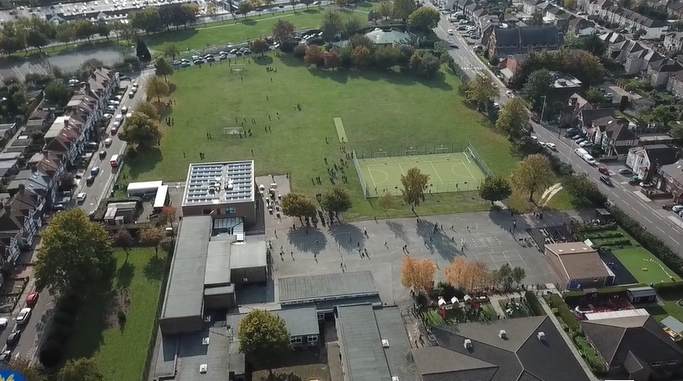
Parent Curriculum Meeting Nursery May 2024

Slide 2
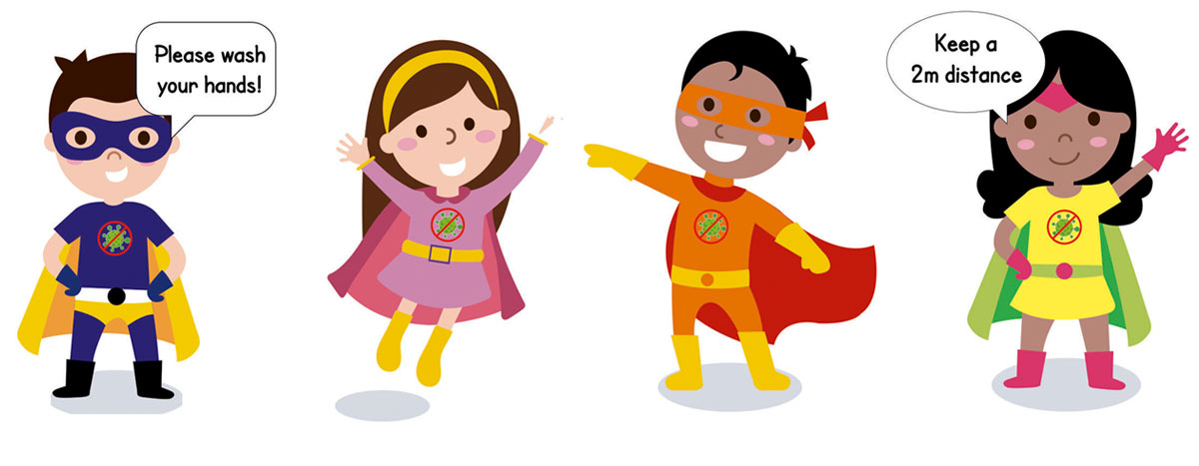
School Vision and Motto
At Barley Lane Primary School it is important that we all work together to ensure that everyone feels happy, safe and ready to learn.
Our School Motto
Believe in yourself, Learn together, Persevere and Succeed

Slide 3
Information Outline
1. Welcome
2. Summer Curriculum Topics and Big Question
3. Literacy/Phonics
4. Maths
5. Other areas of Learning
6. Questions

Slide 4
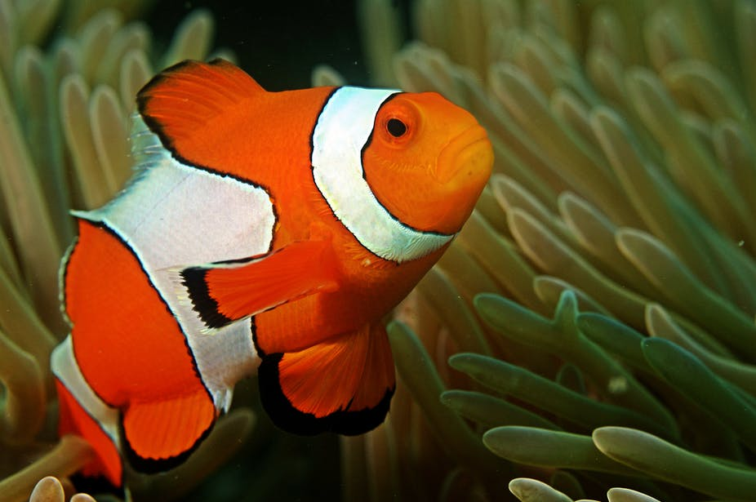
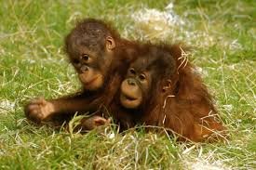
Summer Curriculum Topics
Summer Topic:
Creatures of the Land, Sea and Sky
Big Question:
Where in the world are all the creatures?
Notes:
Office.Admin: sending out letters, building and analysing surveys, answering queries, advising ov everchanging guidance and answering emails and phone calls
Premises staff: working tirelessly mornings, afternoons, evenings to create safe bubbles, signage, cleaning
LTAs working via zoom with their children, taking resources home to prepare, joining in on zooms
Catering staff: on furlough, Bal agreeing to come in
Fellow SLT: managing remote learning, staff welfare, keeping up with guidance

Slide 5
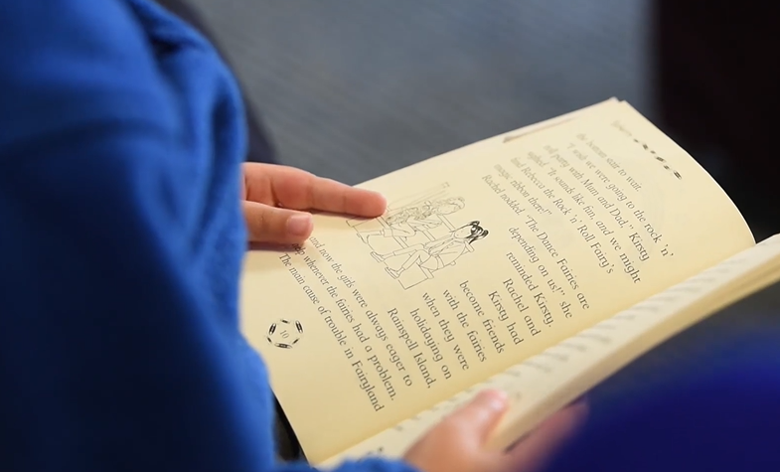
Literacy/Phonics Communication and Language
A variety of creatures– we will be focusing facts about creatures
Cursive name writing
Reading stage 0 books that focus on picture cues.
Phase 1 and initial sounds and segmenting and blending familiar words
Sounds in the environment
Communication and Language
Listening
Understanding and responding appropriately
Speaking skills (having conversations in full sentences)
Turn taking

Slide 6
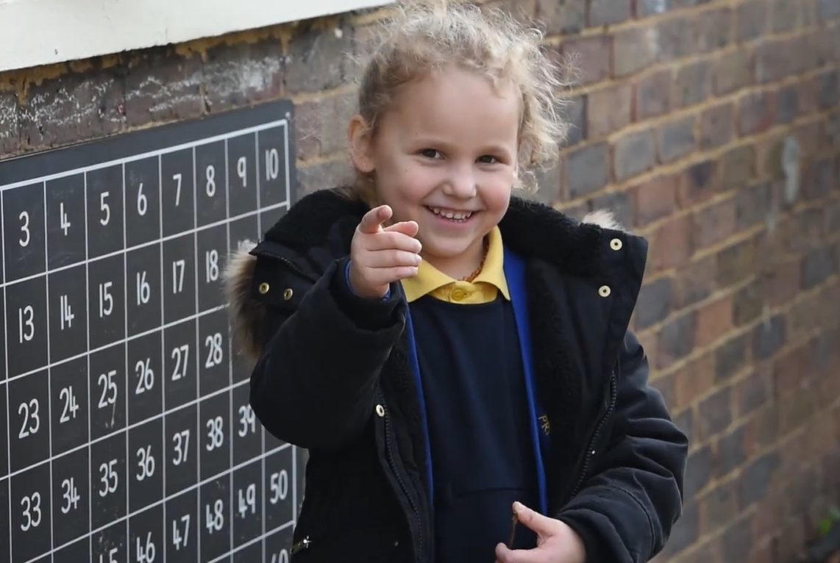
Maths
Recognising numbers and shapes in the environment
Daily counting to 10 and beyond
Singing songs
Writing numbers (forming correctly)
Recognising numerals and corresponding quantities
Identifying 2D and 3D shapes by their properties
Number bonds to 5
Measuring
Identify and create repeated patterns
Identify one more and one less of a number
Introduce the language of addition and subtraction

Slide 7
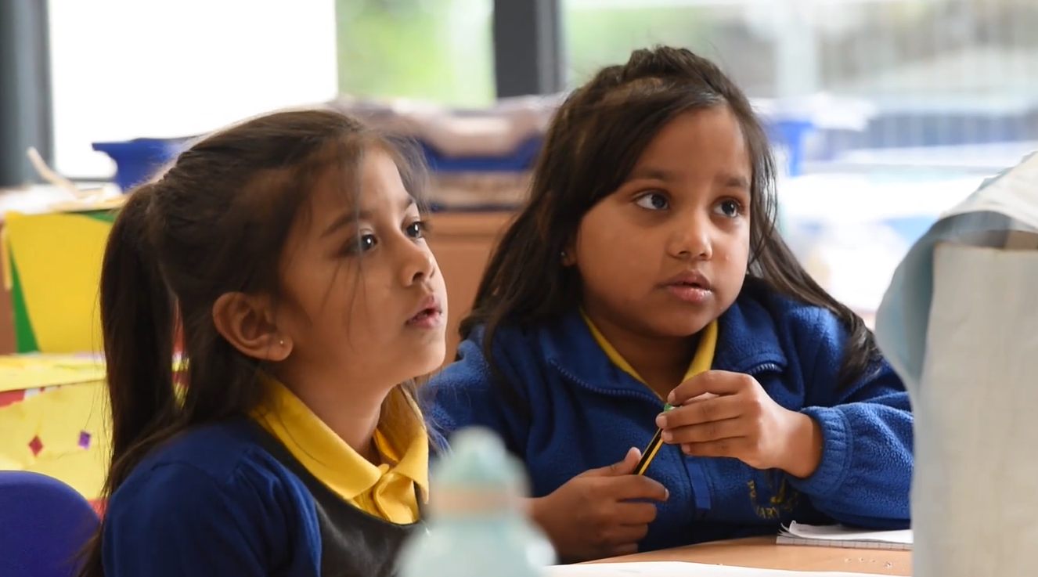
Other areas of Learning
Understanding of the World (Science, History, Geography, Religious Studies and Technology)
Expressive Art and Design
Personal, Social, Emotional Development
Physical Development – Fine Motor, Gross Motor

Slide 8
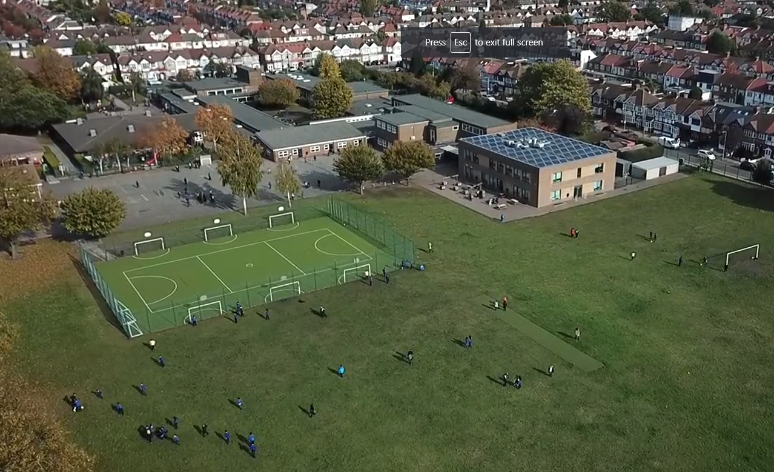
Any questions?
If you have any questions please email the Class Teachers.
nursery1@barleylane.redbridge.sch.uk

